Slide 1
Neuropsychiatry-
a multidisciplinary approach
Dr. med. Tobias Wowra, MD, DEGUM II, Consultant
Pediatric Department Constance
Freiburg University Teaching Hospital
Almaty, 14 October 2021

Slide 2
Neuro- psychiatry Psycho- neurology
FURTHER RESEARCH NEEDED
„Clinical neuropsychiatry considers mental disorders from a neurological
standpoint“ King‘s College London
Salvador Dalí

Slide 3
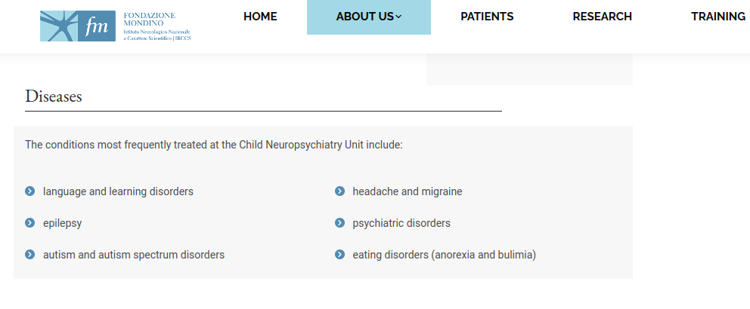
Neuropsychiatry- what is it about?
Insitute of Child Neuropsychiatry, Prof. Umberto Balottin, Pavia University

Slide 4
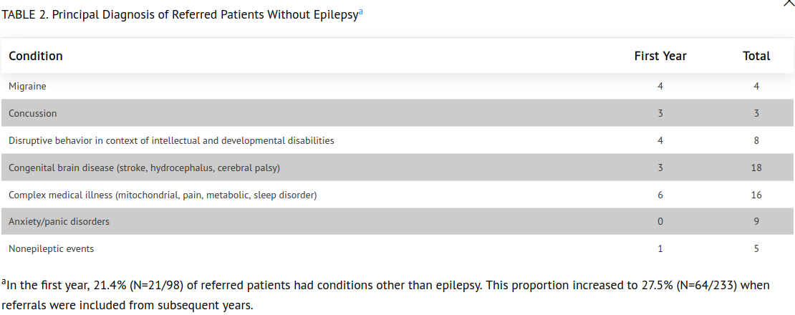
Neuropsychiatry- what is it about?
Kennedy Krieger Institute, John Hopkins University, Baltimore, USA

Slide 5
Neuropsychiatry- example I epilepsy
epilepsy is a complex disorder
with difficulties in:
thinking
learning
mood
anxiety
requiring a multidisciplinary approach:
neuropsychiatrists, social workers, nursing, neurorehabilitation, genetics, behavioral neurologists,
neurobiologists, neurosurgery...

Slide 6
Neuropsychiatry- example II FND
Funtional Neurologic Disorder
Neurosymptoms.org / Australia
Signs & Symptoms: partly overlapping
Difficulties in walking
Sensational impairment, weaknesses, palsy
Unconsciousness / seizures in the sense of
dissociative fuges, multiple personality disorders, other
disorders affecting mental health...

Slide 7
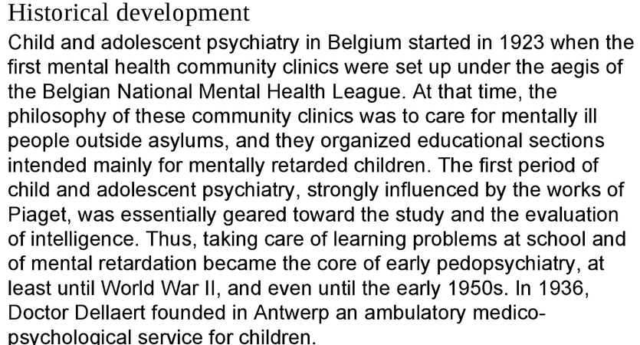
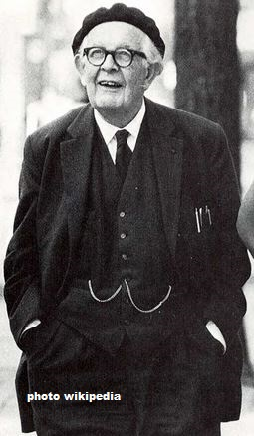
Neuropsychiatry- Origins I

Slide 8
Neuropsychiatry- Origins II

Slide 9
Neuropsychiatry- Origins II
Year 1999

Slide 10
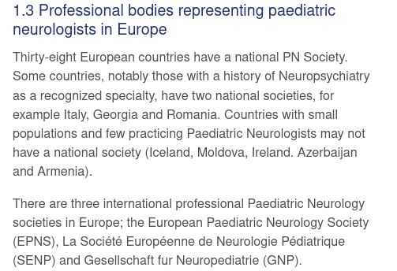
Neuropsychiatry- Origins III
Some European Countries have a history of Neuropsychiatry like Italy, Romania, Georgia.
Child Neurology was accepted on the European level as a subspecialty of Pediatrics in the year 2002.

Slide 11
Neuropsychiatry- and beyond?
Oxford, GB
2020
Baltimore, USA 2018

Slide 12
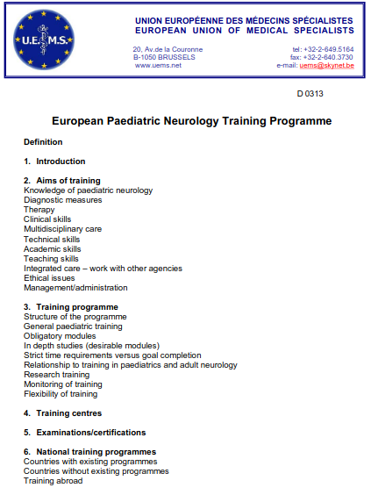
Neuropsychiatry- curriculum I
Fulfilment of core competencies/ obligatory modules
Accreditation through examination system
Enhancemnet by continuing medical education (CME)

Slide 13
Neuropsychiatry- curriculum II training requirements
Dkdkdkdk
Kdkdkdk
Dkdkdkd
Dkdkdkd
Dkdkdkdk
kdkdkdkdkd

Slide 14
Neuropsychiatry- curriculum III
Austrian template
Specialization in Pediatrics
Core competencies: diagnosis and management of all physical illnesses, prevention, vaccination, pediatric intensive care, rehabilitation and care of children and adolescents
Minimum duration
1. common trunk of specialisation: 4 years
2. compulsory complementary training for 2 months: ENT, dermatology, surgery, gynecology/ obstetrics, orthopedics, general medicine...
3. optional complementary training in other fields (...) for 6 months
Subspecialisation in child and adolescent neuropsychiatry altogether 3 years divided by
minimum 1 year in child and adolescent neuropsychiatry
1 year in child neurology and/ or in psychiatry
„National regulations in several EU countries demand full paediatric specialty training, or at least a longer time spent in paediatrics to allow a person to hold a post in paediatric neurology....
When national rules allow an entry from general neurology, trainees should complete one year of general paediatrics ....“ UEMS

Slide 15
Neuropsychiatry- curriculum IV
Central Asian syllabus?
Specialization in Pediatrics
Minimum duration
1. common trunk of specialisation: 3- 4 years
2. compulsory complementary training for 2 months: ENT, dermatology, surgery, gynecology/ obstetrics, orthopedics, general medicine...
3. optional complementary training in other fields (...) for 6 months
Subspecialisation in child and adolescent neuropsychiatry altogether partly included in the common trunk
+ 1 year
in child and adolescent neuropsychiatry
+ 1 year
year in child neurology and/ or in psychiatry
„National regulations and demands may slightly vary from each CA country“

Slide 16
Neuropsychiatry- a multidisciplinary approach
Social Medicine
Neurosurgery
Medicine
Neurobiology
Neuropsychiatry
Psychiatry
Neurology
Psychology
Baby PIC
Grandma PIC

