Slide 1
European Training Requirements in Paediatrics
Przemko Kwinta
Jagiellonian University, Cracow, Poland

Slide 2
In 2015, a common position statement of 37 European national pediatric societies was published, setting out recommendations for the construction of specialization programs in pediatrics.

Slide 3
European medical specialty training is governed by the EU Directive 2005/36/EC
minimum of 4 years, preferably 5 years of full-time training as a primary medical specialty.
pediatric training should consist of:
3 years of Common Trunk Curriculum training in general pediatrics
followed by 2-3 years in:
primary care,
acute or general pediatrics,
or in a subspecialty.
3 years of Common Trunk are not specialization (no certificate, no permissions, no promotion at work))

Slide 5
Common Trunk Curriculum
Key elements:
Clinical experience gained from direct patient care, supervised by senior clinicians and based on a clinical curriculum and with a focus on excellent clinical skills, sound decision making and the judicious use of investigations. On completion of the training, the candidate should be competent to look after most common paediatric conditions.
Professional and ethical practice learnt through mentorship by senior clinicians
Practice in both the inpatient and ambulatory settings.
Academic knowledge and proof of clinical ability as determined by various assessment tools.

Slide 9
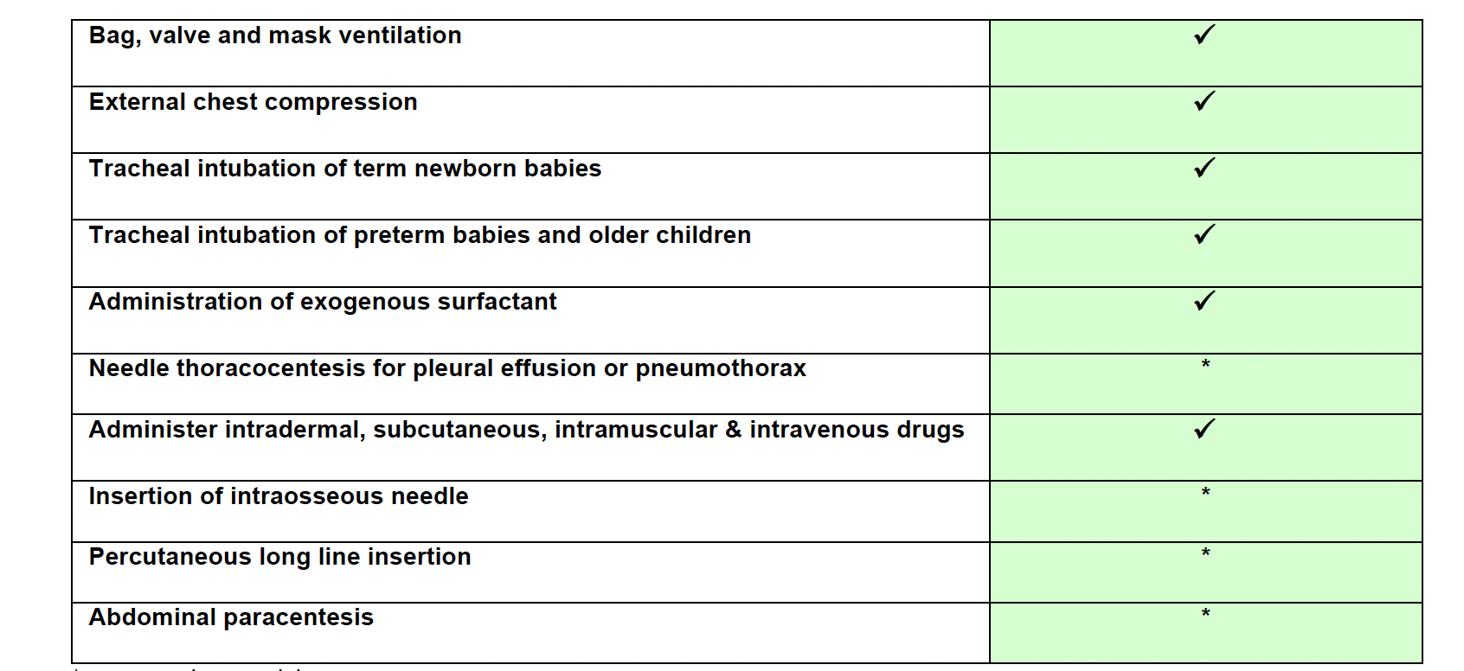
*may need supervision

Slide 10
Knowledge, skills and competencies
General skills and competencies
Normal and abnormal development
Normal and abnormal growth
Nutrition
Pharmacology
Research
Safeguarding
Substance abuse/toxicology/poissoing
Specialist skills and competenies
Some basic aspects of pulmonology, gastroeneterology, endocrinology etc.

Slide 11
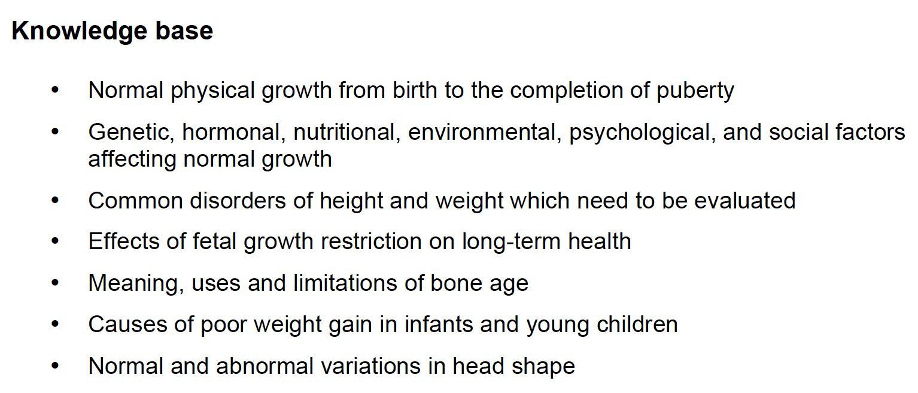
Normal and abnormal growth

Slide 12
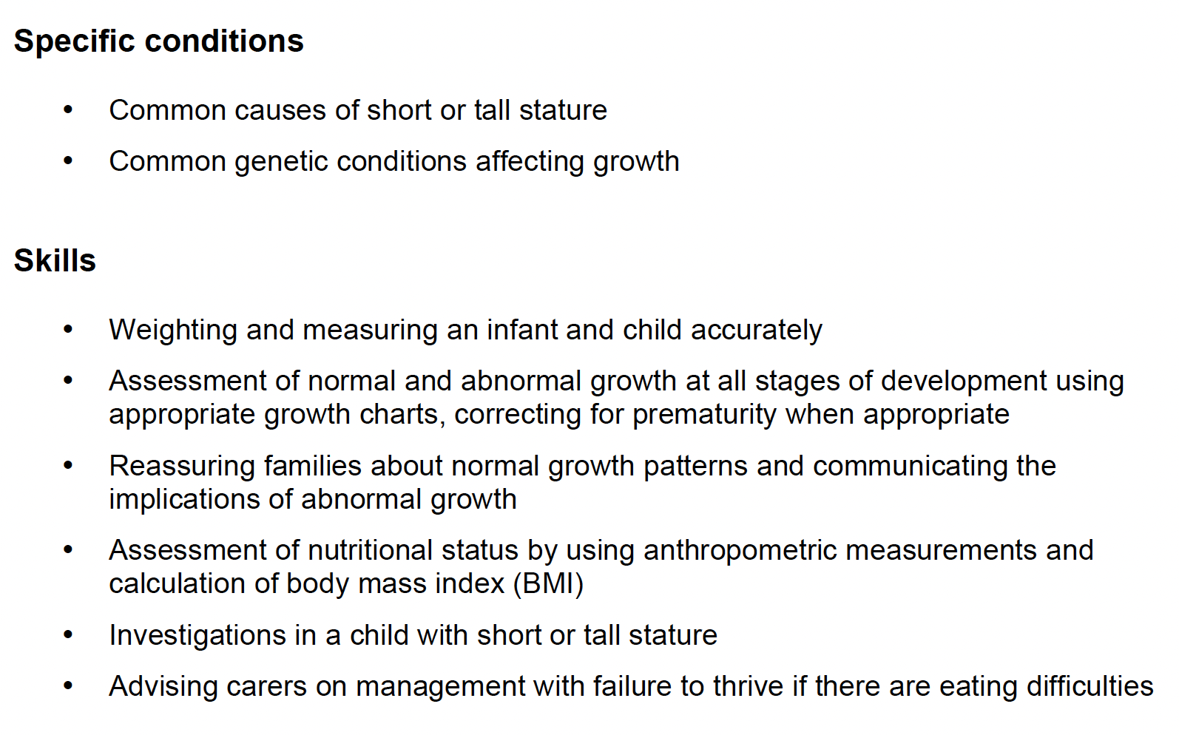
Normal and abnormal growth

Slide 13
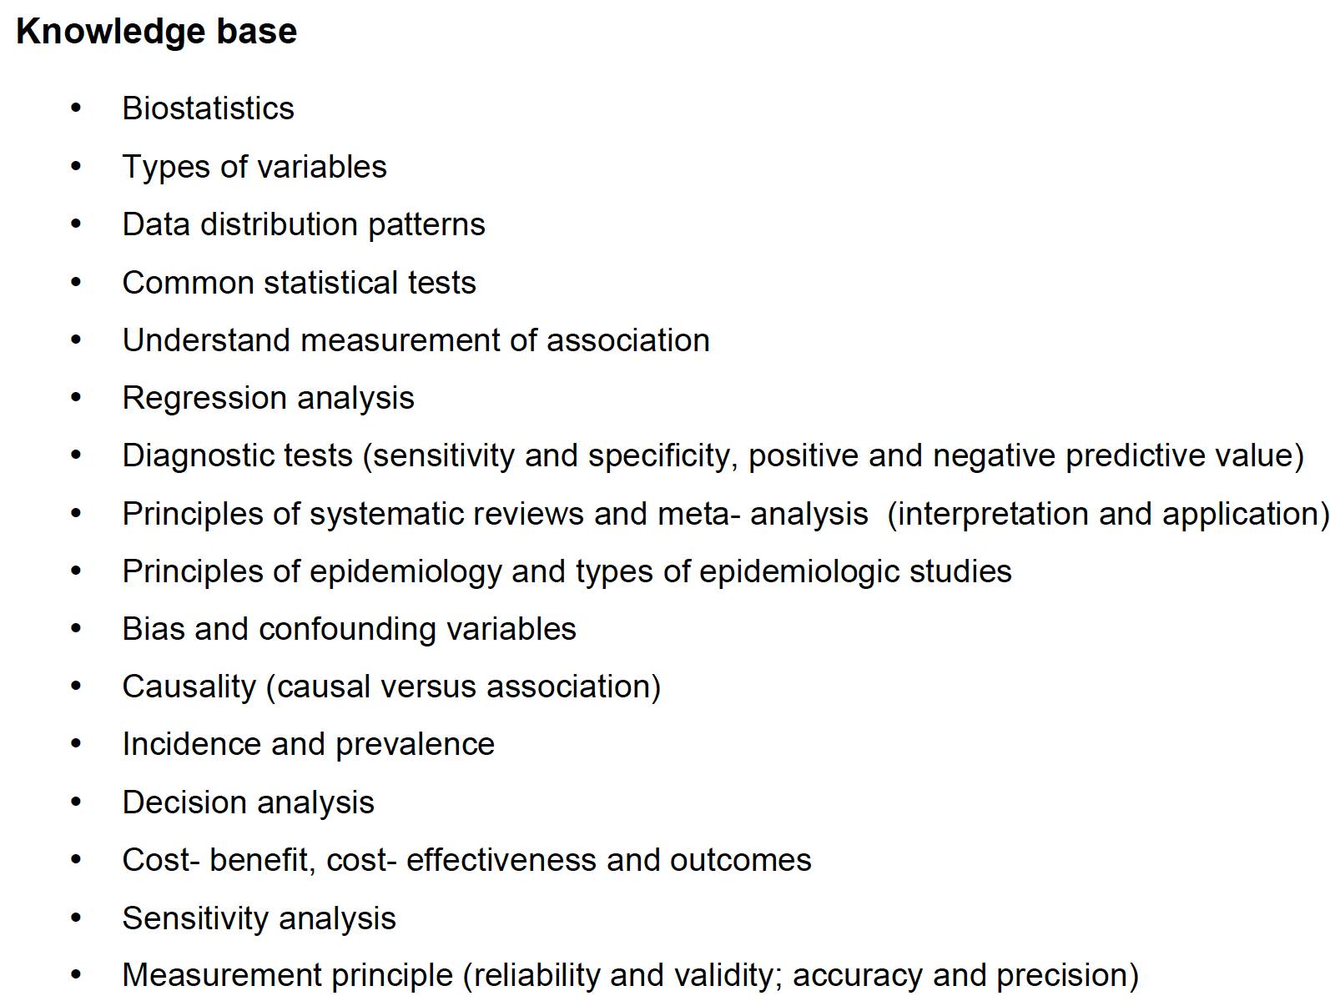
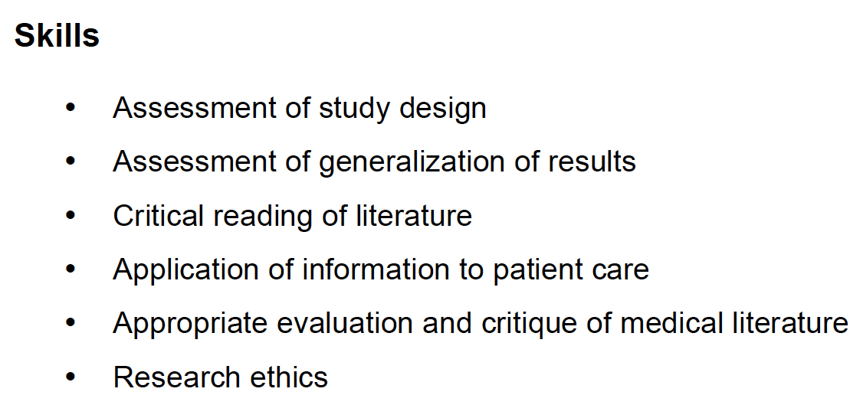
Research

Slide 14
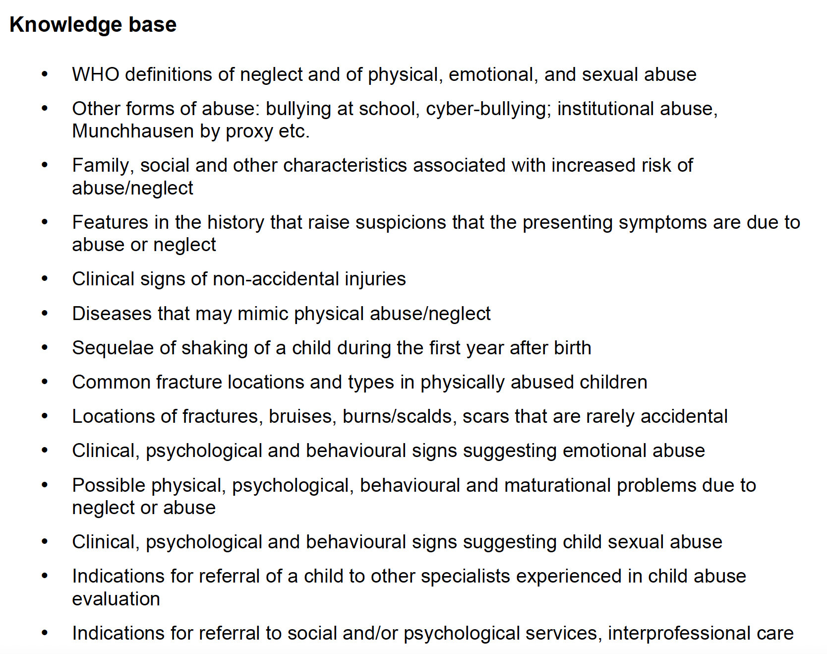
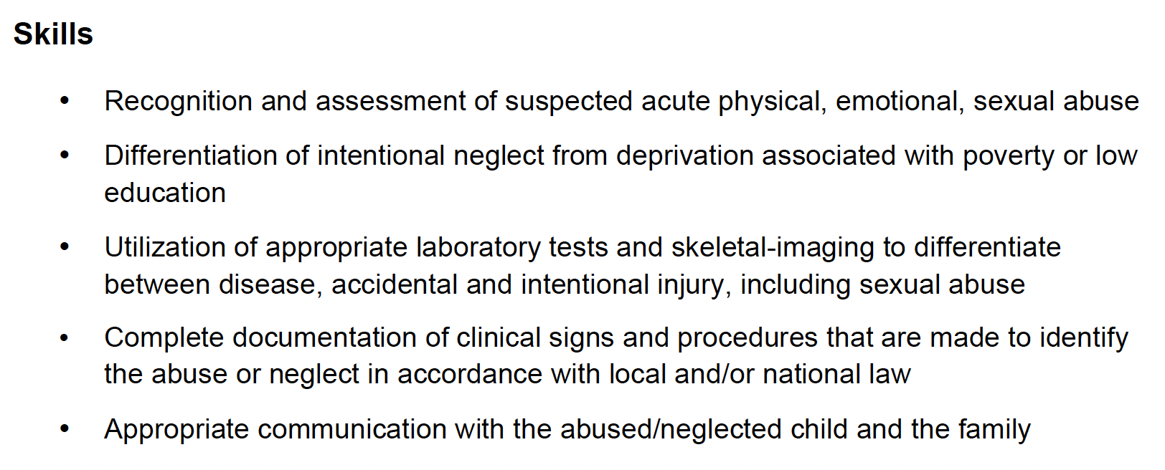
Safeguarding

Slide 15
Assessments
MCQ examination (national level/ EU level) – knowledge
Logbook of skills and competencies
Formal letters of recomendations
Structured oral examination/disscusion (e.g.)
CbD – Case based disscusion
LEADER – Leader case based dissusion
MiniCEX – Mini Clinical Evaluation Excercise
ACAT – Acute Care Assessment Tool
DOC – Disscusion on documentation

Slide 16
After common trunk
2-3 years in:
primary care,
acute or general pediatrics,
or in a subspecialty.

Slide 17
To be neonatologist
6 years !!!

