Slide 1
General Rules on Medical Specialist Training in Europe
European Training Requirements in Pediatric Surgery
Prof. Gian Battista Parigi, MD, FEBPS
University of Pavia, Italy
ChildCA Project Coordinator
Almaty, 14 October 2021

Slide 2
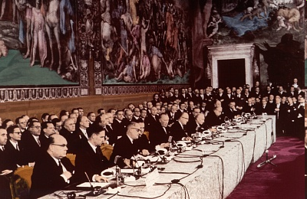
March 25th, 1957 Signature of the Treaty of Roma Foundation of European Economic Community (EEC)

Slide 3
1/11/1993 Maastricht treaty
E U
EEC

Slide 4
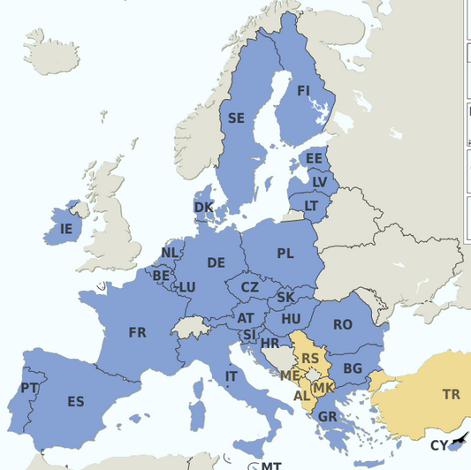
The European Union today
Inhabitants: 450.131.902 (July 2021 est.)
24 official languages
3 alphabets (latin, greek, cyrillic)
GDP $19,885,625,000,000
9,9% in health expenditure

Slide 5
EU incidence on world economy
% on total World Purchasing Power Standards (PPS)

Slide 6
EU common legislation and its ranking
Regulations
A binding legislative act that must be applied in its entirety across the EU
Directives
A legislative act that sets out a goal that all EU countries must achieve; it is up to the countries to devise their own laws on how to reach these goals.
Decisions
A "decision" is binding on those to whom it is addressed and is directly applicable
Recommendations
Suggesting a line of action without imposing any legal obligation.
Opinions
A statement in a non-binding fashion

Slide 7
Mutual recognition of medical professional qualification
1975
Doctors Directives – 75/362/EEC and 75/363/EEC (mutual recognition of diplomas)
1993
Consolidation of Doctors Directives – Directive 93/16/EC
2005
Professional Qualifications Directive

Slide 8
Directive on Mutual recognition of professional qualifications 2005/36/EC
This Directive can offer us the official answers to the questions to be addressed
Updated the 24 April 2020 -Document 02005L0036-20200424

Slide 9
Questions to be addressed
What is required to enter in the medical program?
How long does it take to prepare medical doctors?
How long does it take to prepare medical specialists?
Where do medical specialists can get employed or are allowed to work after the study program?
Which are the contents of the program?

Slide 10
Questions to be addressed
What is required to enter in the medical program?
How long does it take to prepare medical doctors?
How long does it take to prepare medical specialists?
Where do medical specialists can get employed or are allowed to work after the study program?
Which are the contents of the program?

Slide 11
Basic medical training (2005/36/EC chapt. III, Sect.1, art.24)
Admission to basic medical training shall be contingent upon possession of a diploma or certificate providing access, for the studies in question, to universities.

Slide 12
Questions to be addressed
What is required to enter in the medical program?
How long does it take to prepare medical doctors?
How long does it take to prepare medical specialists?
Where do medical specialists can get employed or are allowed to work after the study program?
Which are the contents of the program?

Slide 13
Basic medical training (2005/36/EC chapt. III, Sect.1, art.24)
2. Basic medical training shall comprise a total of at least five years of study, which may in addition be expressed with the equivalent ECTS credits, and shall consist of at least 5500 hours of theoretical and practical training provided by, or under the supervision of, a university.

Slide 14
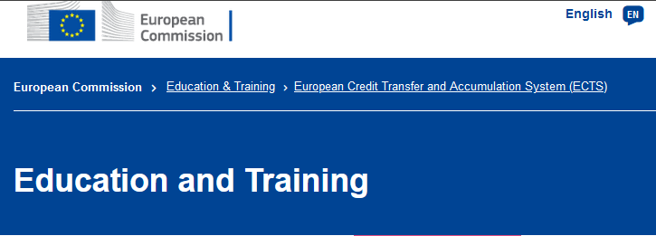
Title of the slide
Text

Slide 15
ECTS definitions
60 ECTS credits are the equivalent of a full year of study
Workload ranges from 1,500 to 1,800 hours for an academic year, which means that one credit corresponds to 25 to 30 hours of work.
A ‘first cycle’ (or bachelor's) degree consists of either 180 or 240 ECTS credits; a ‘second cycle’ (or master's) degree equates to 90 or 120 ECTS credits
A “unique cycle” degree (as the one in Medicine) equates 300 to 360 ECTS (5 to 6 years study)
https://ec.europa.eu/education/sites/default/files/document-library-docs/ects-users-guide_en.pdf

Slide 16
Questions to be addressed
What is required to enter in the medical program?
How long does it take to prepare medical doctors?
How long does it take to prepare medical specialists?
Where do medical specialists can get employed or are allowed to work after the study program?
Which are the contents of the program?

Slide 17
Specialist medical training (art.25)
1. Admission to specialist medical training shall be contingent upon completion and validation of a basic medical training programme as referred to in Article 24(2) in the course of which the trainee has acquired the relevant knowledge of basic medicine. 2. Specialist medical training shall comprise theoretical and practical training at a university or medical teaching hospital or, where appro­priate, a medical care establishment approved for that purpose by the competent authorities or bodies.

Slide 18
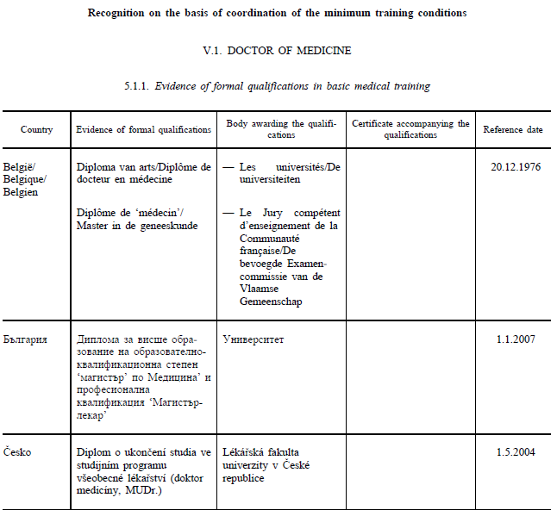

Slide 19
Specialist medical training (art.25)
2b. The Member States shall ensure that the minimum duration of specialist medical training courses referred to in Annex V, point 5.1.3 is not less than the duration provided for in that point. Training shall be given under the supervision of the competent authorities or bodies. It shall include personal participation of the trainee specialised doctor in the activity and responsibilities entailed by the services in question.

Slide 20
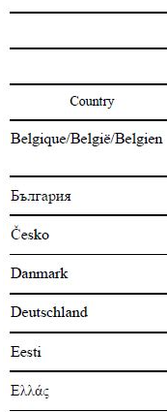
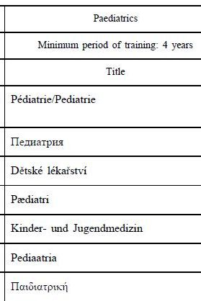

Slide 21
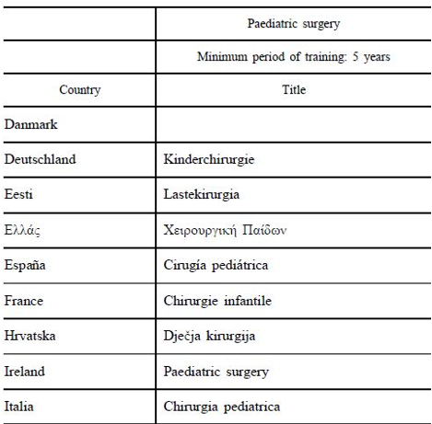

Slide 22
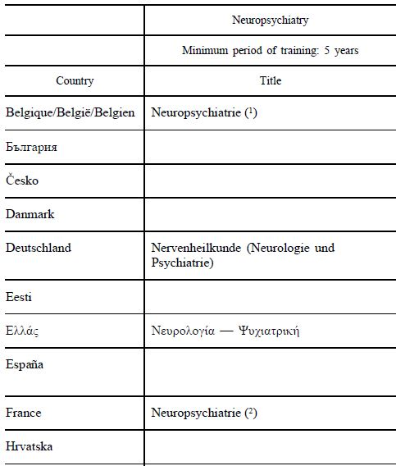
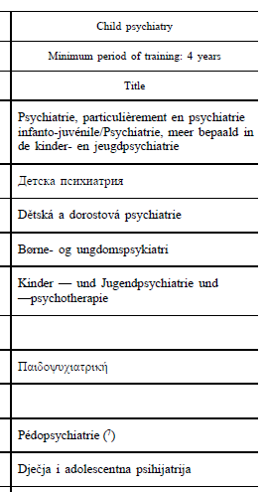

Slide 23
Specialist medical training (art.25)
3. Training shall be given on a full-time basis at specific estab­lishments which are recognised by the competent authorities.
It shall entail participation in the full range of medical activities of the department where the training is given, including duty on call.
…..
Accordingly, these posts shall be the subject of appropriate remuneration.

Slide 24
Questions to be addressed
What is required to enter in the medical program?
How long does it take to prepare medical doctors?
How long does it take to prepare medical specialists?
Where do medical specialists can get employed or are allowed to work after the study program?
Which are the contents of the program?

Slide 25
Principle of automatic recognition on the basis of coordination of minimum training conditions (2005/36/EC chapt. III, Sect.1, art.21)
1. Each Member State shall recognise evidence of formal qualifications as doctor giving access to the professional activities of doctor with basic training and specialised doctor, …., which satisfy the minimum training conditions referred to in Articles 24, 25, 31, 34, 35, 38, 44 and 46 respectively, and shall, for the purposes of access to and pursuit of the professional activities, give such evidence the same effect on its territory as the evidence of formal qualifications which it itself issues.

Slide 26
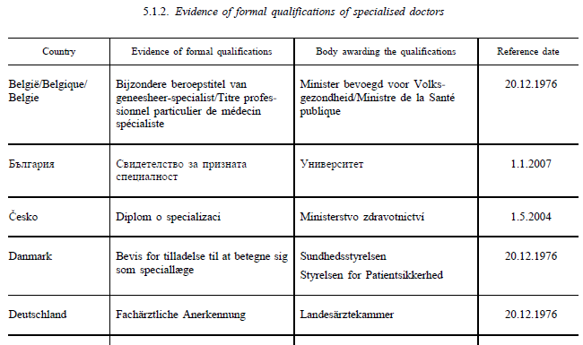
Formal qualifications recognised

Slide 27
The actual implementation of the inter-EU exchange of specialists
The Directive on the mutual recognition of medical professional qualification must be implemented by each member Country duly amending their internal laws
The mobility of specialists trained in the EU cannot have any limitations based on the non-recognition of qualifications issued in the EU
The only limitation that EU countries can legitimately oppose to mobility is the knowledge of the language of the country where the profession is to be practiced

Slide 28
Knowledge of languages (art. 53)
Professionals benefiting from the recognition of professional qualifications shall have a knowledge of languages necessary for practising the profession in the host Member State.
A Member State shall ensure that any controls carried out by… the competent authority for controlling compliance… shall be limited to the knowledge of one official language of the host Member State

Slide 29
Informatic process of recognition of titles enabling to be employed in Europe

Slide 30
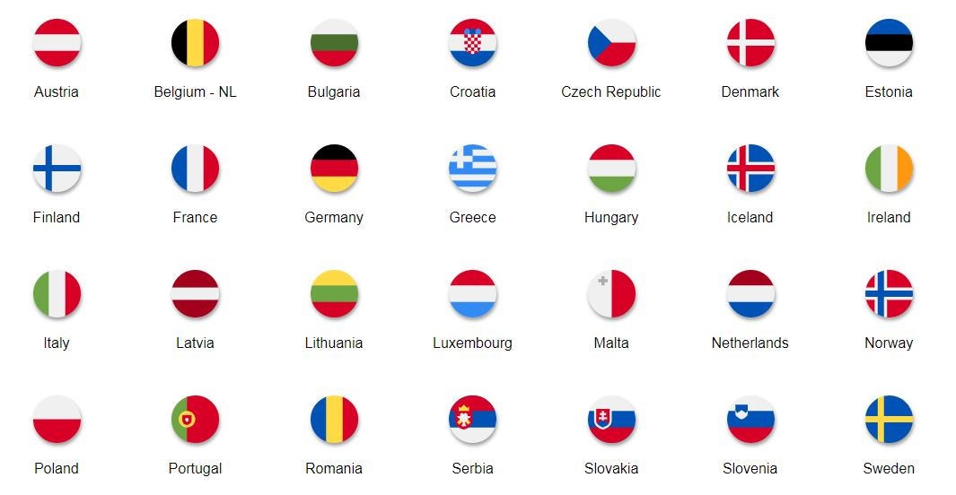
Cross-check among two countries

Slide 31
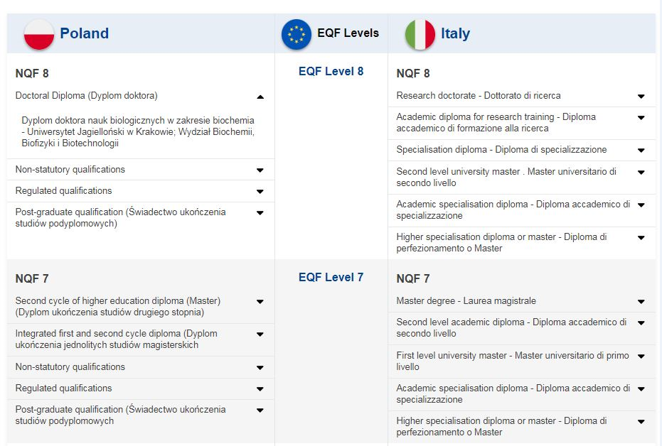
Titles equivalence between EU Countries
NQF = National qualification Level
EQF = European Qualification Level

Slide 32
Questions to be addressed
What is required to enter in the medical program?
How long does it take to prepare medical doctors?
How long does it take to prepare medical specialists?
Where do medical specialists can get employed or are allowed to work after the study program?
Which are the contents of the program?

Slide 33
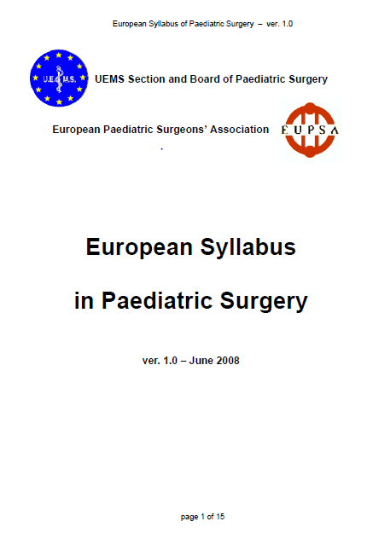
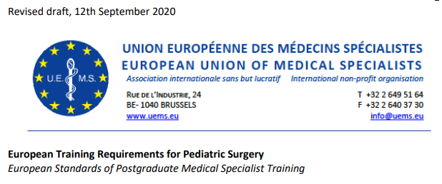
European Training Requirements
Text

Slide 34
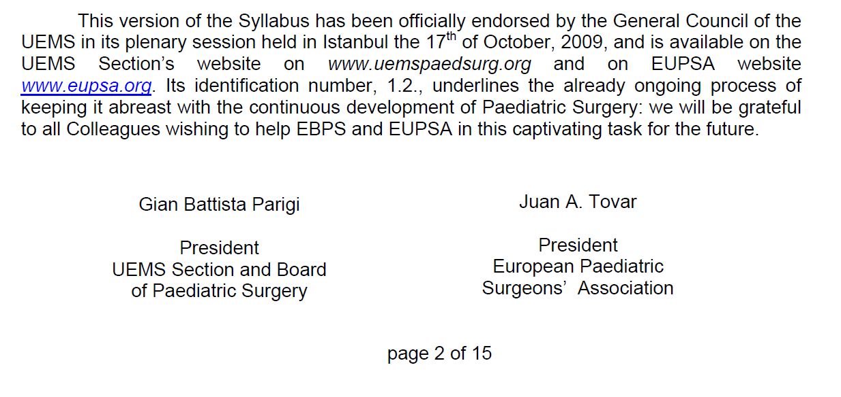
European Syllabus of Pediatric Surgery

Slide 35
Basic sciences curriculum
Basic sciences
genetics, embryology, anatomy, physiology and biochemistry, pathology immunology, microbiology, pharmacology, epidemiology and statistics
Communication and behaviour
Clinical contact with the patient, counselling and communication skills, role of family education in pediatric surgical disorders, role of staff
Management
Management skills in running a PS Unit, socioeconomic and legal aspects of pediatric surgical disorders
Teaching and research
Quality control
Audit Methodology and Specific Outcome Measures

Slide 36
Allied disciplines curriculum
General Surgery
Surgical Infections and their Prevention
Surgical Technique and Technology
Organ Transplantation
Pediatrics
Pediatrics / Neonatology
NICU / PICU
Pediatric Anaesthesia
Anesthesiology Techniques
Critical Surgical illness and Intensive Care Medicine

Slide 37
Pediatric surgery core curriculum
Preoperative and postoperative care
Screening programs and prenatal diagnosis, Laboratory tests, Endoscopic techniques, Other instrumental techniques
Neonatal Surgery
Emergency Surgery
General Pediatric Surgery
Central and peripheral nervous systems, Head and neck surgery, Thoracic surgery, Gastrointestinal surgery, Genitourinary surgery, Orthopaedic traumatology, Tumour Surgery, Endocrine Surgery, Minimally invasive surgery, Day case surgery

Slide 38
Training programme
Access
Selection procedure on a national basis open to all EU citizens
Duration
Recommended six years; allowed five years according to EU rules
Structure
basic training programme in the early years
preliminary common trunk in general surgery
core curriculum training structured in a modular system
Essential an active participation in a structured program of formal lectures, seminars, journal clubs, clinical and audit meetings
Minimal practical requirements of surgical competence

Slide 39
Surgical competence
The degree of competence is determined by the trainer and driven by the trainee.
Levels of competence:
1. Has observed
2. Can do with assistance
3. Can do almost all – may need assistance
4. Competent to do without assistance, including complications
Level to be reached by the end of the training program for a minimum required number of cases:
Level 2 for complex procedures
Level 3 for average procedures
Level 4 for day case procedures

Slide 40
Minimum required number of cases
Group of procedures | 1st surgeon | 2nd surgeon
Neonatal surgery | 10 | 20
Emergency surgery | 30 | 60
Day case surgery | 100 | 200
Head and neck surgery | 10 | 20
Thoracic surgery | 15
Gastrointestinal surgery | 30 | 60
Tumour surgery | 25
Endoscopies | 20 | 40
TOTAL | 200 (250) | 400 (450)
If included in the National core curriculum
Central /peripheral NS | 10 | 20
Urology | 20 | 40
Traumatology | 80 | 100

Slide 41
Training Institutions requirements
Training must take place in an institution, preferably based in a university hospital, formally recognized by their proper National Authority
Facilities for inpatient care, day care and ambulatory care
At least two trained paediatric surgeons
Educational and research facilities
Access to adequate national and international literature
Up to date facilities for:
paediatrics and its subspecialties
paediatric anaesthesia
child psychiatry
paediatric imaging
laboratory services

Slide 42
Principle of (automatic) recognition on the basis of coordination of minimum training conditions

Slide 43
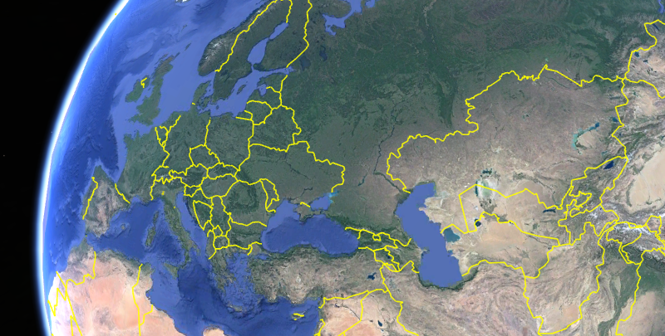
Shall we try together ?

