Slide 1
Improvement of children care teaching as a template for upgrading medical education in Central Asia

Slide 2
General objectives
To improve children's care in Central Asia Countries through a modern and innovative postgraduate training of the specialists devoted to their care
To utilise the project as a feasibility study of a new way of structuring and delivering postgraduate training in the field of children care in CA Countries, as a template for the same improvements in other medical fields
To improve the possibilities of implementing a successful future structural project aiming to modernise delivery of postgraduate medical training in CA countries

Slide 3
Specific objectives of the project
1) To increase and improve the quality of professionals trained in CA HEI who work for the care of children, both at hospital level and in the primary paediatric health care, through the development and implementation of new constructive and collaborative curricula in children care management resorting to updated contents and modern teaching techniques such as e-learning components and simulation-based training
2) To improve the level of competences and skills in CA HEIs for the design and implementation of postgraduate curricula in medical fields, emphasising the need of an holistic approach and interdisciplinary interaction
3) To introduce ICT technologies to implement an effective virtual interaction among partner HEIs

Slide 4
Preparation Working packages
WP-1: aimed at learning and analysing the user needs for the settlement of the baseline of a curricular proposal for the upgrading of postgraduate training in children care.
WP-2: aimed to quantify the hospital services dedicated to children care in terms of structures, staff and ancillary services, and the forecasted need of professionals in the fields of children care, through a structured Census of Paediatric clinical supplies.

Slide 5
Development Working Packages
WP-3: based on the data collected in the preparatory WPs and aimed at designing new curricula for the postgraduate training of medical professionals in Paediatrics, Paediatric Surgery and Child Neuropsychiatry, in an integrated way and with strong interaction among all partners.
WP-4: logical evolution of the previous one, aimed at training the academic staff involved in the actualization of the new integrated curricula.
WP-5: aimed at testing the practical feasibility of the new curriculum through a one-year trial of implementation in at least one CA HEI, possibly one for each partner Country and still better through a joint group of students in each CA Country.
WP-6: aimed at introducing ICT technologies for e-learning and interactive connection among partners.

Slide 6
Transversal Working packages
WP-7, Quality Assurance: aimed at guaranteeing that the project processes and results meet the established standards and goals.
WP-8, Dissemination and exploitation: aimed at widely spreading and publishing the results of the project, as well as at exploiting its results also for other medical specialties in the CA curricula.
WP-9, Management: aimed at ensuring that the project remains on track and that it is effectively and correctly administrated.

Slide 7
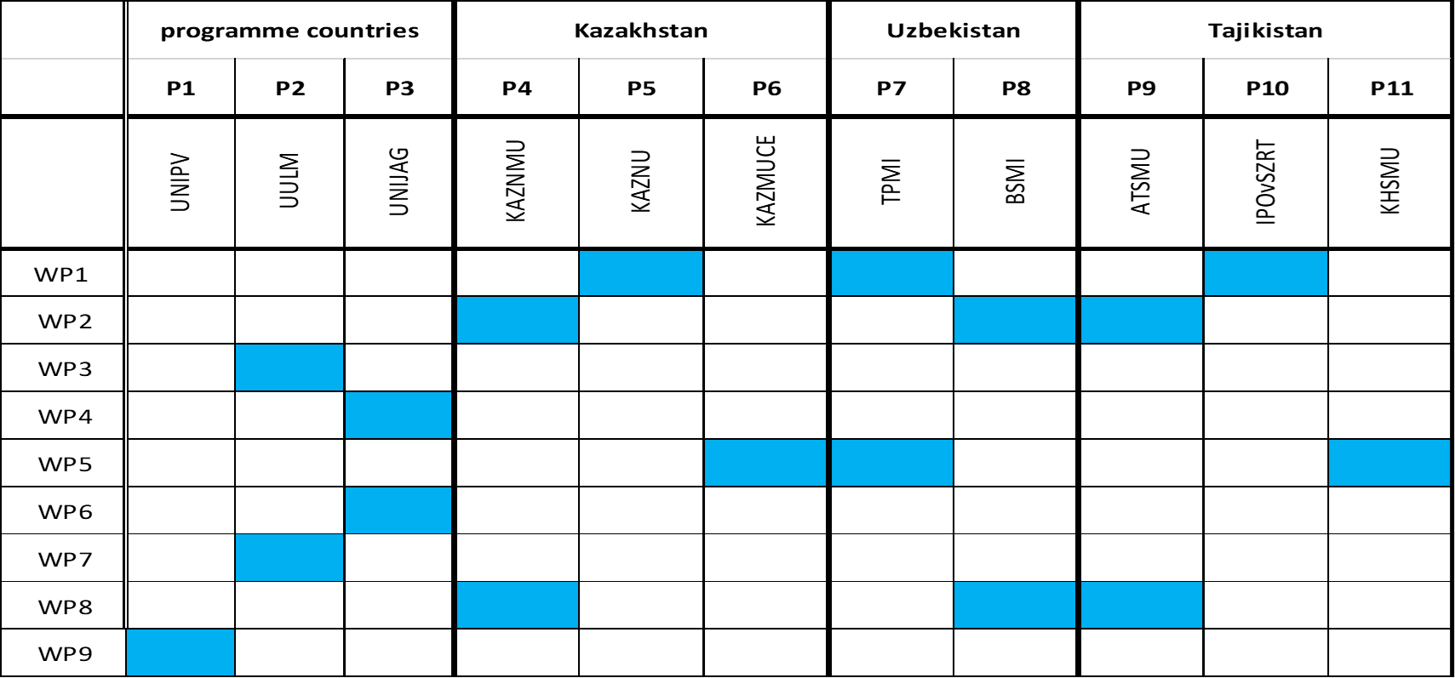
WP leaders

Slide 8
Wp 1 - User needs analysis and situation assessment
1.1Creation of ‘ad hoc questionnaires’ for the survey of user needs and actual situation
Achieved
1.2 Dissemination of questionnaires and collection of relative answers
Achieved
1.3 Creation of a database containing all relevant information to compare the various curricula adopted in the partner Countries
Achieved
1.4 Survey on the teaching methods adopted in the partner Countries
Achieved
1.5 Elaboration of the ‘Baseline document for a CA curricular proposal for the professionalization of children care management”
Achieved
1.6 Presentation of the baseline documents before the authorities of the main national and regional actors.
Work in progress
1.7 Assessing a sample of trainees by an external examination body
Achieved

Slide 9
Wp 2 - Census of Paediatric clinical supplies and needs
2.1 Elaborate the template for the census for Pediatrics, Pediatric Surgery and Child Neuropsychiatry
Achieved
2.2. Collect addresses of all Pediatric Centers in each CA country
Achieved
2.3 Disseminate the census scheme via the Internet to all Centers
Achieved
2.4 Collect and analyze data from the Centers
Achieved
2.6 Prepare a summative document with all the data collected
Achieved

Slide 10
WP 3 - Curricular design for the postgraduate training of medical professionals in Pediatrics, Pediatric Surgery and Child Neuropsychiatry (integrated curricula)
3.1 Studying and drafting of a curriculum for the postgraduate training in Pediatrics.
Work in progress
3.2 Studying and drafting of a curriculum for the postgraduate training in Pediatric Surgery.
Work in progress
3.3 Studying and drafting of a curriculum for the postgraduate training in Child Neuropsychiatry.
Work in progress
3.4 Studying and drafting of a common curriculum in Clinical Genetics, Genetic counselling and Bioethics for all postgraduate training in children’s care.
Work in progress

Slide 11
WP 4 - Training of academic staff involved in the new integrated curricula in pediatric care management and in new teaching techniques
4.1 Preparation of a modular training course for CA HEIs teachers
Achieved, Work in progress
4.2. Development of course materials.
Achieved, Work in progress, To be done
4.3 Implementation of virtual training course
Achieved, Work in progress
4.4 Implementation of practical training course
To be done
4.5 Evaluation of the training course (teachers).
To be done
4.6 Selection of young academics for stages in EU HEI
Achieved, Work in progress
4.7 Updating stages in EU HEI
To be done

Slide 12
WP 5 - Trial implementation of the new Pediatric Care integrated curricula (months 21 to 36)
5.1 Management of the approval of the trial by legal authorities.
Work in progress
5.2. Selection and designation of the teachers.
To be done
5.3 Pre-enrollment and admission procedures of the trainees
To be done
5.4 Trial implementation of the first year of the new curricula.
To be done

Slide 13
WP 6 - Introduction of ICT technologies as a tool for interactive education, e-Learning, Continuing Education, Online Training and Virtual Mobility (month 4 to 24)
6.1. To equip one ICT classroom in each CA HEI
Achieved in Kazakhstan and Tajikistan; Work in progress in Uzbekistan
6.2. To train the technical staff in classroom management
Achieved in Kazakhstan and Tajikistan; Work in progress in Uzbekistan
6.3. To train teachers in the use of the new ICT tools
Achieved in Kazakhstan and Tajikistan; Work in progress in Uzbekistan
6.4 To prepare a guideline document for the effective utilisation of the provided technology
Achieved in Kazakhstan and Tajikistan; Work in progress in Uzbekistan

Slide 14
WP 7 - Quality assurance
7.1 Establishment of predetermined quality indicators and standards for:
European standard of Postgraduate training in pediatric care
Training for tutors teaching in postgraduate training curricula;
Academic materials for distance learning;
Trial implementation of the first year of postgraduate training;
Processes of the project management.
Achieved
7.2 Designation of quality instruments, such as templates, questionnaires and protocols, with the aim of assessing the expected results and identifying strengths and weaknesses for specific activities (workshops, internships, training).
Achieved
7.3 Monitoring, assessment and control of the predetermined and defined indicators, standards and goals.
Achieved, work in progress
7.4 Elaboration of the project quality assurance report at month 12; 24; 36.
Achieved at month 12; to be done at month 24, 36.
7.5 Evaluation of training process by an external institution.
Preliminary evaluation achieved ; Final evaluation to be done.

Slide 15
WP 8 - Dissemination and exploitation
8.1 Identification of dissemination groups and elaboration of a dissemination plan.
Achieved
8.2 Creation of a project website as platform of collaboration and dissemination.
Achieved
8.3 Maintenance and administration of the website.
Achieved, continuously ensured
8.4 Elaboration of 3 virtual bulletins and distribution among the target groups.
Achieved: virtual bulletin n°1; Work in progress: virtual bulletin n°2; to be done: virtual bulletin n°3
8.5 Organization of meetings for the dissemination of the project among the HEIs of the country, the professional associations of each country, the Ministries of Health and Education, and representatives of regional and international agencies.
Achieved, work in progress.
8.6 Social media coverage to increase visibility: press interviews, press releases, elaboration and publication of different articles in printed media.
Achieved, continuously ensured
8.7 Final Conference: New paradigm in training professionals on healthcare management.
To be done

Slide 16
Wp 9 - Project properly and efficiently managed
9.1 Formalization of network and agreements among the participating HEIs
Achieved
9.2 Planning and development of meetings for the administration of the project.
Achieved
9.3 Designing and administration of the organizational and communicational structures (internal and external)
Achieved
9.4 Provision of templates for the associates to prepare the reports.
Achieved
9.5 Collection and storage of data for the monitoring of the project and the elaboration of reports and budgets
Achieved, continuously ensured
9.6 Periodic actualization of the plan and monitoring of the fulfillment of the working schedule
Achieved, continuously ensured
9.7 Monitoring, assessment and control of any deviation in the progress of the project
Achieved, continuously ensured
9.8 Elaboration of mid-term and final evaluation reports
Mid-Term report: Achieved; Final Report: to be done
9.9 Control of the use of resources and budgetary Execution
Achieved, continuously ensured
9.10 Monitoring of the compliance of the grant agreement
Achieved, continuously ensured

