Slide 1
Mental Health of Healthcare Workers during COVID-19 Pandemic Aryntayeva Nurila MD, MSPH, PhD(c)
ASFENDIYAROV KAZAKH NATIONAL MEDICAL UNIVERSITY
Advisers:
c.м.s. Aimbetove G.Е.
c.м.s. Bagiyrova F.А.
International adviser:
Isabel Griffin MPH, PhD
Center for Disease Control, USA

Slide 2
Overview
Background
Methods
Study objectives
Data source
Study population
Variables
Statistical analysis
Results
Discussion
Public Health Implications

Slide 3
Background
Coronavirus disease 2019 (COVID-19), is continuing to spread worldwide, which was first reported in Wuhan, Hubei, China in February 2019 [1].
According to the World Health Organization’s report (WHO), as of October 14, 2021, 2,860,332 weekly new cases of COVID-19 infection have been confirmed globally, including 47,008 deaths from this disease [2].
The common symptoms of COVID-19 patients are mostly respiratory issues with acute respiratory distress syndrome, leading to death in the most severe cases [3].
COVID-19 also affects other organs like brain causing neurological problems as a side effect of COVID-19 infection [4].
During the SARS epidemic patients with SARS-CoV-1 reported psychiatric symptoms including posttraumatic stress disorder (PTSD), depression, anxiety, and insomnia [5] and after 1 month [6] [7], 1 year [8] and 30 months and longer follow-up [9] [10].

Slide 4
Medical workers at the hospitals who are directly involved in the diagnosis, treatment, and care of COVID-19 infected patients are at high risk of developing mental distress and other psychological health symptoms.
Confirmed cases
Suspected cases
Stressful workload
Lack of personal protection equipment
Specific drugs
Adequate psychological support
Mental crisis of healthcare workers
“The Impact of COVID – 19 on mental, neurological and substance use services: result of a rapid assessment”, WHO, 2020

Slide 5
Study objectives
To study the prevalence of mental health disorders in medical workers.
To investigate the mental status of healthcare workers in Kazakhstan.
Identify risk and protective factors, as well as vulnerable groups among healthcare workers.
Conduct a comparative analysis of the local and foreign healthcare workers.
Develop guidelines for maintaining the mental health of healthcare workers during the COVID-19 pandemic.

Slide 6
Methods and materials
Study design: Cross-sectional study
Research methods:
Information-analytical method: a review of the medical scientific literature (PubMed, Medline, Google Scholar, etc.).
Sociological Method:
Patient Health Questionnaire (PHQ-9) - assess symptoms of depression
The Generalized Anxiety Disorder Scale (GAD-7) - assess anxiety symptoms
The Insomnia Severity Index (ISI) - assess insomnia
Demographic characteristics
Statistical analysis:
Patient characteristics between frontline and non-frontline healthcare workers will be tested using the chi-square test.
The test results will be considered significant if p-value ≤ 0.05 (significant level). All statistical analysis will be performed in SAS (v9.3).
Participants: 1500 frontline and non-frontline healthcare workers in Almaty, Kazakhstan.

Slide 7
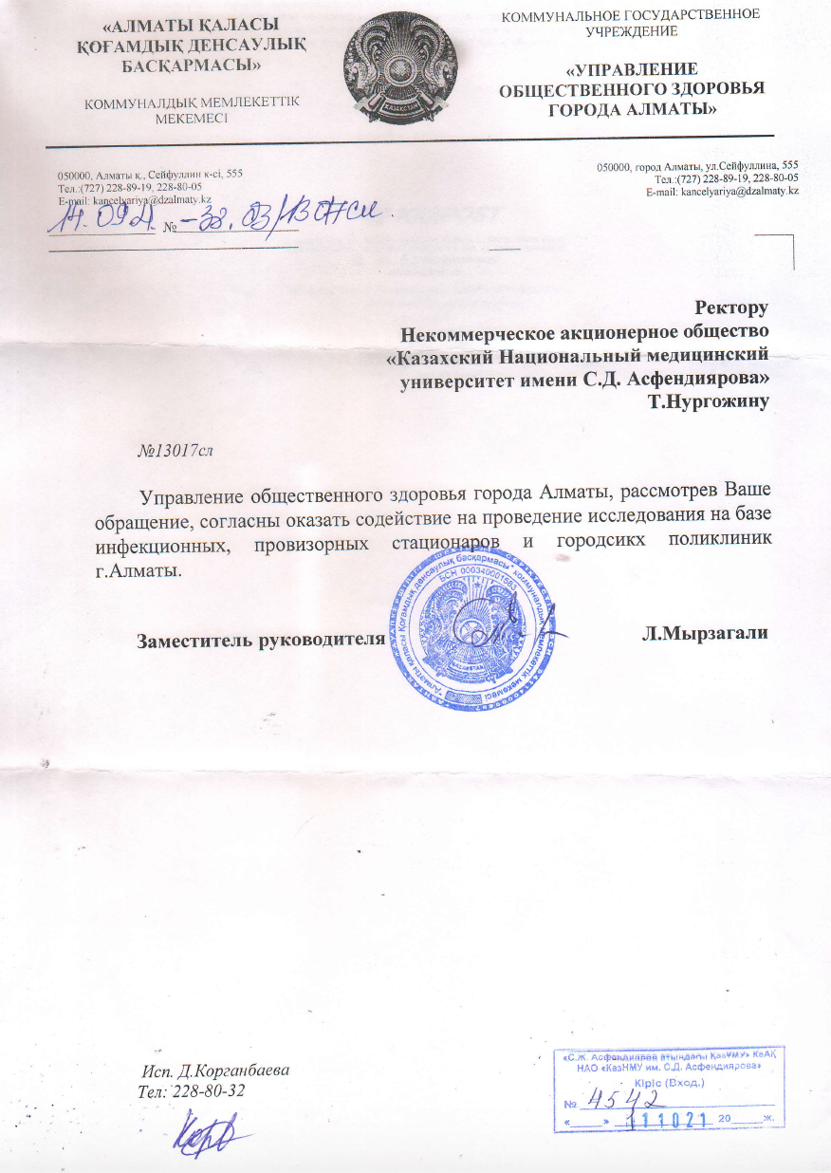

Slide 8
Key findings
Associations between socio-demographic characteristics and the psychological impact of the COVID-19 outbreak, as well as the adverse mental health conditions during the COVID-19 pandemic, will be assessed.
Based on the results of the surveys, a draft of a strategy will be developed to prevent mental crises in healthcare workers during the COVID-19 pandemic.
The final draft of the study will be presented at a scientific-practical conference (APHA, SBM) for the dissemination of the results and knowledge.
Scientific articles will be prepared for publication in peer-reviewed scientific journals indexed in the international scientific databases like Web of Science or Scopus with a high-scored impact factor.

Slide 9
Conclusion
Managing your mental health and psychosocial well-being during this time is as important as managing your physical health.
Try and use helpful coping strategies such as ensuring sufficient rest and respite during work or between shifts, eat sufficient and healthy food, engage in physical activity and stay in contact with family and friends. Avoid using unhelpful coping strategies such as tobacco, alcohol or other drugs. In the long term, these can worsen your mental and physical well-being.
Turn to your colleagues, your manager or other trusted persons for social support – your colleagues may be having similar experiences to you.
Use understandable ways to share messages with patients with intellectual, cognitive and psychosocial disabilities.

Slide 10
References
C. Huang, Y. Wang, X. Li, L. Ren, J. Zhao, Y. Hu, L. Zhang, G. Fan, J. Xu, X. Gu, Z. Cheng, T. Yu, J. Xia, Y. Wei, W. Wu, X. Xie, W. Yin, H. Li, M. Liu, Y. Xiao, H. Gao, L. Guo, J. Xie, G. Wang, R. Jiang, Z. Gao, Q. Jin, J. Wang and B. Cao, "Clinical features of patients infected with 2019 novel coronavirus in Wuhan, China," The Lancet, vol. 395, pp. 497-506, 2020.
"World Health Organization," 16 November 2020. [Online]. Available: https://covid19.who.int/.
L. Fu, B. Wang, T. Yuan, X. Chen, Y. Ao, T. Fitzpatrick, P. Li, Y. Zhou, Y. Lin, Q. Duan and others, "Clinical characteristics of coronavirus disease 2019 (COVID-19) in China: a systematic review and meta-analysis," Journal of Infection, 2020.
M. Haldrup, M. I. Johansen and A. W. Fjaeldstad, "Lugte-og smagstab som primære symptom på COVID-19," Ugeskr. Laeger, vol. 4200205, 2020.
S. K. W. Cheng, C. W. Wong, J. Tsang and K. C. Wong, "Psychological distress and negative appraisals in survivors of severe acute respiratory syndrome (SARS)," Psychological Medicine, vol. 34, p. 1187, 2004.
S. K.-W. Cheng, J. S.-K. Tsang, K.-H. Ku, C.-W. Wong and Y.-K. Ng, "Psychiatric complications in patients with severe acute respiratory syndrome (SARS) during the acute treatment phase: a series of 10 cases," The British Journal of Psychiatry, vol. 184, p. 359–360, 2004.
K. K. Wu, S. K. Chan and T. M. Ma, "Posttraumatic stress, anxiety, and depression in survivors of severe acute respiratory syndrome (SARS)," Journal of Traumatic Stress: Official Publication of The International Society for Traumatic Stress Studies, vol. 18, p. 39–42, 2005.
A. M. Lee, J. G. W. S. Wong, G. M. McAlonan, V. Cheung, C. Cheung, P. C. Sham, C.-M. Chu, P.-C. Wong, K. W. T. Tsang and S. E. Chua, "Stress and psychological distress among SARS survivors 1 year after the outbreak," The Canadian Journal of Psychiatry, vol. 52, p. 233–240, 2007.
I. W. C. Mak, C. M. Chu, P. C. Pan, M. G. C. Yiu and V. L. Chan, "Long-term psychiatric morbidities among SARS survivors," General hospital psychiatry, vol. 31, p. 318–326, 2009.
M. H.-B. Lam, Y.-K. Wing, M. W.-M. Yu, C.-M. Leung, R. C. W. Ma, A. P. S. Kong, W. Y. So, S. Y.-Y. Fong and S.-P. Lam, "Mental morbidities and chronic fatigue in severe acute respiratory syndrome survivors: long-term follow-up," Archives of internal medicine, vol. 169, p. 2142–2147, 2009.

Slide 11
Thank you for your attention!

