Slide 1
COVID-19 in the paediatric population of The Republic of Kazakhstan
Fakhradiyev Ildar

Slide 2
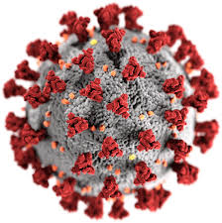
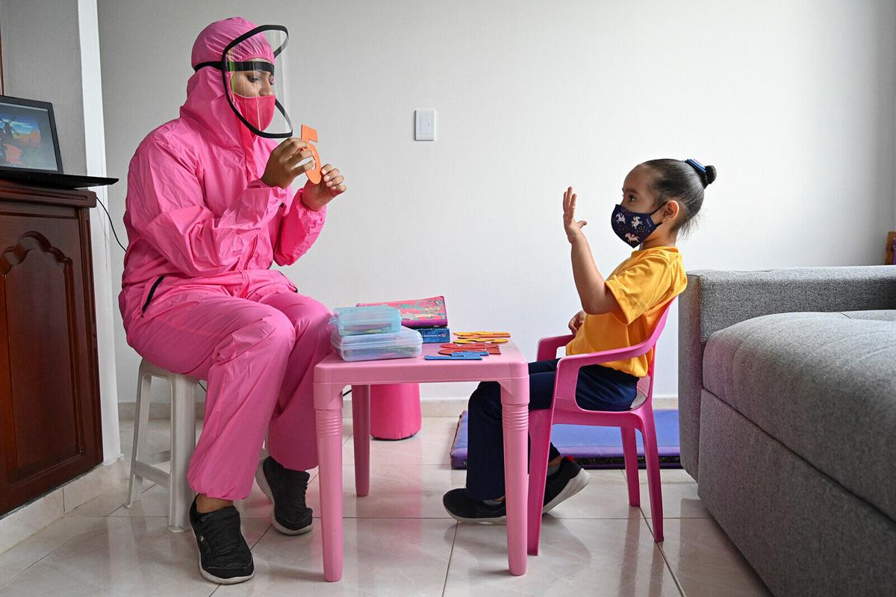
Introduction
Since the first reports of COVID-19 (SARS-CoV-2) in January 2020 from Wuhan, China, the infection has spread rapidly across all continents
Some authors confirm that children compared to adults have better innate immune response and also healthier respiratory system due to smoke-free lifestyle
Coronavirus infection in children is usually mild-to-moderate and many reported cases were asymptomatic also, the rate of infection in children may vary between the sexes

Slide 3
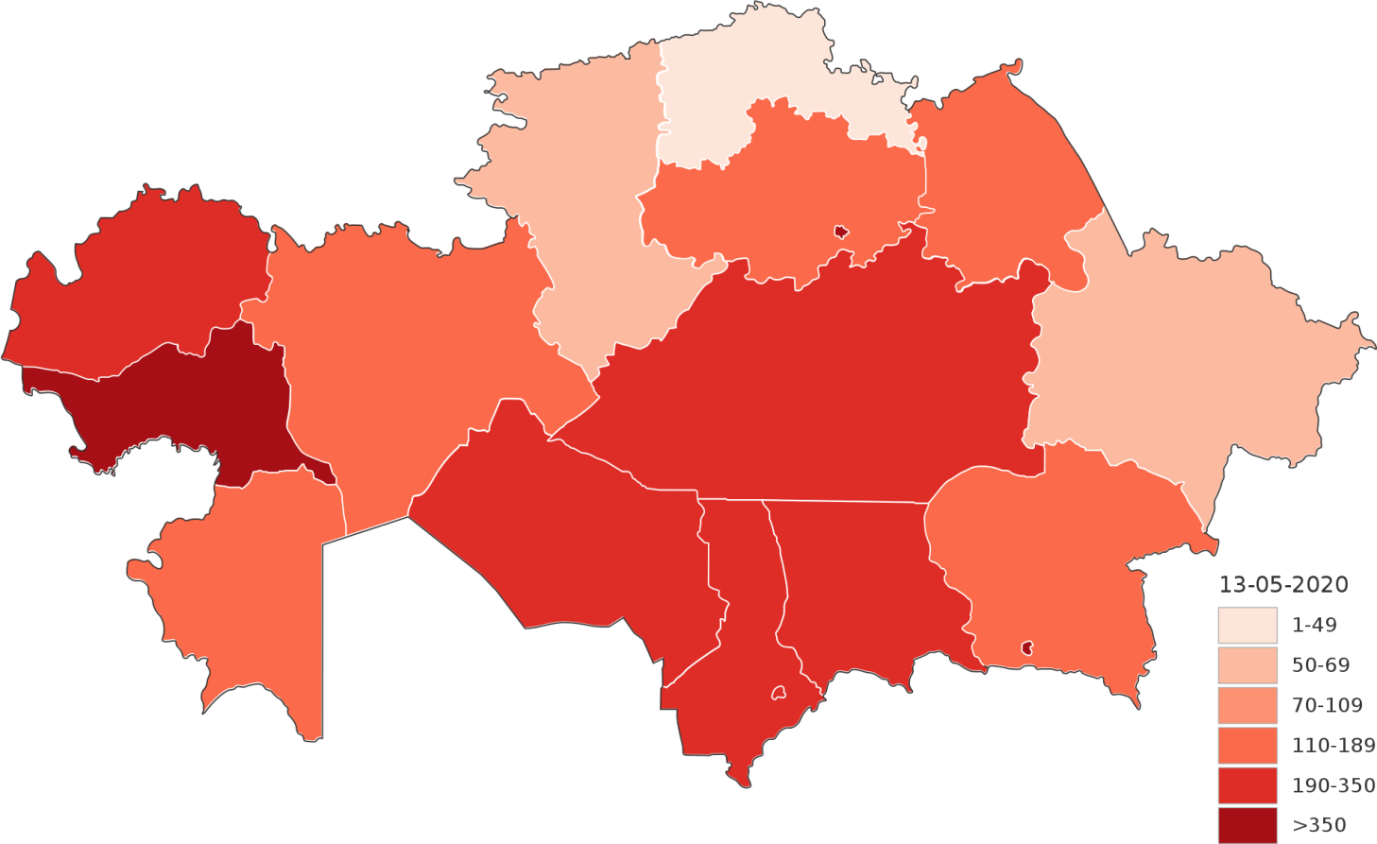
Aim
The objective of this study was to determine the epidemiological and clinical features of paediatric COVID-19 in The Republic of Kazakhstan.
The first epidemiological research and analysis of the incidence of coronavirus infection in children in Central Asia, in particular in The Republic of Kazakhstan

Slide 4
Subjects and methods
The study focused on the epidemiological and clinical features of confirmed cases of COVID-19 in all 17 regions of the Republic of Kazakhstan from 6 March to 11 June 2020
The diagnosis of COVID-19 was confirmed by positive PCR results from nasal and pharyngeal swabs from the following groups: patients with symptoms of COVID-19, those with suspected infection (from ‘contact’ category), patients with respiratory disease, and asymptomatic patients. The severity of the disease was determined by clinical symptoms and radiological findings [chest radiograph and computed tomography (CT)].
Children were subdivided into four age groups according to the WHO classification [9]: neonates and infants (<1 y), young children (1–4 y), older children (5–12 y) and adolescents (13–18 y).
Clinical features were compared and disease outcome in patients diagnosed with COVID-19 were examined for a link between age and severity of disease

Slide 5
Statistical analysis
All statistical calculations were performed using the SPSS program (version 22.0, IBM SPSS Inc., Chicago, IL, USA) and p<0.05 was considered statistically significant. Continuous and categorical variables were presented as mean (SD) and n (%), respectively. The χ² and Fisher’s Exact tests were used to calculate categorical variables.

Slide 6
Characteristics | Value N (%)
Gender, male | 366 (56.3)
Age, mean [SD] Age groups | 7.1 [6.1]
neonates & infants (<1) | 122 (18.8)
young children (1-4) | 156 (24.0)
older children (5-12) | 219 (33.7)
adolescents (13-18) | 153 (23.5)
Residents, urban | 483 (74.3)
The presence of symptoms before case registration | 197 (30.3)
The presence of symptoms after case registration | 138 (21.2)
Disease severity
Mild and w/o symptoms | 558 (85.8)
Moderate | 88 (13.5)
Severe and critical Complications | 4 (0.6)
Pneumonia diagnosed by CT and/or X-ray | 54 (8.3)
ARDS | 1 (0.2)
Changes in CT | 44(6.8)
Round ground glass shadow | 2 (0.3)
Small ground glass shadow | 5 (0.8)
Large ground glass shadow | 7 (1.1)
Large and small mixed ground glass shadow | 5 (0.8)
Ground glass shadow and solid shadow | 10 (1.5)
Small patch consolidation | 6 (0.9)
Large and small mixed patch consolidation | 9 (1.4)
Dissribution ( CT)
Unilateral | 28 (4.3)
Bilateral | 16 (2.5)
Changes in X-ray
Consolidation | 4 (0.6)
Ground glass symptom | 6 (0.9)
Dissribution ( X-ray)
Peripheral predominance | 1 (0.2)
Perihilar predominance | 6 (0.9)
Diffuse | 3 (0.5)
Unilateral | 4(0.6)
Bilateral | 6 (0.9)
ICU admission Respiratory support | 6 (0.9)
Mechanical ventilation | 3 (0.5)
Outcome
Cured | 650(100)
Died | 0 (0)
Results
(N=650)
Symptoms | 306 (47.1)
Cough | 96 (14.8)
Sore throat | 83 (12.8)
Fever | 59 (9.1)
Rhinorrhea | 36 (5.5)
Diarrhea | 13 (2.0)
Dyspnea | 12 (1.8)
Muscle pain | 7 (1.1)
Co-morbidities | 76 (11.2)
Cardiovascular disease | 7 (1.1)
Hypertension | 8 (1.2)
Diabetes | 3 (0.5)
Obesity | 3 (0.5)
Chronic kidney disease | 2 (0.3)
Chronic liver disease | 2 (0.3)
Chronic neurological disease | 6 (0.9)
Anemia | 39 (6.0)
Congenital malformation | 6 (0.9)
Data are mean (SD), n (%);

Slide 7
CT and X-ray results among pediatric COVID-19 cases (N=650)
 | Characteristics | Pneumonia diagnosed by CT or X-ray | Pneumonia not diagnosed by CT or X-ray | CT or X-ray not performed | p-value
Gender | male | 31 (57.4) | 320 (56.1) | 15(57.7) | >0.1
 | female | 23 (42.6) | 250 (43.9) | 11(42.3)
Age group | neonate or infant | 16 (29.7) | 101 (17.7) | 5(19.2) | >0.1
 | young child | 12 (22.2) | 141 (24.7) | 3(11.5)
 | older child | 14 (25.9) | 193 (33.9) | 12(46.2)
 | adolescent | 12 (22.2) | 135 (23.7) | 6(23.1)
Disease Severity | mild or w/o symptoms | 22 (40.7) | 512 (89.8) | 24(92.3) | <0.001
 | moderate | 32 (59.3) | 54 (9.5) | 2(7.7)
 | severe | 0 | 4 (0.7) | 0
Total |  | 54 (8.3) | 570 (87.7) | 26 (4.0)
Data presented in n (%) ; χ² statistic was used to calculate p-values.

Slide 8
Association of demographic characteristics and co-morbidities with severity of disease
Characteristics | Disease severity
 | Severe (n=4) | Moderate (n=88) | Mild or asymptomatic (n=558) | p-value
Gender male female | 3 (75) | 51 (57.9) | 312 (55.9) | 0.7
 | 1 (25) | 37 (42.04) | 246 (44.1)
Age group neonates or infants young children older children adolescents | 1 (25) | 35 (39.7) | 86 (15.4) | <0.001
 |  | 20 (22.7) | 136 (24.4)
 | 1 (25) | 17 (19.3) | 201 (36.02)
 | 2 (50) | 16 (18.2) | 135 (24.2)
Type of settlement urban rural | 4 (100) | 62 (70.4) | 417 (74.7) | 0.3
 |  | 26 (29.5) | 141 (25.3)
Any co-morbidity | 2 (50) | 23 (26.1) | 52 (9.3) | <0.001
Cardio-vascular disease | 1 (25) | 4 (4.5) | 2 (0,35)
Hypertension | 1(25) | 5 (5.7) | 2 (0,35)
Diabetes |  | 1 (1.1) | 2 (0,35) | 0.6
Obesity |  | 1 (1.1) | 2 (0,35) | 0.6
Kidney disease |  | 1 (1.1) | 1 (0.2) | 0.3
Liver disease |  |  | 2 (0,35) | 0.9
Chronic neurological disease | 1 (25) | 1 (1.1) | 4 (0.7) | 0.1
Anemia |  | 13 (14.8) | 26 (4.6) | 0.001
Congenital malformation |  | 2 (2.3) | 4 (0.7) | 0.4
Data presented in n (%) ; χ² statistic was used to calculate p-values

Slide 9
Discussion
Confirmation of COVID-19 in a relatively high proportion of neonates and infants in our study can possibly related to a familial cluster of transmission. Since, according to previously published work, SARS-CoV-2 diagnosis was confirmed on newborn in the delayed neonatal period, who was born from mother infected with COVID-19 during pregnancy, although the risks of vertical transmission of the virus and infection in the early neonatal period were completely excluded [36].
Hence, newborns in such risk group should, at least until the 12 month of life, undergo more frequent regular clinical check with laboratory and instrumental methods for the detection of signs of infection and its possible complications on time [36].
In the present study , only four children and adolescents developed severe forms of the disease and required intensive therapy , but the children under 1 year of age are at substantial at risk of being
infected by COVID-19.

Slide 10
Сonclusions
The results of this study suggest that most paediatric cases in Kazakhstan are asymptomatic or mild. These findings are compatible with the results of a multicentre cohort study of children and adolescents in 82 participating institutions across 25 European countries [20].
In the present study, only four children and adolescents developed severe forms of the disease and required intensive therapy, but the children under 1 year of age are at substantial at risk of being infected by COVID-19.

Slide 11
Спасибо за внимание
Thank you for attention

