Slide 2
Principles of Post-Graduate Medical Education in Başkent University Faculty of Medicine
Aydan A. ÖZDEMİR MPH, Ph.D.

Slide 3
Presentation Plan
The Emerging Need for Residency
Residency in Turkey
Residency Education in Turkey
SubSpecialization
SubSpecialization Education in Turkey
Postgraduate Medical Education at Başkent University

Slide 6
RESIDENCY IN TURKEY
1987: First TUS (Medical Specialization Exam) executed
September & April
≈ 10.000-13.000 undergraduates
200 questions, 210 minutes
Anatomy (10), Physiology – Histology – Embryology (10), Biochemistry (20), Microbiology (20), Pathology (20), Pharmacology (20), Internal Medicine (20), Pediatrics (20), General Surgery (20), Obstetrics and Gynecology (15), Minor Internships (15)*
*Internships that lasted 3 -5 weeks; Cardiology, Radiology, Anesthesia and Reanimation, Plastic Surgery, Orthopedics, Public Health, Dermatology, Ophthalmology, Ear-Nose-Throat and Head-Neck Surgery, Neurology, Neurosurgery, Infectious Diseases, Pulmonology, Pulmonary Surgery, Cardiovascular Surgery, Urology, Psychiatry, Forensic Medicine, Emergency Medicine, Physiotherapy and Rehabilitation, Nuclear Medicine, Radiation Oncology

Slide 7
RESIDENCY DURATIONS IN TURKEY
3 YEARS | FAMILY MEDICINE, ANATOMY, MILITARY HEALTH SERVICES, PHYSIOLOGY, AIR AND SPACE MEDICAL SCIENCE, HYSTOLOGY AND EMBRIOLOGY, SUBAQUEOUS MEDICAL SCIENCE AND HYPERBARIC MEDICINE, MEDICAL ECOLOGY AND HYDROCLIMATOLOGY

Slide 8
RESIDENCY DURATIONS IN TURKEY
4 YEARS | EMERGENCY MEDICINE, FORENSIC MEDICINE, ANESTHESIOLOGY AND REANIMATION, PEDIATRICS, PHYSICAL MEDICINE AND REHABILITATION, PEDIATRIC PSYCHIATRY, DERMATOLOGY, PULMONARY DISEASES, OPHTALMOLOGY, PUBLIC HEALTH, INTERNAL DISEASES, OBSTETRICS AND GYNECOLOGY, NEUROLOGY, NUCLEAR MEDICINE, RADIATION ONCOLOGY, PSYCHIATRY, SPORTS MEDICINE, MEDICAL BIOCHEMISTRY, MEDICAL PHARMACOLOGY, MEDICAL GENETICS, MEDICAL MICROBIOLOGY, CLINICAL PATHOLOGY

Slide 9
RESIDENCY DURATIONS IN TURKEY
5 YEARS | MAXILLOFACIAL SURGERY, NEUROSURGERY, PEDIATRIC SURGERY, INFECTIOUS DISEASES AND CLINICAL MICROBIOLOGY, GENERAL SURGERY, THORACIC SURGERY, CARDIOVASCULAR SURGERY, ORTHOPEDICS AND TRAUMATOLOGY, PLASTIC, RECONSTRUCTIVE AND ESTHETICS SURGERY, UROLOGY, CARDIOLOGY, EAR-NOSE AND THROAT DISEASES,

Slide 10
SUBSPECIALTY EDUCATION IN TURKEY
2014: First YDUS (Sub Specialization Exam) executed
December
80 Multiple Choice questions, 20 Essay, 160 minutes
Multiple Choice Fields: Anesthesiology and Reanimation, Pediatrics, General Surgery, Internal Medicine, Obstetrics and Gynecology
Essay Fields: Pediatric Surgery, Dermatology, Infectious Diseases and Clinical Microbiology, Physio Therapy and Rehabilitation, Pulmonary Diseases, Public Health, Cardiovascular Diseases, Neurology, Orthopedics and Traumatology, Plastic and Reconstructive Surgery, Radiology, Psychiatry, Medical Pathology, Urology

Slide 11
SUBSPECIALTY EDUCATION DURATIONS IN TURKEY
2-3 YEARS
FIELDS OF SUBSPECIALTIES:
ALGOLOGY, SURGICAL ONCOLOGY, ENVIRONMENTAL HEALTH, HAND SURGERY, ENDOCRINOLOGY AND METABOLIC DISORDERS, EPIDEMIOLOGY, GASTROENTEROLOGY, GASTROENTEROLOGICAL SURGERY, GERIATRICS, HEMATOLOGY, IMMUNOLOGY AND ALLERGIC DISORDERS, OCCUPATIONAL HEALTH, GYNECOLOGICAL ONCOLOGY SURGERY, CLINICAL NEUROPHYSIOLOGY, NEPHROLOGY, NEONATOLOGY, PERINATOLOGY, RHEUMATOLOGY, SITOPATHOLOGY, BASIC IMMUNOLOGY, MEDICAL ONCOLOGY, MEDICAL VIROLOGY, MEDICAL PARASITHOLOGY, INTENSIVE CARE
PEDIATRICS; EMERGENCY MEDICINE, ENDOCRINOLOGY, GENETIC DISOERDERS, PULMONARY DISEASES, HEMATOLOGY AND ONCOLOGY, IMMUNOLOGY AND ALLERGIC DISEASES, CARDIOVASCULAR SURGERY, METABOLIC DISOERDERS, NEPHROLOGY, NEUROLOGY, RADIOLOGY, RHEUMATHOLOGY, UROLOGY, INTENSIVE CARE
MILITARY: PSYCHIATRY, SURGERY

Slide 12
BOARD OF RESIDENCY IN MEDICINE, TURKEY
MEMBERS
Undersecretary of Ministry of Health
4 medical doctors, 1 dentist, selected by Ministry of Health)
4 academicians from Faculties of Medicine, 1 academician from Faculty of Dentistry, selected by Higher Education Council
1 MD selected by Faculty of Medicine of Arm Forces
1 MD selected by the Union of Turkish Medical Doctors Association
1 Dentist selected by the Turkish Dentists Association

Slide 13
ACTIVITIES OF THE BOARD OF RESIDENCY IN MEDICINE, TURKEY
Quotas of Residency, Sub Specialty; Country wide and Institution Basis
Transfers of Residency Students; spouse &health related, regarding convictions
Auditing Visits to Institutions
Syllabus and Standards Regulations
Rotations
Applications
Residency education of non-medical professions
Accreditation

Slide 14
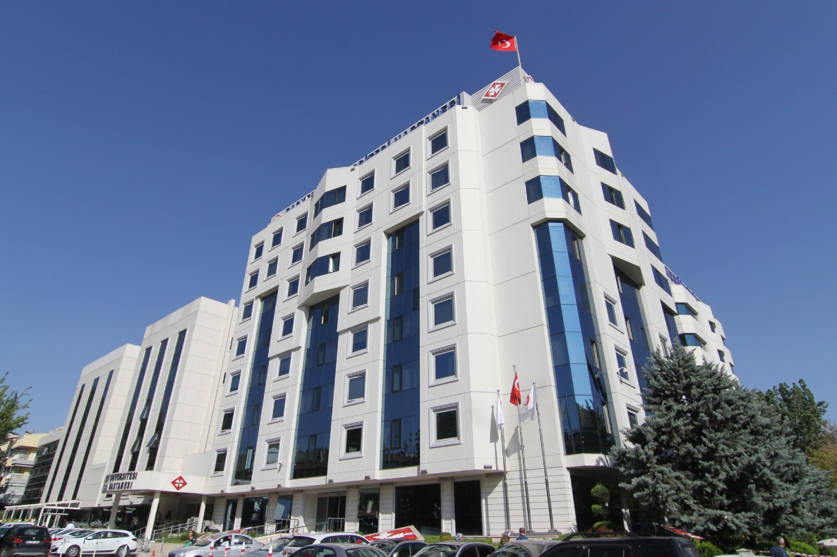
POSTGRADUATE MEDICAL EDUCATION
AT
BAŞKENT UNIVERSITY

Slide 15
POST GRADUATE EDUCATION IN MEDICINE, BAŞKENT UNIVERSITY MODEL
COMPETENCIES
CAPABILITIES
QUALIFICATION
EXPERIENTIAL LEARNING
Notes:
Modern health care management takes place in organizations and institutions that are becoming more and more complex.

Slide 16
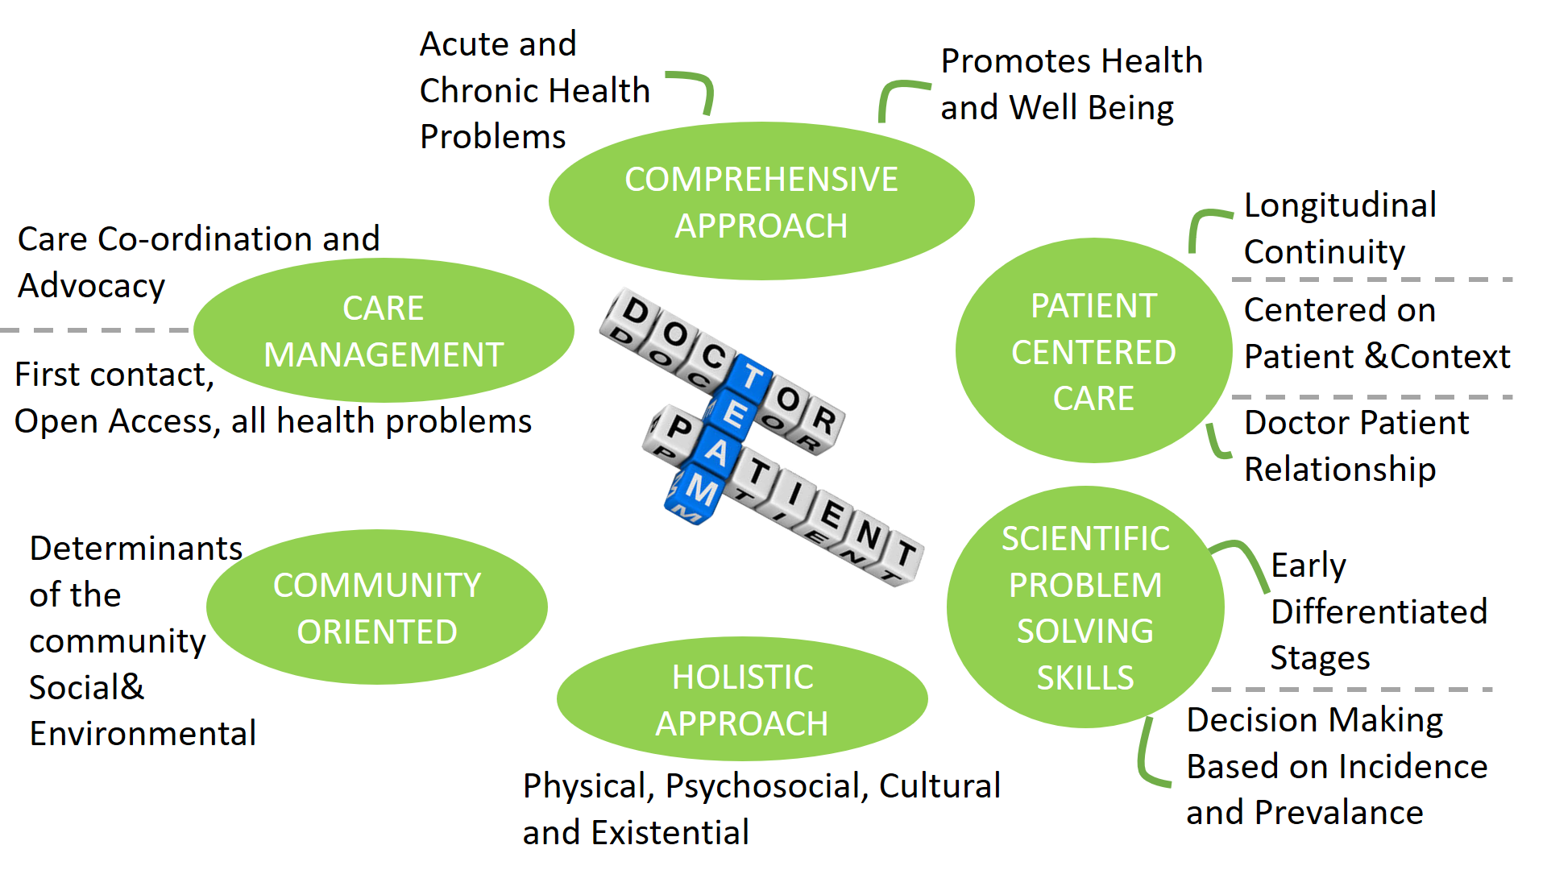
Notes:
"a comprehensive approach includes the ability to manage multiple complaints and pathologies simultaneously, promote health and well-being by applying disease prevention strategies appropriately and manage and coordinate health promotion, prevention, cure, care, palliation, and rehabilitation "
A holistic approach includes the ability to use a biopsychosocial model that takes into account cultural and existential dimensions
Patient-centered care is the practice of caring for patients (and their families) in ways that are meaningful and valuable to the individual patient. It includes listening to, informing and involving patients in their care.
Involve patients in decision-making, recognizing they are individuals with their own unique values and preferences. Treat patients with dignity, respect and sensitivity to his/her cultural values and autonomy.
During focus groups, patients expressed feeling vulnerable and powerless in the face of illness. Proper coordination of care can alleviate those feelings. Patients identified three areas in which care coordination can reduce feelings of vulnerability:
Coordination of clinical care
Coordination of ancillary and support services
Coordination of front-line patient care
In interviews, patients expressed their worries that they were not being completely informed about their condition or prognosis. To counter this fear, hospitals can focus on three kinds of communication:
Information on clinical status, progress and prognosis
Information on processes of care
Information to facilitate autonomy, self-care and health promotion
The level of physical comfort patients report has a significant impact on their experience. Three areas were reported as particularly important to patients:
Pain management
Assistance with activities and daily living needs
Hospital surroundings and environment
Fear and anxiety associated with illness can be as debilitating as the physical effects. Caregivers should pay particular attention to:
Anxiety over physical status, treatment and prognosis
Anxiety over the impact of the illness on themselves and family
Anxiety over the financial impact of illness
This principle addresses the role of family and friends in the patient experience. Family dimensions of patient-centered care were identified as follows:
Providing accommodations for family and friends
Involving family and close friends in decision making
Supporting family members as caregivers
Recognizing the needs of family and friends
Patients expressed concern about their ability to care for themselves after discharge. Meeting patient needs in this area requires the following:
Understandable, detailed information regarding medications, physical limitations, dietary needs, etc.
Coordinate and plan ongoing treatment and services after discharge
Provide information regarding access to clinical, social, physical and financial support on a continuing basis.
Patients need to know they can access care when it is needed. Focusing mainly on ambulatory care, the following areas were of importance to the patient:
Access to the location of hospitals, clinics and physician offices
Availability of transportation
Ease of scheduling appointments
Availability of appointments when needed
Accessibility to specialists or specialty services when a referral is made
Clear instructions provided on when and how to get referrals.
The OODA Loop can be subdivided further into an eight-step problem solving process.
Observe Step 1: Clarify the Problem This is a critical step. You need to recognize the correct problem and be sure it is completely understood by all. It helps to state the problem by developing a “problem statement” in terms of what, where, when, and the significance. You also need to “lay eyes” on the situation, ensuring you have first-hand observation. This will then help in drafting a flowchart that diagrams the steps of the process. Lastly, you need to conduct surveys and interviews, talking with the “customer” or end user who determines the value of the process under review. Step 2: Break Down the Problem and Identify Performance Gaps It is tempting to jump to action but you must refrain from doing so just yet. Gather and review the key data. Understand what data is necessary and what role it plays in problem solving. Are there gaps in your analysis? Are there bottlenecks in the process you are reviewing? Under this step, you must also look at waste in your practice as it relates to the problem. There are generally eight types of waste: defects, over production, waiting, over processing, transportation, intellect, motion, and excess inventory. You should always look for waste in your processes.
Orient Step 3: Set Improvement Targets Where do you want to be? Determine your desired outcome for the practice. Be sure to look at both strategic and tactical targets. Strategic targets are visions of what your practice strives to become. Tactical targets define the performance level necessary to make your strategic vision a reality. Remember to keep your tactical targets challenging but achievable. Step 4: Determine Root Causes This is the most vital step in the problem solving process. All too often practice managers find themselves addressing problems that have been “solved” many times before. This is usually due to directing problem solving efforts at the symptoms of a problem rather than at the root cause of the problem. It often helps to do much brainstorming and when you think you understand the cause of the problem, ask what caused the problem (continue to ask “why?”).
Decide Step 5: Select Solutions When selecting solutions, consider both quality and practicality. Be sure to also gain acceptance (or “buy in”) from those that must implement the solutions. Some key factors to consider when analyzing solutions include effectiveness, feasibility, and impact. When developing your action plan, be sure that you have created a clear and detailed plan that everyone can understand. Most importantly, build consensus with others by involving all of your team appropriately to cultivate a sense of ownership in the solution and in its success. Effective communications can be a deciding element as to whether the plan succeeds.
Act Step 6: See the Plan Through Collect data according to the action plan. Remember the old adage, “You can’t manage what you can’t measure.” You may need to implement a contingency plan as conditions change and you need to keep the project on focus. Continue to provide required training during this step as well. Step 7: Confirm Results and Process Ensure the plan is producing the intended results. Monitor the project for performance relative to: a) the baseline developed in steps 1 and 2; b) the improvement targets established in step 3; c) where you thought you would be at this stage; and d) meeting targets by the established deadline. You should return to any step as necessary. Step 8: Standardize Successful Processes This is the most commonly skipped and under completed step of the entire problem solving process. You can define this step by asking a series of questions : What is needed to standardize the improvements? Is the appropriate documentation in place? Were other opportunities or problems identified by the problem solving process?

Slide 17
CAPABILITIES
Knowledge, Skills and Performance
Safety and Quality
Communication, Partnership and Teamwork
QUALIFIED
Maintaining Trust
Notes:
different specialties would need to decide the best way to assess doctors’ professional capabilities, and they may need to devise a “variety of assessment approaches to achieve this, including adapting existing assessment methods.
Due to the complex nature of medical practice, doctors in training must develop high levels of communication and interpersonal skills. Doctors in training must demonstrate that they can communicate effectively and be able to share decision making, while maintaining appropriate situational awareness, professional behaviour and professional judgement.
Synthesise conflicting and incomplete information to reach a diagnosis.
– Deal with uncertainty – protocols are great, but doctors often must work off-protocol in the best interests of the patient, for example when the best treatment for one condition may make a co-existing condition worse.
– Manage risk – many patients are alive today because doctors took risks and as doctors we bring all our professional experience to bear on knowing when acceptable, informed and carefully considered risk ends and recklessness begins – and we share that information openly and honestly with our patients, always respecting that the final decision is theirs.
KNOWLEDGE SKILLS AND PERFORMANCE
Develop and maintain your professional performance
7You must be competent in all aspects of your work, including management, research and teaching.³ ⁴ ⁵
8You must keep your professional knowledge and skills up to date.
9You must regularly take part in activities that maintain and develop your competence and performance.⁶
10You should be willing to find and take part in structured support opportunities offered by your employer or contracting body (for example, mentoring). You should do this when you join an organisation and whenever your role changes significantly throughout your career.
11You must be familiar with guidelines and developments that affect your work.
12You must keep up to date with, and follow, the law, our guidance and other regulations relevant to your work.
13You must take steps to monitor and improve the quality of your work.
Apply knowledge and experience to practice
14You must recognise and work within the limits of your competence.
14.1You must have the necessary knowledge of the English language to provide a good standard of practice and care in the UK.⁷
15You must provide a good standard of practice and care. If you assess, diagnose or treat patients, you must:
adequately assess the patient’s conditions, taking account of their history (including the symptoms and psychological, spiritual, social and cultural factors), their views and values; where necessary, examine the patient
promptly provide or arrange suitable advice, investigations or treatment where necessary
refer a patient to another practitioner when this serves the patient’s needs.⁸
16In providing clinical care you must:
prescribe drugs or treatment, including repeat prescriptions, only when you have adequate knowledge of the patient’s health and are satisfied that the drugs or treatment serve the patient’s needs⁹
provide effective treatments based on the best available evidence
take all possible steps to alleviate pain and distress whether or not a cure may be possible¹⁰
consult colleagues where appropriate
respect the patient’s right to seek a second opinion
check that the care or treatment you provide for each patient is compatible with any other treatments the patient is receiving, including (where possible) self-prescribed over-the-counter medications
wherever possible, avoid providing medical care to yourself or anyone with whom you have a close personal relationship.⁹
17You must be satisfied that you have consent or other valid authority before you carry out any examination or investigation, provide treatment or involve patients or volunteers in teaching or research.⁴ ¹¹ ¹²
18You must make good use of the resources available to you.³
Record your work clearly, accurately and legibly
19Documents you make (including clinical records) to formally record your work must be clear, accurate and legible. You should make records at the same time as the events you are recording or as soon as possible afterwards.
20You must keep records that contain personal information about patients, colleagues or others securely, and in line with any data protection law requirements.¹⁴
21Clinical records should include:
relevant clinical findings
the decisions made and actions agreed, and who is making the decisions and agreeing the actions
the information given to patients
any drugs prescribed or other investigation or treatment
who is making the record and when.
COMMUNICATION PARTNERSHIP AND TEAMWORK
Communicate effectively
31You must listen to patients, take account of their views, and respond honestly to their questions.
32You must give patients²⁰ the information they want or need to know in a way they can understand. You should make sure that arrangements are made, wherever possible, to meet patients’ language and communication needs.²¹
33You must be considerate to those close to the patient and be sensitive and responsive in giving them information and support.
34When you are on duty you must be readily accessible to patients and colleagues seeking information, advice or support.
Working collaboratively with colleagues
35You must work collaboratively with colleagues, respecting their skills and contributions.³
36You must treat colleagues fairly and with respect.
37You must be aware of how your behaviour may influence others within and outside the team.
38Patient safety may be affected if there is not enough medical cover. So you must take up any post you have formally accepted, and work your contractual notice period before leaving a job, unless the employer has reasonable time to make other arrangements.
Teaching, training, supporting and assessing
39You should be prepared to contribute to teaching and training doctors and students.
40You must make sure that all staff you manage have appropriate supervision.
41You must be honest and objective when writing references, and when appraising or assessing the performance of colleagues, including locums and students. References must include all information relevant to your colleagues’ competence, performance and conduct.²²
42You should be willing to take on a mentoring role for more junior doctors and other healthcare professionals.³
43You must support colleagues who have problems with their performance or health. But you must put patient safety first at all times.³
Continuity and coordination of care
44You must contribute to the safe transfer of patients between healthcare providers and between health and social care providers. This means you must:
share all relevant information with colleagues involved in your patients’ care within and outside the team, including when you hand over care as you go off duty, and when you delegate care or refer patients to other health or social care providers⁸
check, where practical, that a named clinician or team has taken over responsibility when your role in providing a patient’s care has ended. This may be particularly important for patients with impaired capacity or who are vulnerable for other reasons.
45When you do not provide your patients’ care yourself, for example when you are off duty, or you delegate the care of a patient to a colleague, you must be satisfied that the person providing care has the appropriate qualifications, skills and experience to provide safe care for the patient.⁸
Establish and maintain partnerships with patients
46You must be polite and considerate.
47You must treat patients as individuals and respect their dignity and privacy.¹⁶
48You must treat patients fairly and with respect whatever their life choices and beliefs.
49You must work in partnership with patients, sharing with them the information they will need to make decisions about their care,²¹ including:
their condition, its likely progression and the options for treatment, including associated risks and uncertainties
the progress of their care, and your role and responsibilities in the team
who is responsible for each aspect of patient care, and how information is shared within teams and among those who will be providing their care
any other information patients need if they are asked to agree to be involved in teaching or research.¹²
50You must treat information about patients as confidential. This includes after a patient has died.¹⁴
51You must support patients in caring for themselves to empower them to improve and maintain their health. This may, for example, include:
advising patients on the effects of their life choices and lifestyle on their health and well-being
supporting patients to make lifestyle changes where appropriate.
52You must explain to patients if you have a conscientious objection to a particular procedure. You must tell them about their right to see another doctor and make sure they have enough information to exercise that right. In providing this information you must not imply or express disapproval of the patient’s lifestyle, choices or beliefs. If it is not practical for a patient to arrange to see another doctor, you must make sure that arrangements are made for another suitably qualified colleague to take over your role.²³
MAINTAINING TRUST
Show respect for patients
53You must not use your professional position to pursue a sexual or improper emotional relationship with a patient or someone close to them.¹⁶
54You must not express your personal beliefs (including political, religious and moral beliefs) to patients in ways that exploit their vulnerability or are likely to cause them distress.²³
55You must be open and honest with patients if things go wrong. If a patient under your care has suffered harm or distress, you should:
put matters right (if that is possible)
offer an apology
explain fully and promptly what has happened and the likely short-term and long-term effects.
Treat patients and colleagues fairly and without discrimination
56You must give priority to patients on the basis of their clinical need if these decisions are within your power. If inadequate resources, policies or systems prevent you from doing this, and patient safety, dignity or comfort may be seriously compromised, you must follow the guidance in paragraph 25b.
57The investigations or treatment you provide or arrange must be based on the assessment you and your patient make of their needs and priorities, and on your clinical judgement about the likely effectiveness of the treatment options. You must not refuse or delay treatment because you believe that a patient’s actions or lifestyle have contributed to their condition.
58You must not deny treatment to patients because their medical condition may put you at risk. If a patient poses a risk to your health or safety, you should take all available steps to minimise the risk before providing treatment or making other suitable alternative arrangements for providing treatment.
59You must not unfairly discriminate against patients or colleagues by allowing your personal views²⁴ to affect your professional relationships or the treatment you provide or arrange. You should challenge colleagues if their behaviour does not comply with this guidance, and follow the guidance in paragraph 25c if the behaviour amounts to abuse or denial of a patient’s or colleague’s rights.
60You must consider and respond to the needs of disabled patients and should make reasonable adjustments²⁵ to your practice so they can receive care to meet their needs.
61You must respond promptly, fully and honestly to complaints and apologise when appropriate. You must not allow a patient’s complaint to adversely affect the care or treatment you provide or arrange.
62You should end a professional relationship with a patient only when the breakdown of trust between you and the patient means you cannot provide good clinical care to the patient.²⁶
63You must make sure you have adequate insurance or indemnity cover so that your patients will not be disadvantaged if they make a claim about the clinical care you have provided in the UK.
64If someone you have contact with in your professional role asks for your registered name and/or GMC reference number, you must give this information to them.
Act with honesty and integrity
65You must make sure that your conduct justifies your patients’ trust in you and the public’s trust in the profession.
66You must always be honest about your experience, qualifications and current role.
67You must act with honesty and integrity when designing, organising or carrying out research, and follow national research governance guidelines and our guidance.⁴
Communicating information
68You must be honest and trustworthy in all your communication with patients and colleagues. This means you must make clear the limits of your knowledge and make reasonable checks to make sure any information you give is accurate.
69When communicating publicly, including speaking to or writing in the media, you must maintain patient confidentiality. You should remember when using social media that communications intended for friends or family may become more widely available.^{14, 27}
70When advertising your services, you must make sure the information you publish is factual and can be checked, and does not exploit patients’ vulnerability or lack of medical knowledge.
71You must be honest and trustworthy when writing reports, and when completing or signing forms, reports and other documents.²² You must make sure that any documents you write or sign are not false or misleading.
You must take reasonable steps to check the information is correct.
You must not deliberately leave out relevant information.
Openness and legal or disciplinary proceedings
72You must be honest and trustworthy when giving evidence to courts or tribunals.²⁸ You must make sure that any evidence you give or documents you write or sign are not false or misleading.
You must take reasonable steps to check the information.
You must not deliberately leave out relevant information.
73You must cooperate with formal inquiries and complaints procedures and must offer all relevant information while following the guidance in Confidentiality.
74You must make clear the limits of your competence and knowledge when giving evidence or acting as a witness.²⁸
75You must tell us without delay if, anywhere in the world:
you have accepted a caution from the police or been criticised by an official inquiry
you have been charged with or found guilty of a criminal offence
another professional body has made a finding against your registration as a result of fitness to practise procedures.²⁹
76If you are suspended by an organisation from a medical post, or have restrictions placed on your practice, you must, without delay, inform any other organisations you carry out medical work for and any patients you see independently.
Honesty in financial dealings
77You must be honest in financial and commercial dealings with patients, employers, insurers and other organisations or individuals.³⁰
78You must not allow any interests you have to affect the way you prescribe for, treat, refer or commission services for patients.
79If you are faced with a conflict of interest, you must be open about the conflict, declaring your interest formally, and you should be prepared to exclude yourself from decision making.
80You must not ask for or accept – from patients, colleagues or others – any inducement, gift or hospitality that may affect or be seen to affect the way you prescribe for, treat or refer patients or commission services for patients. You must not offer these inducements.
SAFETY AND QUALITY
Contribute to and comply with systems to protect patients
22You must take part in systems of quality assurance and quality improvement to promote patient safety. This includes:
taking part in regular reviews and audits of your own work and that of your team, responding constructively to the outcomes, taking steps to address any problems and carrying out further training where necessary
regularly reflecting on your standards of practice and the care you provide
reviewing patient feedback where it is available.
23To help keep patients safe you must:
contribute to confidential inquiries
contribute to adverse event recognition
report adverse incidents involving medical devices that put or have the potential to put the safety of a patient, or another person, at risk
report suspected adverse drug reactions
respond to requests from organisations monitoring public health. When providing information for these purposes you should still respect patients’ confidentiality.¹⁴
Respond to risks to safety
24You must promote and encourage a culture that allows all staff to raise concerns openly and safely.³ ¹⁵
25You must take prompt action if you think that patient safety, dignity or comfort is or may be seriously compromised.
If a patient is not receiving basic care to meet their needs, you must immediately tell someone who is in a position to act straight away.
If patients are at risk because of inadequate premises, equipment¹³ or other resources, policies or systems, you should put the matter right if that is possible. You must raise your concern in line with our guidance ¹⁵ and your workplace policy. You should also make a record of the steps you have taken.
If you have concerns that a colleague may not be fit to practise and may be putting patients at risk, you must ask for advice from a colleague, your defence body or us. If you are still concerned you must report this, in line with our guidance and your workplace policy, and make a record of the steps you have taken.¹⁵ ¹⁶
26You must offer help if emergencies arise in clinical settings or in the community, taking account of your own safety, your competence and the availability of other options for care.
27Whether or not you have vulnerable¹⁷ adults or children and young people as patients, you should consider their needs and welfare and offer them help if you think their rights have been abused or denied.¹⁸ ¹⁹
Risks posed by your health
28If you know or suspect that you have a serious condition that you could pass on to patients, or if your judgement or performance could be affected by a condition or its treatment, you must consult a suitably qualified colleague. You must follow their advice about any changes to your practice they consider necessary. You must not rely on your own assessment of the risk to patients.
29You should be immunised against common serious communicable diseases (unless otherwise contraindicated).
30You should be registered with a general practitioner outside your family.

Slide 18
Notes:
1. Concrete Experience - a new experience or situation is encountered, or a reinterpretation of existing experience.
2. Reflective Observation of the New Experience - of particular importance are any inconsistencies between experience and understanding.
3. Abstract Conceptualization reflection gives rise to a new idea, or a modification of an existing abstract concept (the person has learned from their experience).
4. Active Experimentation - the learner applies their idea(s) to the world around them to see what happens
Various factors influence a person's preferred style. For example, social environment, educational experiences, or the basic cognitive structure of the individual.
Whatever influences the choice of style, the learning style preference itself is actually the product of two pairs of variables, or two separate 'choices' that we make, which Kolb presented as lines of an axis, each with 'conflicting' modes at either end.
A typical presentation of Kolb's two continuums is that the east-west axis is called the Processing Continuum (how we approach a task), and the north-south axis is called the Perception Continuum (our emotional response, or how we think or feel about it).
Kolb believed that we cannot perform both variables on a single axis at the same time (e.g., think and feel). Our learning style is a product of these two choice decisions.
It's often easier to see the construction of Kolb's learning styles in terms of a two-by-two matrix. Each learning style represents a combination of two preferred styles.
The matrix also highlights Kolb's terminology for the four learning styles; diverging, assimilating, and converging, accommodating:
Knowing a person's (and your own) learning style enables learning to be orientated according to the preferred method.
That said, everyone responds to and needs the stimulus of all types of learning styles to one extent or another - it's a matter of using emphasis that fits best with the given situation and a person's learning style preferences.
Diverging (feeling and watching - CE/RO)
These people are able to look at things from different perspectives. They are sensitive. They prefer to watch rather than do, tending to gather information and use imagination to solve problems. They are best at viewing concrete situations from several different viewpoints.
Kolb called this style 'diverging' because these people perform better in situations that require ideas-generation, for example, brainstorming. People with a diverging learning style have broad cultural interests and like to gather information.
They are interested in people, tend to be imaginative and emotional, and tend to be strong in the arts. People with the diverging style prefer to work in groups, to listen with an open mind and to receive personal feedback.
Assimilating (watching and thinking - AC/RO)
The Assimilating learning preference involves a concise, logical approach. Ideas and concepts are more important than people.
These people require good clear explanation rather than a practical opportunity. They excel at understanding wide-ranging information and organizing it in a clear, logical format.
People with an assimilating learning style are less focused on people and more interested in ideas and abstract concepts. People with this style are more attracted to logically sound theories than approaches based on practical value.
This learning style is important for effectiveness in information and science careers. In formal learning situations, people with this style prefer readings, lectures, exploring analytical models, and having time to think things through.
Converging (doing and thinking - AC/AE)
People with a converging learning style can solve problems and will use their learning to find solutions to practical issues. They prefer technical tasks, and are less concerned with people and interpersonal aspects.
People with a converging learning style are best at finding practical uses for ideas and theories. They can solve problems and make decisions by finding solutions to questions and problems.
People with a converging learning style are more attracted to technical tasks and problems than social or interpersonal issues. A converging learning style enables specialist and technology abilities.
People with a converging style like to experiment with new ideas, to simulate, and to work with practical applications.
Accommodating (doing and feeling - CE/AE)
The Accommodating learning style is 'hands-on,' and relies on intuition rather than logic. These people use other people's analysis, and prefer to take a practical, experiential approach. They are attracted to new challenges and experiences, and to carrying out plans.
They commonly act on 'gut' instinct rather than logical analysis. People with an accommodating learning style will tend to rely on others for information than carry out their own analysis. This learning style is prevalent within the general population.
Ideally, activities and material should be developed in ways that draw on abilities from each stage of the experiential learning cycle and take the students through the whole process in sequence.

Slide 19
TRAINING FRAMEWORK
Mission:
Community oriented education and care
Stability and comprehended education, research capabilities
Multidisciplinary approach
Evidence based Medicine approach
Individual and sociocultural sensitivity
Competency based health care service
Professional attitude and behavior
Continous education apprehension

Slide 20
TRAINING PROGRAM
OCCUPATIONAL AND INDIVIDUAL DEVELOPMENT
Determination of the list of main duties and core tasks
Based on the competencies, progressive and process oriented education
Active learning (on the job basis)
Experiential learning basis, planned and structured competencies
Evidence based
ʺReflection onʺ and ʺReflection inʺ approach
Reconstruction of the competencies regarding new acquired experiences
Re-planning the education plan by regarding the lacks of the students to be improved

Slide 21
6 STEPS APPROACH ON CLINICAL LEARNING
Preparation/ Planning:
Trainees and trainers jointly plans the clinical education
Trainees: Preparation by literature reading and defines expectations
Trainers: states the goals, competencies to be developed, preparing the requirements of the qualification

Slide 22
6 STEPS APPROACH ON CLINICAL LEARNING
2. Structured Experience:
Trainees: Experiencing the structured but realistic situations based on the level of the knowledge of the trainee
Trainers: Observing the performance of the trainee by using the pre-prepared competency evaluation sheet

Slide 23
6 STEPS APPROACH ON CLINICAL LEARNING
3. Reflection:
Trainees: Reflecting the education during or after the session has completed.
Trainers: Evaluating the reflection of the trainee(s) by using the pre-prepared competency evaluation sheet

Slide 24
6 STEPS APPROACH ON CLINICAL LEARNING
4. Restructuring the competencies:
Based on the reflection of the trainees, the existing competencies are evaluated (knowledge, attitude and behavior) and to improve occupational and personal competencies more comprehensive ones are added.

Slide 25
6 STEPS APPROACH ON CLINICAL LEARNING
5. The creation of the personal development plan:
SWOT of the trainee becomes clear.
The weaknesses are defined and according to the improvement needs the trainee defines a personal development plan under the supervision of the trainer

Slide 27
6 STEPS APPROACH ON CLINICAL LEARNING
6. The implementation of the personal development plan:
According to the plan trainee developed his/her competencies
Trainer and trainee jointly observe the development process

Slide 28
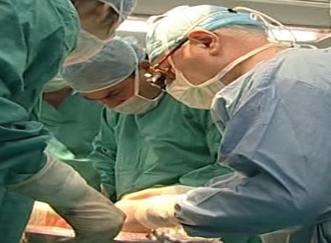
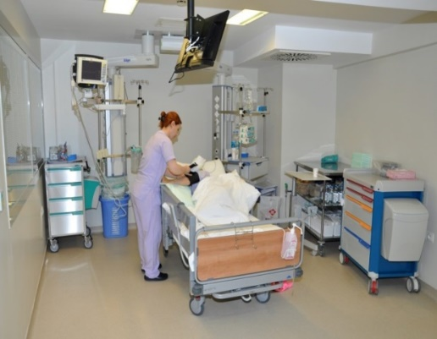
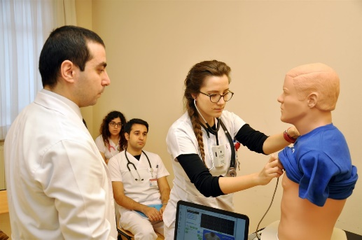
THE MAIN CONTENTS OF RESIDENCY TRAINING
Medical abilities and practice
Knowledge and core sciences based
Professionalism on attitudes and behaviors

Slide 29
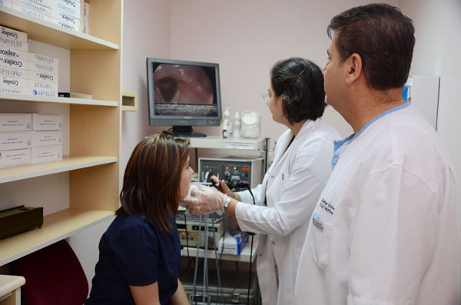
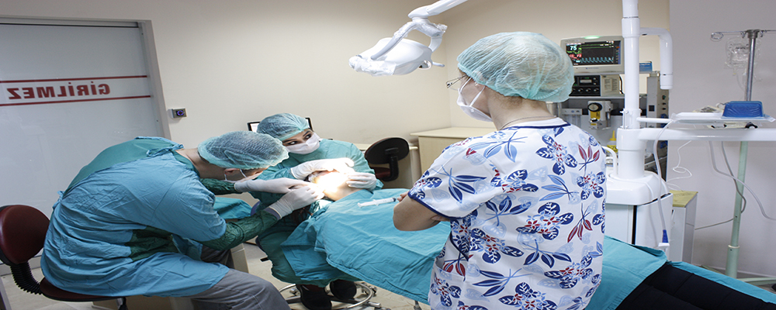
RESIDENCY TRAINING TECHNIQUES
Theoretical courses and seminars
Freelance learning and preparation
Multidisciplinary training activities
Article discussion hours
E-learning
Reflection sessions
Critical case discussions
Case studies
On the job learning

Slide 30
MEASUREMENT AND EVALUATION TECHNIQUES
Evaluation of medical practices
Evaluation of knowledge
Evaluation of Professional attitudes and behaviors
* Evaluation Sheets

Slide 31
PHASES OF RESIDENT EDUCATION
Basic Training (1-2 years)
Acquiring the basic knowledge and abilities for residency
Acquiring the knowledge and abilities on the residential field
Orientation Programs
Core education program
Certification programs of related associations

Slide 32
PHASES OF RESIDENT EDUCATION
2. Residency Training (3-4 years)
In-depth education on the related field
I. Field Education Phase: Executing the projected tasks under supervision.
II. Advanced Residency Phase: Last 1-1,5 years of education.
Trainee executes the projected tasks without supervision.

Slide 33
BLOCKS AND ROTATIONS
Modules/ Blocks: Core task list is grouped in to 6-8 blocks.
Every block has a supervisor.
Enables the integration of service
and education process.
Rotations: Executed under supervisors
Mandatory and elective rotations

Slide 34
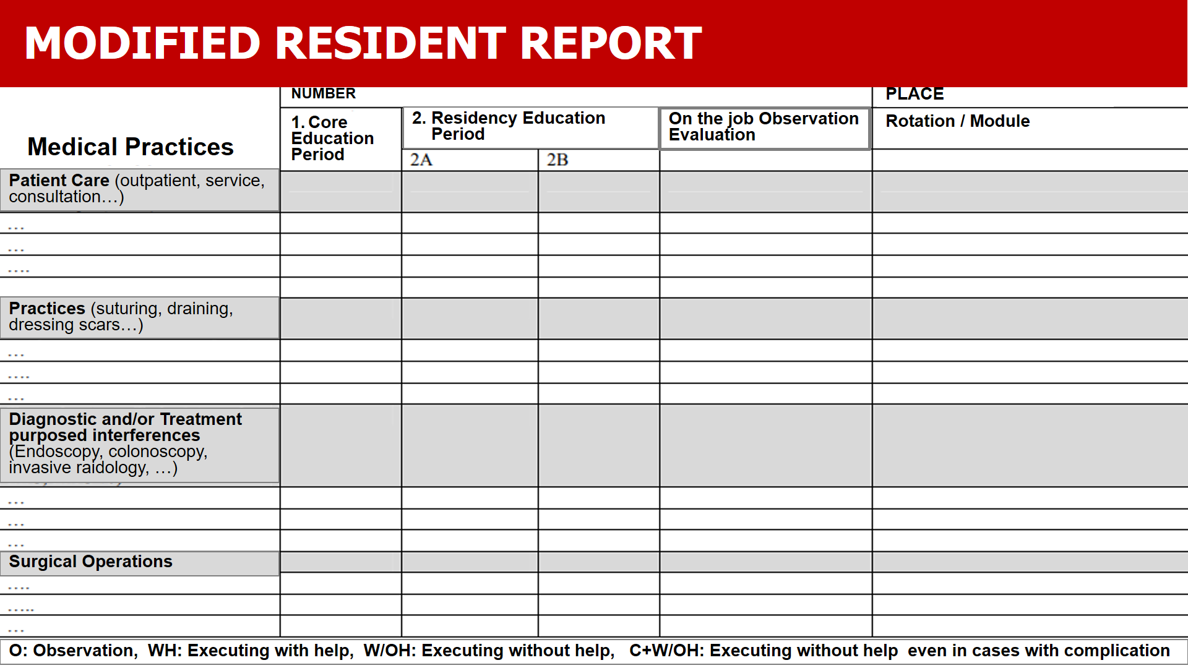

Slide 36
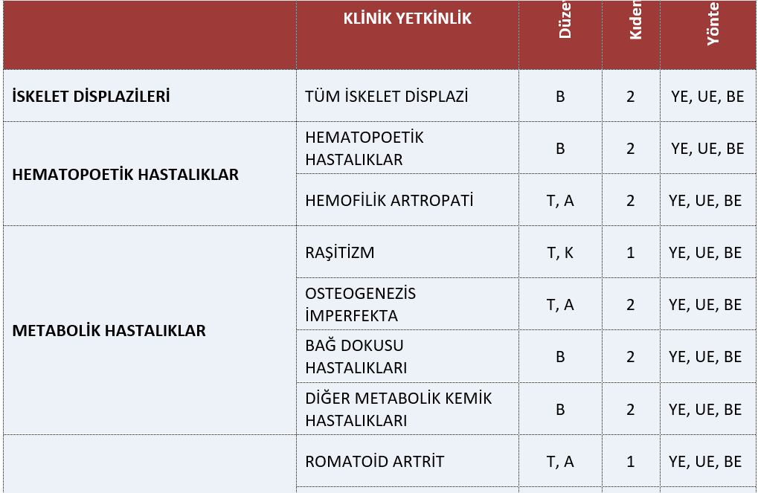
TUKMOS Sample

Slide 37
TUKMOS Sample

Slide 38
THANK YOU FOR YOUR ATTENTION
Aydan A. ÖZDEMİR MPH, Ph.D.

