Slide 1
Kazakh National Medical University named after S.D. Asfendiyarov
Module propaedeutics pediatric dentistry and orthodontics
Occupation: "5В130200-Dentistry"
Training direction "Dentist Orthodontist"
Elective course :
Prevention of dentoalveolar anomalies in children
The volume of training hours - 90 hours
Practical lessons - 30 hours
Independent work of students (IWS) - 30 hours
Independent work of students with the teacher (IWST) - 30 hours
Almaty 2015-2016 academic year

Slide 2
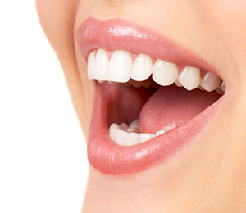
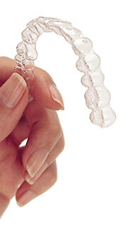
Compiled ass. Ruzdenova A.S.,
ass. Sharipova S.K.
Teacher :
professor Mamekov A.D.
Assoc. Telebaeva G.T.
ass. Ruzdenova A.S.
ass. Dosberdieva G.T.
Trainee teacher . Durumbetova M.M.
Trainee teacher . Muhamediyarova M.M.

Slide 3
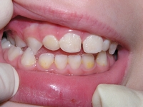
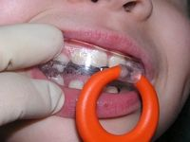
Course description: - Prevention of functional and morphological changes in the dentition. Bad habits lead to anomalies of dentition in children.Miogimnastic exercises and speech therapy for the treatment and prevention pathological bites.

Slide 4
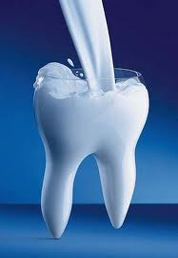
purpose of the lesson :
Cognitive knowledge | Operational (skills) | Axiological (kommun. skills) | Legal issues | Self-education
Age features of the development of dental system Dentoalveolar anomalies: types and classification Etiology dentition anomalies Methods of diagnosis of dentoalveolar anomalies | Identify morphological and functional abnormalities in various periods of development of dental system Diagnosing various types of dentoalveolar anomalies in children, use classification at diagnosis in orthodontics Identify prenatal and postnatal etiologic factors anomalies. | Ability to generate log in psychological contact with children and their parents Possess communication skills in a team and work with students Instill in students the skills of clinical work with children. | Rights and responsibilities of students and teachers Law on health care in the Republic of Kazakhstan Social policy in the Republic of Kazakhstan Organization of medical and preventive process in children's dental services Sanitary-epidemiological control in children's dental services | Independent work with additional literature and the Internet (educational, reference, regulatory, scientific). Research under the guidance of teachers in the department

Slide 5
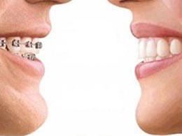
Motivating students to select this Electives :
At the workshops explored emerging symptoms and formed anomalies symptoms dysfunctions maxillodental-facial system for health education to prevent the development of persistent anomalies and deformities of the maxillofacial region, which affect a healthy lifestyle, career success, the aesthetic appearance of the face.

Slide 6
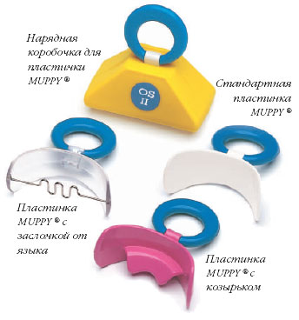
Learning objectives:
introduce basic laws of biomechanics of the masticatory apparatus;
identification of etiologic and pathogenetic factors contributing to the emergence of dentition anomalies in children;
teach manual skills of miogimnasticheskih and speech therapy exercises.

Slide 7
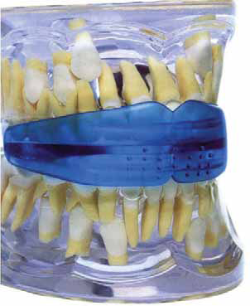
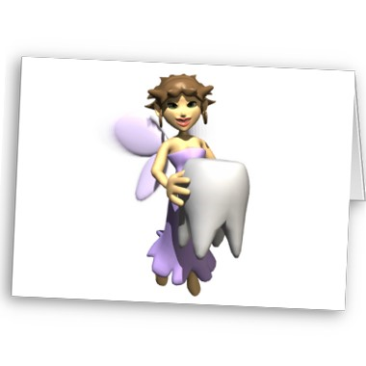
Prerequisite subjects: - normal anatomy - prevention dentistry disease. Postrekvizity discipline : - pediatric dentistry, - prosthodontics, - preventive dentistry - dental surgery

Slide 8
Thank you for your attention!

