Slide 1
Department of Operative Dentistry
Specialty - "051302 - DENT" Direction of preparation - dentist surgeon. elective Course Cycle - Features maxillofacial area; The volume of training hours - 90;

Slide 2
№ | surname | post | degree
1. | Mirzakulova Ulmeken Rahimovna | module leader | MD
2 | Tuleuov Kaldan Tuleuovich | professor | MD
3. | Rusanov Vladimr Petrovich | professor | MD
4. | Vansvanov Murat Ilyasovich | docent | Candidate of Medical Sciences
5 | Stabaeva Gulsum Seydelovna | docent | Candidate of Medical Sciences
6. | Kosmaganbetova Alma Temirhanovna | assistant | Candidate of Medical Sciences
7 | Beeman Kalbergen Seydahmetovich | assistant
8. | Talim Kakimzhan Kenzhekovich | assistant | -

Slide 3
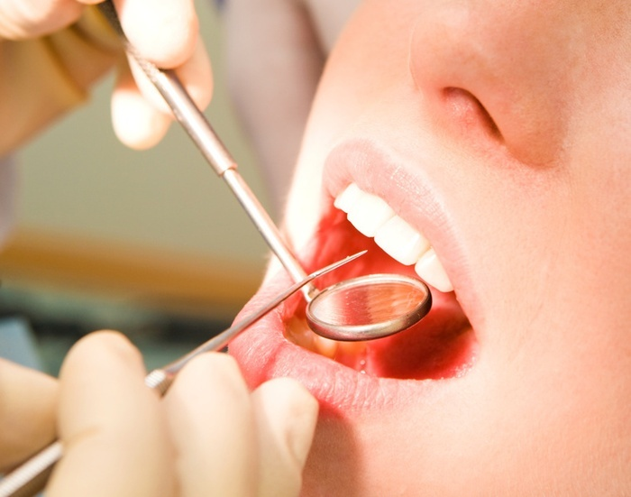
Relevance of the topic:
Elective Course "Features maxillofacial region" is a preclinical section propaedeutics surgical dentistry and surgical dentistry - a leading discipline in the preparation of specialist dental profile.

Slide 4
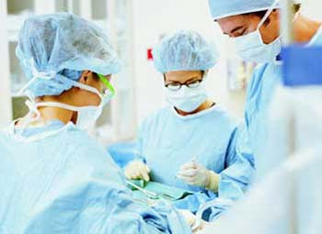
expected results
The student should know: 1.Rol course "Features maxillofacial region" in the preparation of a dentist for further study of dental surgery, therapeutic dentistry, prosthetic dentistry, pediatric dentistry.

Slide 5
2. Anatomical features of the structure of the facial bones. 3. Anatomic and topographic features of the innervation of the maxillofacial region. 4. Anatomic and topographic features of the blood supply to the maxillofacial region. 5. Anatomical and physiological features of the topography and the lymphatic system of the maxillofacial region. 6. Anatomic and topographic features of the structure of the face and neck

Slide 6
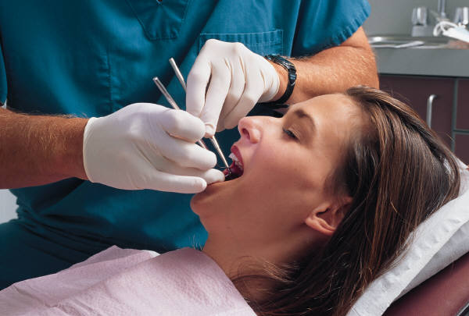
7. Anatomic and topographic features of the front and rear groups of masticatory muscles. 8. Anatomic and topographic features of facial muscles. 9. Mechanisms of fractures of the jaws. 10. Functionality TMJ. 11. Have an understanding of neuralgia, trigeminal neuropathy and facial nerve. 12. An understanding of the anatomical landmarks with local anesthesia conductor. 13.Sostav oral microbial flora in pathological processes.

Slide 7
The student should be able to:
1.Opredelyat target item using semiconductor techniques of local anesthesia. 2.Nahodit anatomical landmarks for different types of conduction anesthesia. 3.Vybirat method of local anesthesia in various pathological conditions of the maxillofacial region. 4.Provodit differential diagnosis between abscess and cellulitis.

Slide 8
5. Differential diagnosis between edema and infiltration. 6. Evaluate the results of studies of oral fluid. 7. Evaluate the results of quantitative and qualitative research gingival fluid. 8. Predict the development of the pathological process in the mouth with changes in the composition, properties, oral fluid and saliva Abuse

Slide 9
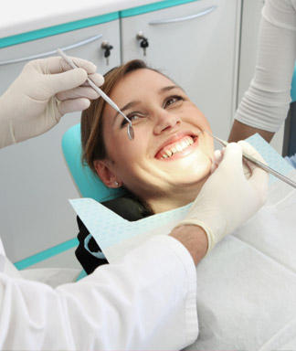
The student must have skills:
1) Select the desired dental instruments. 2) Work dental instruments. 3) Select the desired local anesthetic agents 4) interpret the results of blood count, blood chemistry in inflammatory processes and injuries of the maxillofacial region. 5) Be able to collect saliva for research.

Slide 10
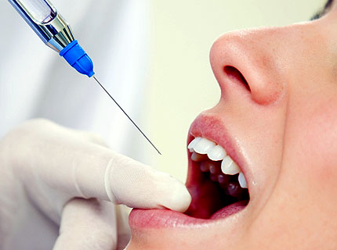
Prerequisite subjects:
Elective course "Features maxillofacial" precedes the study of anatomy, clinical anatomy of the head and neck, normal physiology, pathological physiology, pathological anatomy

Slide 11
Postrekvizity discipline:
Elective Course "features maxillofacial region" is fundamental to the study of dental surgery, pediatric dentistry, therapeutic dentistry, prosthetic dentistry.

Slide 12
Abstract discipline
Study in elective subject "Materials dental surgery" structure, device tool applied in surgical interventions in maxillofacial surgery with tooth extraction, anesthesia, surgical techniques of periodontal disease, inflammatory diseases and injuries of soft tissues and bones of the facial skeleton. Methods of sterilization. Composition, properties of the suture, osteoplastic materials.

Slide 13
THANK YOU!

