Slide 1
Department of Pediatric Dentistry
С.Ж.АСФЕНДИЯРОВ АТЫДАҒЫ ҚАЗАҚ ҰЛТТЫҚ МЕДИЦИНА УНИВЕРСИТЕТІ |  | КАЗАХСКИЙ НАЦИОНАЛЬНЫЙ МЕДИЦИНСКИЙ УНИВЕРСИТЕТ ИМЕНИ С.Д.АСФЕНДИЯРОВА
Discipline – Dentistry
Specialty - 051,302 "dentistry"
Elective course:
"Features of treatment of complicated caries permanent young (immature) teeth"

Slide 2
Discipline - Dentistry
Specialty - 051,302 "dentistry"
The amount of hours: 135:
Practical (seminar) classes - 45 hours
SRSP - 45 hours
CPC -45 hours
Course - 4
Semester - 7, 8
Form of control: examination

Slide 3
Topicality.
Treatment of permanent teeth with unformed roots is always a challenge for a dentist. This is due to the complex anatomy of the root of the unformed when the apical portion has a funnel shape. The basic principle of treatment of teeth with unformed tip of the root is the maximum long-term preservation of pulp vitality to complete the formation of the root apex.

Slide 4
Prerequisites: psychology and communication skills, histology, normal anatomy, prevention of dental diseases, propaedeutics pediatric dentistry, pediatrics, pediatric surgery
Postrekvizity: prevention of dental diseases, pediatric dentistry, preventive dentistry, oral surgery, prosthodontics, orthodontics.

Slide 5
The purpose of the elective cycle:
1) To form the cognitive skills by:
- The main stages of development and mineralization of teeth .
- Avilable temporary and permanent teeth in children of different ages.
- X-ray picture of teeth and their germs at various stages of formation.
- Characteristic radiographic changes in the tissues of growing zone, periapical tissues in complicated forms of caries in permanent teeth of children with unformed and formed roots.

Slide 6
2) Establish operational skills:
-Identifying and detailing complaints to parents and teenagers;
-Anamnesis pregnancy woman;
-Conducting and interpreting the results of inspection;
-Interpretation of the results of additional research methods;
-Treatment tactics aimed at apeksogenez and apeksofikatsiyu.
-Endodontics young teeth with pulpitis and chronic periodontitis.
-Choice of filling materials to fill the channels of young permanent teeth.
-Filling medical history, accounting -otchetnoy documentation.

Slide 7
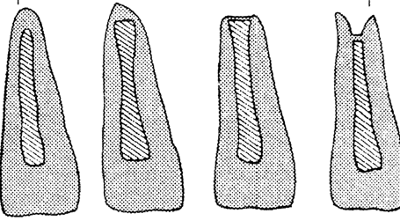
According to the results of the clinical study of AL Frank apexification the following types (Fig. 3) [3, 7]
1) the closure of the root apex of the normal form;
2) closing the root apex dome shape, whereas the root canal is shaped bell;
3) the absence of radiographic changes in the presence of symptoms of "positive stop";
4) symptoms of a "positive stop" and radiographically defined barrier at the top of the anatomical region

Slide 8
Clinical Example 1
The child is 7 years old. He appealed for continuation of treatment of tooth 46. From history: in the tooth 46 a month ago, was imposed devitaliziruyuschaya paste for chronic pulpitis. On examination, it was found partially preserved a temporary filling in the tooth 46, percussion tooth 46
painless. On radiographs of teeth 46: roots in the stage of parallel walls, resorption of cortical bone growth zone, hearth of destruction of bone tissue with fuzzy contours of 0,2 × 0,2 cm in sformirovaveysya part of the root (Fig. 4). Based on clinical and
radiological symptoms was diagnosed with chronic granulating periodontitis tooth 46. Endodontic treatment was carried out as described vyshemetodike with toothpaste «Metapex». Up visits were performed at 1 week, 1, 3, 6, 12, 24 months, and was confirmed by the clinical well-being. Substitution of calcium hydroxide paste channels was performed three times (respectively in the first three visits). On radiographs at 24 months: lack of focus mentioned enlightenment bone restoration kortikal parallel plate wells tooth 46, an increase in the length of the distal root of 1/4, medial - 1/2 and the final formation of the medial root. Root kanalybyli constantly are sealed with gutta-percha.

Slide 9
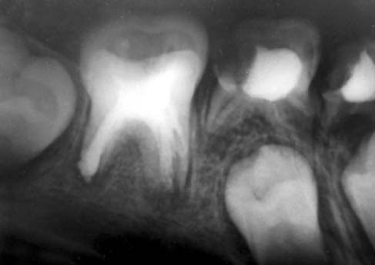
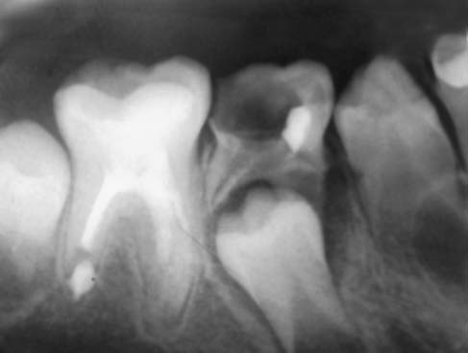
Clinical Example №1
Noting the lack of focus of enlightenment bone cortical plate recovery wells tooth 46, an increase in the length of the distal root of 1/4, medial - 1/2 and the final formation of the medial root
roots in the stage of parallel walls, resorption of cortical bone growth zone, hearth of destruction of bone tissue with no
precise contours 0,2 × 0,2 cm in forming part of the root sheysya

Slide 10
Clinical Example №2
Patient 8u years complained of a loss of luster of the tooth crown 21. From history: three months ago received a contusion of the tooth 21 during the game. To the doctor did not address. When viewed from the crown of the tooth 21 is intact, gray, percussion tooth 21 is painless. The mucosa of the tooth 21 in pink. On radiographs of teeth 21: roots in the stage of parallel walls, resorption of cortical bone growth zone. .On The basis of clinical and radiological findings diagnosed with necrosis of the pulp of a tooth 21. Endodontic treatment was carried out as described above
procedure using calcium hydroxide zameshennoy distilled water. Up visits were performed at one week, 1, 3, 6, 12, 15 months, and was confirmed by the clinical well-being. Under the same visit is conducted Replacement of calcium hydroxide paste channels. After 6 months of symptom defined "positive stop" with the introduction of an endodontic instrument in the root canal on the radiograph it was marked the beginning of formation tverdotkannogo api
Calne barrier apexification ended after 15 months from the start of treatment was confirmed clinically and radiologically. The root canal tooth 21 was constantly obturated using gutta percha.

Slide 11
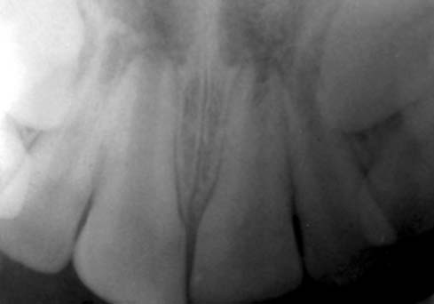
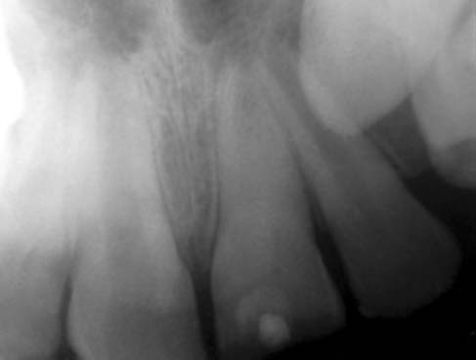
Clinical Example №2
On radiographs of teeth 21: roots in the stage of parallel walls, resorption of cortical bone growth zone
tverdotkannogo beginning of the formation of the apical barrier

Slide 12
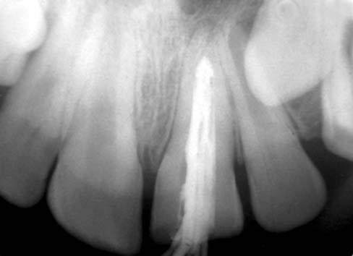
The root canal tooth 21 was constantly obturated using gutta perchevyh pins

Slide 13
Thus, the treatment of permanent teeth with incomplete root formation and pulp unsustainable in children with the use of calcium hydroxide has a probability of success and favorable long-term prognosis, minimizes the chance of complications, achieves the main result - apexification, and possibly apeksogeneza. Our clinical experience shows that in order to achieve positive results of treatment requires not only knowledge and skills of the dentist pediatrician, but also the cooperation and understanding of the parents that would ensure a successful outcome of treatment conditions.

Slide 14
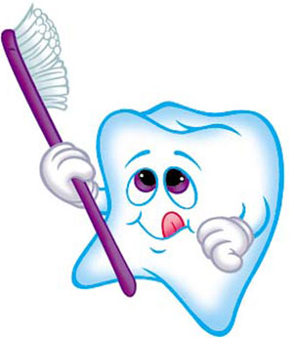
Thank you for attention!!!

