Slide 1
Leadership in the Health System and in Medical Education: Some Views

Slide 2
Leadership
Management and Leadership often used interchangeably
Growing emphasis on leadership
Important element in realizing change and innovation in medical education

Slide 3
Leading and Managing Framework
Leading
Scanning
Focussing
Aligning/mobilizing
Inspiring
Managing
Planning
Organizing
Implementing
Monitoring and evaluation

Slide 4
Leaders must be able to:
Build Trust
Manage conflict
Encourage divergent views
Build shared culture and values
Be a visionary, a champion
Be enthusiastic
Mobilize others
Cultivate creative leadership in others and be willing to share leadership
Communicate effectively

Slide 5
Key areas for development of leaders and managers in Medical Faculties
Looking to the future and promoting change
Teamwork
Conflict resolution and negotiations
Building trust and an ethical organization
Communication skills
Understanding budgeting and financial management

Slide 6
Characterizations of leadership models
Situational/Contingency
Transactional
Transformational
Psychodynamic

Slide 7
Transformational leadership
Focuses on a charismatic, motivating and empowering style of leadership & includes:
Creating & communicating a clear vision
Being a strong role model
Empowering others
Encouraging collaboration
Making people feel good about themselves

Slide 8
New Canadian Framework to Leadership in Health Care
Lead Self
Engage Others
Achieve Results
Develop Coalitions
Systems Transformation

Slide 9
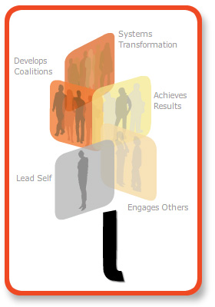
Overview of LEADS
Five domains
4 capabilities per domain
Total 20 capabilities
Behavioural descriptors at four levels
Systems
Transformation
Develop
Coalitions
Achieve
Results
Lead
Self
Engage
Others

Slide 10
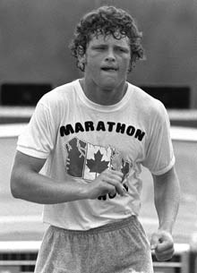
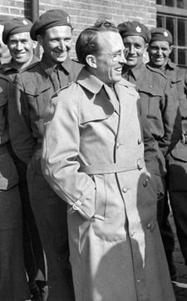
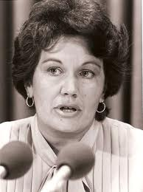
Leadership Defined
“Leadership is the capacity to influence self and others to work together to achieve a constructive purpose”.
Terry Fox
The Honourable Monique Begin
Tommy Douglas

Slide 11
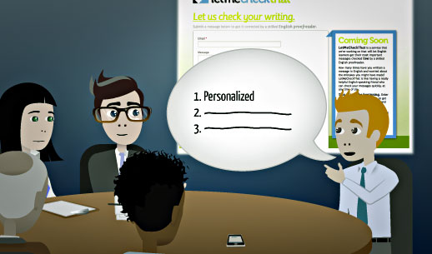
Advantages of LEADS
Pan-Canadian
By health, for health
Simple/memorable
Grounded in research
Systems-level
Change leadership
Focus on results and behaviour
Flexible re implementation
Capabilities
LEADS has
many
advantages
Notes:
Slide 17
LEADS as a construct has the attributes outlined on this slide. It is for these reasons that the framework has been so positively received within the Canadian health sector.
11

Slide 12
The LEADS Change Model
Future state
Outcomes
Achieve
Results
Engage
Others
Personal Processes
Relationships
Develop
Coalitions
Strategic Processes
Current
State
Lead
Self
Systems
Transformation
Change Dynamics

Slide 13
Systems Transformation Capabilities
Successful Leaders…
Demonstrate systems/ critical thinking
Encourage and support innovation
Orient themselves strategically to the future
Champion and orchestrate change
(LEADS)

Slide 14
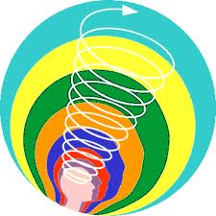
The LEADS model in action
Engage others
Achieve
Results
Achieve
Results
Develop
Coalitions
Lead
Self
Lead
Self
Achieve
Results
Achieve
Results
System
Trans
For-
mation

Slide 15
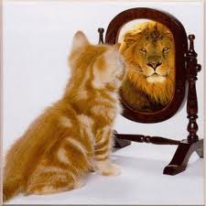
Lead Self
Self-Motivated Leaders….
Are self aware
Manage themselves
Demonstrate character
Develop themselves

Slide 16
Research required
It is suggested that the Republic of Kazakhstan
conduct research on leadership in health care and develop its own model of required capabilities.
All health care systems require strong leaders with appropriate capabilities

Slide 17
Acknowledgements
Ellen.melis@unlimited-potential.ca
btholl@chlnet.ca
Naomi.Chambers@mbs.ac.uk. et. al.

