Slide 1
Innovations in Public Health Education at UNMC-COPH
Chandran Achutan, PhD,
Assistant Professor
December 2, 2011
Almaty, Kazakhstan

Slide 2
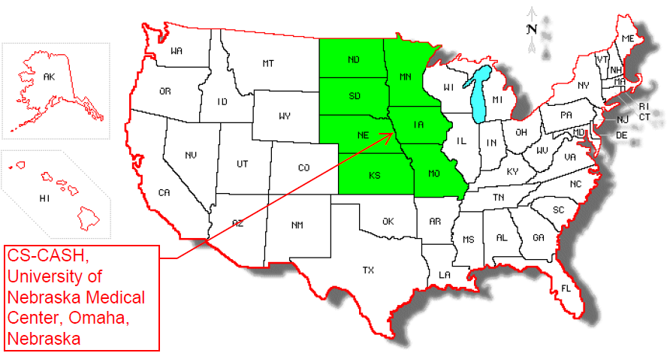
Nebraska

Slide 3
College of Public Health at UNMC
Accredited School of Public Health
5 departments
Biostatistics
Epidemiology
Environmental & Occupational Health
Health Promotion
Health Services Administration
50 faculty; 150 students
Academic programs:
MPH certificate
MPH degree
Doctoral degrees

Slide 4
Teaching through Research
Discuss concepts through scientific journal articles
Conduct field investigations
Various centers on campus provide students with research experience

Slide 5
Distance Education
Popular among traditional students
Either synchronized or a synchronized mode
http://unmcconnect.adobeconnect.com/p2kwn6xhpmd/

Slide 6
cachutan@unmc.edu

