Slide 1
Trends in Higher Education
Presentation to the
Kazakh National Medical University named after S.D.Asfendiyarov
Shigeo Katsu
President
Nazarbayev University
December 2, 2011

Slide 2
Outline of Presentation
Why education and skills, and in particular higher education is important
Importance for Kazakhstan within framework of “Asia 2050”
Trends in Higher Education and import for Kazakhstan – with emphasis on research universities
Nazarbayev University and its role in promoting research universities in Kazakhstan

Slide 3
Importance of Education
Education (from ECD to tertiary education), skills, and research capabilities are increasingly tied to countries’ abilities to generate economic growth and sustain it:
“a well educated population is essential for economic and social development; societies therefore have a real interest in ensuring that children and adults have access to a wide range of educational opportunities” (OECD 2011)
“good education lies at the heart of economic growth and development” (World Bank, 2011)
But important to note that we talk about quality education leading to acquisition of skills relevant to today’s world

Slide 4
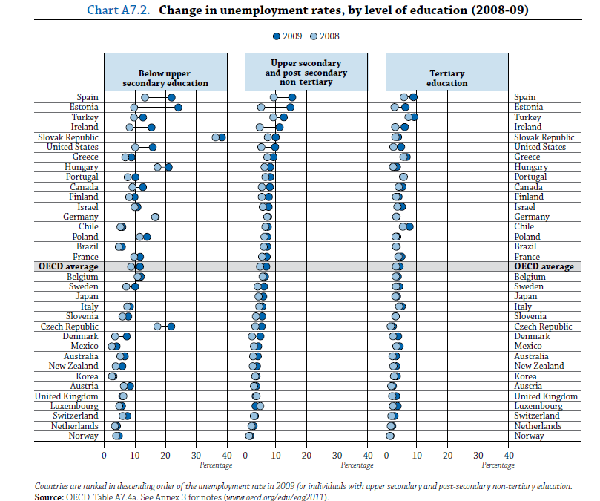
Importance of Education – unemployment statistics in OECD countries

Slide 5
Importance of Education
Some socio-economic evidence from OECD countries:
Unemployment rates among secondary school drop-outs was 11.5% on avg. vs. 4.4% for university graduates (in 2009 – i.e. during crisis), adding to huge problem of youth unemployment ( > 17% in 2010)
“Cost to individuals and to society of young people leaving schools without qualifications keeps rising” (OECD SG A. Gurria) (>50% of 15-19 year olds outside of schools are out of work) => spectre of “lost generation”
Governments need to invest in education even in difficult fiscal times: it’s about the future

Slide 6
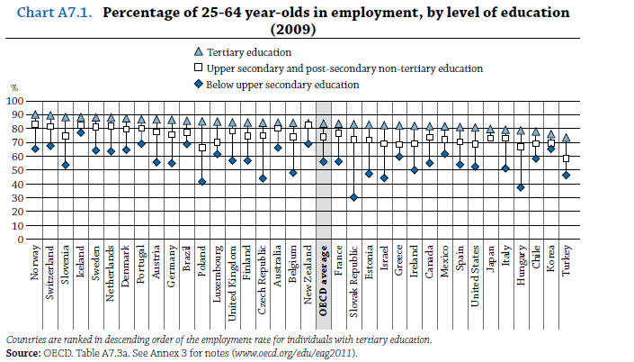
Importance of Higher (Tertiary) Education
Higher education improves job prospects (tertiary graduates are more likely to be in work: 84% vs. 74% for upper secondary); tertiary education graduates are less likely to rely on unemployment benefits / welfare assistance and pay more taxes --- similar outcomes have also been observed in Kazakhstan

Slide 7
How much do OECD countries spend on Education?
Countries collectively spent 6.1% of GDP on education (2008), an increase of about 1/3 over 2000, with tertiary education accounting for 1.9% of combined GDP (Canada, Chile, Korea, Norway, and USA spent between 2.0 and 2.7%), and tertiary education spending keeping at least pace with GDP growth in all but 3 countries ---the corresponding numbers for Kazakhstan are 4.2% (2011), and tertiary education 0.4% (2010)
Countries spent 12.9% of total public expenditures on education (2008), ranging from <1O% (Czech Republic, Italy, Japan) to >20% (Mexico), on average at a ratio of 1 : 3 between tertiary and all other forms of education (ratios vary depending on the private share of higher education)
Private funding(households, businesses, other) in tertiary education ranged from less than 5% (Denmark, Finland, Norway) to more than 40% (Australia, Canada, Israel, Japan, UK, USA), and even over 75% (Chile, Korea)
R&D in tertiary education accounts for about 0.4% of GDP, with higher shares in the USA, Canada, UK, Switzerland, and Nordic countries --- in Kazakhstan, total R&D expenditures are less than ¼ percent of GDP, though slated to grow to 1% by 2015

Slide 8
Importance of Higher (Tertiary) Education
Some socio-economic evidence from OECD countries:
The earnings premium for tertiary education on average exceeds 50% compared with non-tertiary education and has in most countries been rising over the last 10 years (D > S)
Gross earnings premium (in present value ) for an individual with tertiary degree exceeds US$ 300 K (men), US$ 200 K (women)
Net financial return (in present value), i.e. private benefits (increased lifetime earnings) minus private costs (tuition fees and foregone earnings) are for women in the order of US$ 110 K, and for men close to US$175

Slide 9
Importance of Measuring Education Outcomes (1)
PISA (OECD’s Programme for International Student Assessment) measures the quality, equity, and efficiency of school systems around the world (some 65 countries and regions):
Held every three years, most recent round in 2009
Assesses performance of 15 year olds, in reading, mathematics, and science
The results are of concern for CIS countries in general, including for Kazakhstan:
A large proportion of 15 year olds have such poor numeracy and literacy skills that their success in the modern workplace is highly doubtful (while primary level – grade 4 assessments are positive)
As to fundamental cognitive skills, CIS education systems are adept at imparting basic skills, but not at higher order skills such as problem solving -- these are the skills sought by employers

Slide 10
Importance of Measuring Education Outcomes (2)
No PISA-equivalent assessment program exists for higher education; OECD is about to launch AHELO = Assessment of Higher Education Learning Outcomes, to provide cross-country comparative data on the relevance and quality of teaching and learning outcomes in higher education
Assessment areas:
Generic skills such as critical thinking, analytical reasoning, problem solving, written communication
Discipline-specific skills (economics and engineering)
Contextual information (to link data to student background and learning environment)
Status:
Feasibility study is ongoing – testing instruments have been developed, they will be administered in about 150 institutions in 16 participating pilot countries (end 2011/beginning 2012), final evaluation of feasibility study by end 2012 to decide whether to roll out
=> Of interest for Kazakhstan

Slide 11
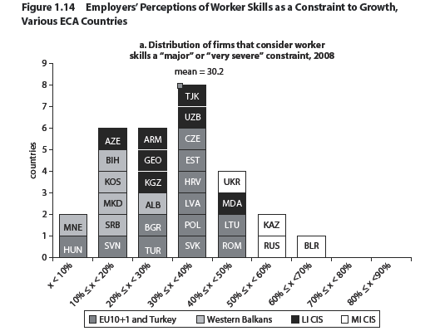
Why Acquiring Relevant Skills Matters: Skills as Constraints to Growth

Slide 12
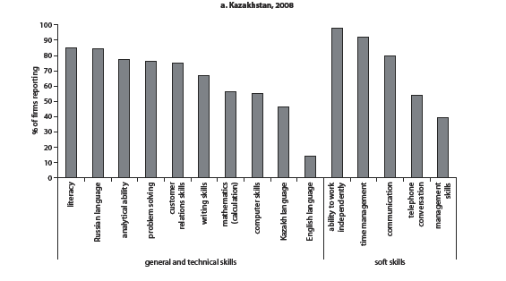
Why Acquiring Relevant Skills Matters: Employers’ Valuation of Workers’ Knowledge and Skills

Slide 13
Now, let’s look at some additional indications of why education is important

Slide 15
Asia 2050 – Realizing the Asian Century….. or
By 2050 Asia could account for more than half of global trade, investment and GDP
Asia’s per capita income is up sixfold. Three billion additional Asian’s would be affluent by today’s standards
Asia regains its global economic position of 250 years ago; and there would be no poor country
GDP per capita in PPP terms would be up to $40,900 in 2050
Asia accounts for 52.2 % ($175 trillion) of global GDP ($334 trillion in market ER)

Slide 16
…..Asia 2050 – Mired in the Middle Income Trap
Countries stuck in MIT – Countries enjoy short periods of growth followed by stagnation or even decline – stuck at low growth rates
GDP per capita in PPP terms would be $20,600 in 2050, i.e. only half of that of the Asian Century scenario
Asia accounts for 31 % ($65 trillion) of global GDP ($209 trillion), i.e. just 37 % of that of the Asian Century scenario; global GDP in this scenario would only be 63% of the one under the Asian Century

Slide 17
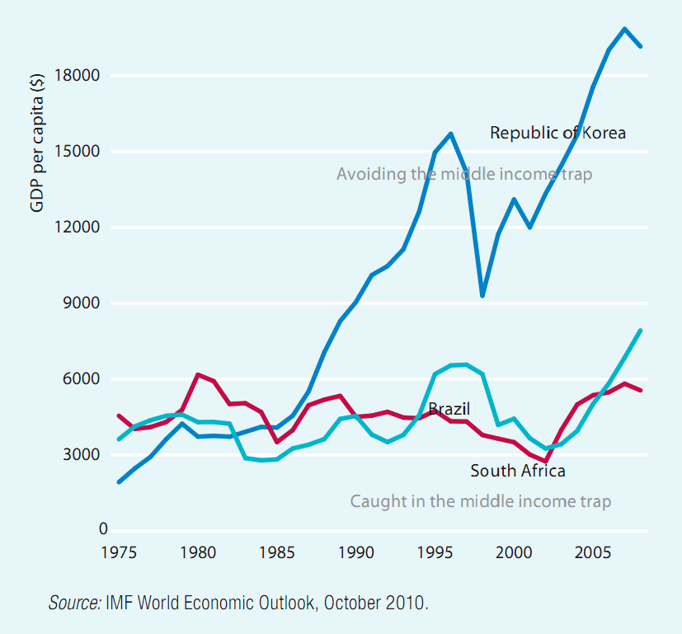
Middle Income Trap
Notes:
The Middle Income Trap refers to countries stagnating and not growing to advanced country levels. This is illustrated in the figure which plots the per capita incomes of three middle income countries between 1975 and 2005. In a steadily growing economy, the per capita GDP would rise continuously over time, towards higher income. This is the experience of the Republic of Korea. But many MICs do not follow this pattern. Instead, they have short periods of growth followed by stagnation of even decline, or are stuck at low growth rates. They are caught in the Middle Income Trap -- unable to compete with low income economies in manufacturing or with advanced economies in high skill innovations. Put another way, such countries cannot make a timely transition from resource-driven growth with low cost labor and capital to productivity driven growth.

Slide 18
Asia 2050: Six Mega-Challenges
The report points to six mega-challenges:
Inequalities within countries that could undermine social cohesion
Some big countries could fall into the MIT
Competition for natural resources will be intense
Disparities across countries and subregions could add to instability
Climate change could threaten agricultural production and coastal populations
Governance and institutional capacity where all Asian countries have to improve

Slide 19
Asia 2050: National, Global, and Regional Agenda
National Agenda:
Achieve growth with inclusion and equity
Transform finance
Manage massive urbanization
Radically reduce energy and natural resource use
Unleash entrepreneurship and innovation
Improve institutions and governance
Move to policies promoting social well-being
Global Agenda:
Take ownership of the global commons: open trade, stable financial system, climate change, peace and security
Participate actively and constructively in the formulation of global rules
Act as and be seen as a responsible global citizen
Manage its changing role in global governance in a non-assertive and constructive manner
Regional Agenda:
Allow unhindered flow of trade and investments throughout the region
Implement development assistance to reduce cross-country disparities
Manage regional commons including maritime security and disaster preparedness
Harmonize geopolitical position on global issues
Develop own model of regional cooperation: market-driven, bottom-up and pragmatic
Avoid conflict to maintain social and political stability

Slide 20
Two Scenarios for CAREC Countries
Asian Century Scenario Middle Income Trap Scenario
Source: Centennial Group, 2011
Notes:
Asian Century Scenario: Shares of Asian GDP
Afghanistan: <1%
Azerbaijan: <1%
Kazakhstan: <1%
Kyrgyz Republic: <1%
Mongolia: <1%
Pakistan: <1%
Tajikistan: <1%
Uzbekistan: <1%
China: 39%
Middle Income Trap Scenario: Shares of Asian GDP
Afghanistan: <1%
Azerbaijan: <1%
Kazakhstan: 1.2%
Kyrgyz Republic: <1%
Mongolia: <1%
Pakistan: 1.5%
Tajikistan: <1%
Uzbekistan: <1%
China: 30%
Note the cumulative difference for the CAREC countries (we leave aside PRC) – $4.5 trillion vs. $2.5 trillion in 2050 – the gap is not so big in 2020 as the cumulative effect of being “stuck” shows up mostly after 2020. In either scenario, the share of the CAREC 9 in Asia’s GDP is small, 3 or 4 %.

Slide 21
Asia 2050 – Drivers of Growth and Development Outcomes, and keys to avoid the Middle Income Trap
Total Factor Productivity
Growth in capital stock
Population and labor force
Business environment
Urbanization
Emerging middle class as driver for change
Attainment of Millennium Development Goals
Income distribution (reduce inequality)
Education
Governance and institutions reforms (“MPH”+I+H)
=>Building a knowledge economy

Slide 22
Kazakhstan and 2020 /2050 – the Challenges
TFP still lagging behind: How to close gap with e.g. USA (lag by 40 years)
Capital Stock: in Kazakhstan, over the last 20 years, growth in capital/labor ratio has been between 2-3%/year, compared with 5-6% in many ASEAN countries, and 8-9% in China, India, Vietnam; CAREC will be had pressed to close gap with rest of Asia
Population and labor force: challenge of creating employment (diversification); stabilizing labor force over the next decade, implying aging population by 2030
Business environment: good progress overall, now in the top 50 according to “Doing Business 2012” (World Bank), but challenges in property rights and judicial reforms
Urbanization and middle class: a key driver – demands for increased quality of life and voice will grow, challenges include investments in urban and rural infrastructure and services, institutions will matter more and more
MDGs: slow on reducing child mortality rates, combating HIV/AIDS and other diseases, and ensuring environmental sustainability
Inequality: absence of data is unfortunate, need more research
Education and skills: systematically collect and analyze data on learning and employment outcomes; introduce autonomy and accountability of school systems and embrace performance –oriented management instead of input –oriented compliance monitoring systems; improve efficiency of financial resource use
Governance and institutions: key enabler for meeting above challenges and to build a knowledge economy

Slide 23
Trends in Higher Education – the Challenges of building a World Class Research University (1)
(key messages from a recent (2011) World Bank research publication:
“The Road to Academic Excellence - The Making of World-Class Research Universities”)
New institutions can have an easier path than existing ones,
But even so, it will at least take several decades
Three key factors have to be aligned from the beginning and maintained over a long period:
Talent; resources; governance
New research universities need to present a convincing alternative to existing institutions – easier with specialization
Success is fragile and entirely dependent on continued existence of the 3 key factors
Research universities do not operate in a vacuum – the tertiary education ecosystem is vital: enabling public policy framework ( the three essential factors), plus vision and leadership at the national level, implementation capacity, accountability mechanism (goes together with good governance), quality assurance framework (accreditation and benchmarking), location, IT infrastructure, communication links to the secondary school system, and balancing technical skills and methodological rigor with ethical values

Slide 24
Trends in Higher Education – the Challenges of building a World Class Research University (2)
(Philip Altbach, from the same WB publication)
Why research universities? Because they
stand at the center of the 21st century global knowledge economy and technology-intensive society
are the key link between global science and scholarship and a nation’s scientific and knowledge system
produce much of the new information and analysis that lead to important advancements in science and technology, but as importantly, but also to better understanding of the human condition through the social sciences and humanities
The best research universities are both
national institutions that contribute to culture, technology, and society; and
international institutions that link to global intellectual and scientific trends
They are elite , complex institutions with multiple academic and societal roles
Because of what they stand for, international competition is intense, and the race is on to build great research universities
Nazarbayev University, created in 2010, is Kazakhstan’s entry into this global race.

Slide 25
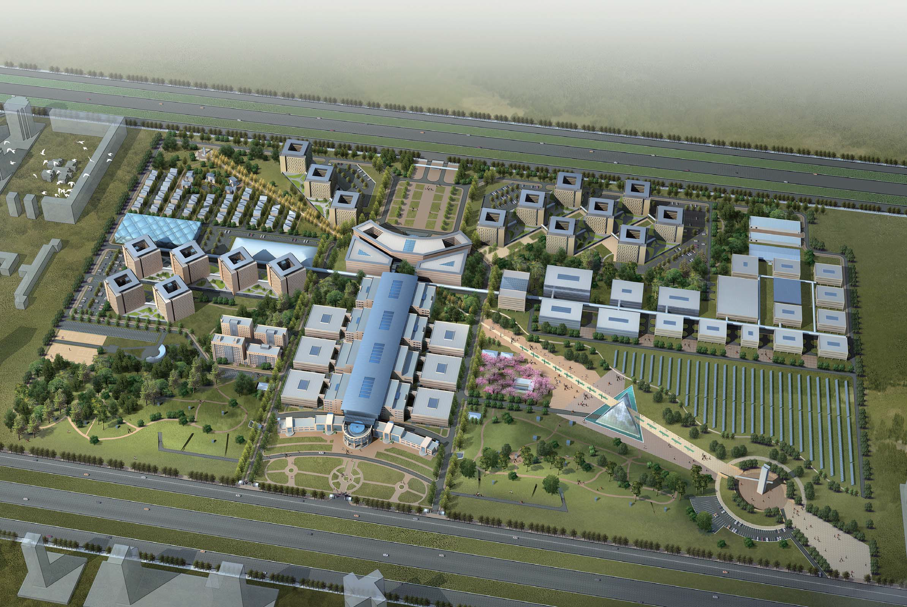
Nazarbayev University

Slide 26
Nazarbayev University: Profile and Directions (1)
Vision – a “western” style global standard research university, fittingly located in Astana which is to become a Eurasian education and research hub
Mission – educate tomorrow’s leaders of Kazakhstan in engineering, science & technology, and other areas; contribute to Astana becoming the education and research hub for the region; and become a model for other universities in Kazakhstan
Legal framework: Special NU law (effective February 2011); status as not-for-profit autonomous institution for education purposes; academic freedom and institutional autonomy formally enshrined; board of trustees system;
Institutional Development model – enter into extensive partnership with top-level international universities and research institutions; 11 main partnerships to date

Slide 27
Nazarbayev University: Profile and Directions (2)
Status today:
Foundation Program (managed entirely by UCL) – since Sept. 2010
3 Undergraduate Schools (Engineering; Science & Technology; Humanities & Social Sciences- since August 2011
Total faculty (Foundation Program and 3 Undergraduate Schools) – approx. 150
4 Research Centers (Energy Research, Instrumentation, Life Sciences, Education Policy – total of some 100 researchers) and 30+ labs
Some 15 seed projects under way, with State financing, plus research that faculty has brought along
A number of international research conferences hosted (nuclear energy; accounting and auditing; regenerative medicine and healthy aging; and education trends)
Executive education courses operated for (i) SME owners and managers – 210 participants, 22 graduates on whom we conferred NU alumni status – our first alumni; this program is part of the Kazakhstan 2020 strategy (“Road Map”); and (ii) senior government officials – two courses so far, addressed at vice-minister level
Professional Development Program for 100 future teachers of NIS (11 month certificate course – ongoing)
Nazarbayev Fund (endowment fund) established
National Medical Holding restructuring under way

Slide 28
Nazarbayev University: Profile and Directions (3)
Plans for 2012
Establish 2 professional graduate schools:
School for business – start with an Executive MBA program
School for public policy
Welcome another 500 students to Foundation Program (Cohort 3)
Increase the number of international students (we currently have 1)
Implement NU research framework
NU faculty to fully engage in research; students to be initiated in research
Establish student career counseling services
“Socio-Economic Development Institute” (working title) to be established, including a Center for Eurasian Studies
Continue with executive education and PDP programs
Host research conferences (e.g. Education – August 23&24)
Obtain JCI accreditation for at least one of NMH’s hospitals
Work on the establishment of a cultural center
Phase II Construction under way
Pursue more and diversified sponsorship

Slide 29
New system of research governance and financing was established at NU as research university
Governance
Grant application
Peer Review
Approval
Central Research Office
Research Council
School of Engineering
Faculty and researchers submit their applications which go through external peer review based on the review results approved by Research Council and forwarded for funding
Internal funding (NU Funds)
Researchers
School of Science and Technology
Center for Energy Research
External funding
(MES grants and others)
Center for Life Sciences
Interdisciplinary Instrumentation Center
Research projects funding

Slide 30
Nazarbayev University: Profile and Directions (4)
Plans for 2013
Establish a Graduate School of Education
Operate graduate schools of business and public policy
Welcome at least some 500 new students to NU’s FP/U-G schools
Further diversify student body
Launch student (and faculty) exchanges with international universities
Intensify alumni-relations
Continue to offer executive education and PDP courses
Intensify research and conference activities
JCI accreditation for at least another 2 NMH hospitals
Phase II construction advanced; launch Phase III construction
Pursue diversified sponsorship

Slide 31
Nazarbayev University: Profile and Directions (5)
Plans for 2014
Class of 2014 – first graduates from School of Engineering
Establish Graduate School of Engineering
Finalize establishment preparations for NU School of Medicine
Further scale up all activities mentioned in preceding year
Plans for 2015
Class of 2015 – first graduates from Schools of Science and Technology, and School of Humanities and Social Sciences, together with Cohort 2 of School of Engineering
Establish Graduate Schools of Science and Technology, and Humanities and Social Sciences
Open NU School of Medicine and initiate NU’s integrated academic health care system (teaching, research, and clinical practice) under “Nazarbayev Medicine” brand
Further scale up all activities mentioned in preceding year

Slide 32
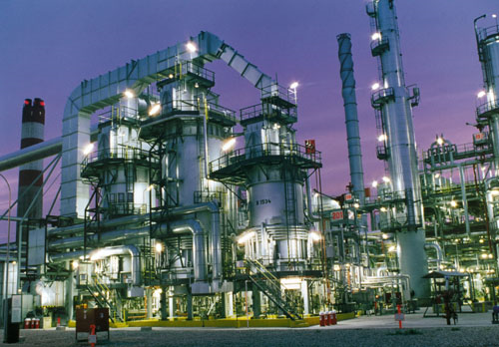
Future Ecosystem of Nazarbayev University
Research outcomes
- Venture capital
- Joint laboratories
- Commercialization,
IP rights Office
Industry
SCIENCE
PPP
MARKET

Slide 33
Thank you for your attention!

