Slide 1
Environmental Health:
Risk Assessment and Risk Management
Michael Brody, PhD
Senior Environmental Scientist
2 December 2011
Almaty, Kazakhstan

Slide 2

Пенсильвания, США, 35 лет назад
(The air is no longer dirty there)

Slide 3
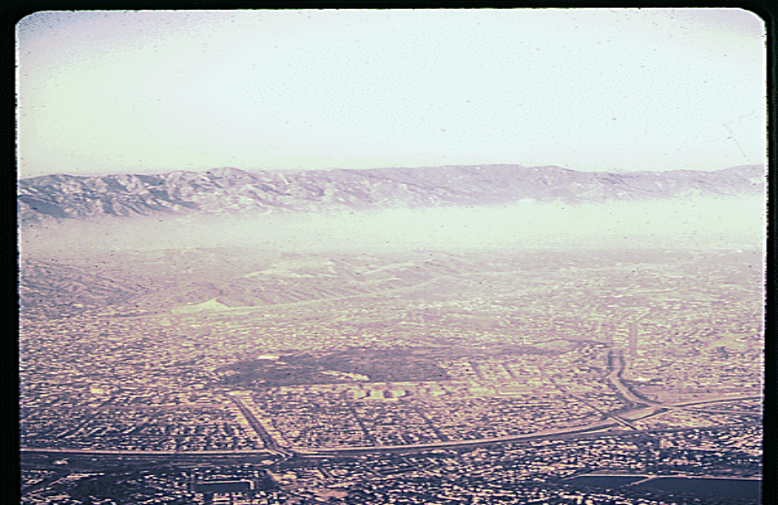
Лос-Анжелес 35 лет назад
(the air is much cleaner now)

Slide 4
World Health Organization http://www.who.int/mediacentre/factsheets/fs313/en/index.html
“Air pollution is a major environmental risk to health. By reducing air pollution levels, we can help countries reduce the global burden of disease from respiratory infections, heart disease, and lung cancer. “
“PM (particulate matter) affects more people than any other pollutant”

Slide 5
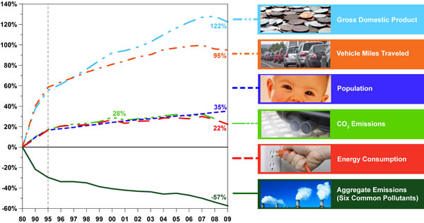
Emissions – USA- 1980-2009
(compared to growth areas)

Slide 6
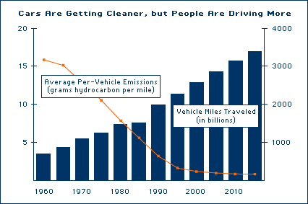
US Transportation Trends:
Demographics & Technology
(Source: US EPA, OTAQ http://www.epa.gov/otaq/invntory/overview/vmt.htm)

Slide 7
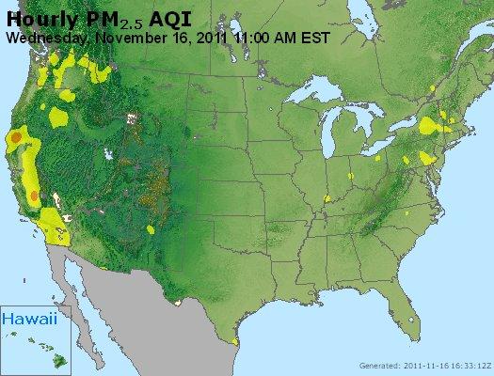
Real Time Monitoring
Частицы в США www.airnow.gov

Slide 8
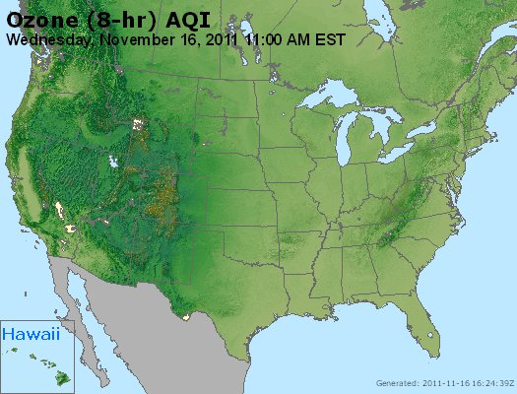
Real Time Monitoring
Озон в США www.airnow.gov

Slide 9
USA 1990 Clean Air Act Protects Public Health
(in addition to benefits from 1970 & 1977 legislation) http://www.epa.gov/cleanairactbenefits/
In 2010 - reductions in fine particles and ozone pollution prevented more than:
  160,000 cases of premature mortality
  130,000 heart attacks
  13 million lost work days
  1.7 million asthma attacks
In 2020, the benefits will be even greater, preventing more than:
  230,000 cases of premature mortality
  200,000 heart attacks
  17 million lost work days
  2.4 million asthma attacks

Slide 10
Risk Assessment & Risk Management
Risk Assessment provides practical information to guide the reduction of emissions
We carry out risk assessment to support management of risks
  not for the sake of science
Emissions can be significantly reduced, with these 2 principles in mind

Slide 11
Setting Environmental Priorities
Health Effects of Pollution
Risk Assessment – Identify The Most Significant Pollution
  Multiple pollutants from multiple sources
    Identify those that can cause the most harm
    Identify the most important sources
    Identify the highest exposures
  Rank pollutants based on health and environmental risks
Economic Analysis
  Benefits and costs of addressing risks
Notes:
11

Slide 12
Risk Assessment Requirements
Accurate Exposure Information:
  What pollutants are being emitted?
  How much is being emitted?
  What is their concentration in air and water?
Health Effects From The Pollutants:
  Are they carcinogens?
  What are health effects from short- and long-term exposure?

Slide 13
Risk Assessment Requirements
Exposure Information Is Site-specific
Concentrations Of Pollutants
  Compare to health safety standards
  Compare to cancer potency curves
Health Information On Pollutants Is Available From Different Sources

Slide 14
How Is Risk Information Different From An Epidemiology Study?
Risk - comparisons of exposure concentrations with health standards - predictions of future health effects that could be avoided
Epidemiology identifies effects from past exposures – they can help identify health effects from pollutants.
Risk assessments are used to regulate allowable emissions into air, water, waste and land.

Slide 15
Risk Assessment Summary
Accurate Site-specific Exposure Information:
  What pollutants are being emitted and in what quantities?
  What is their concentration in air and water?
Building The Emissions Inventory Will Be Critical
Health Effects From The Pollutants:
  Health and toxicity information on pollutants is already available from multiple sources
Risk Assessment Can Be The Foundation For Many Regulations Of Emissions

Slide 16
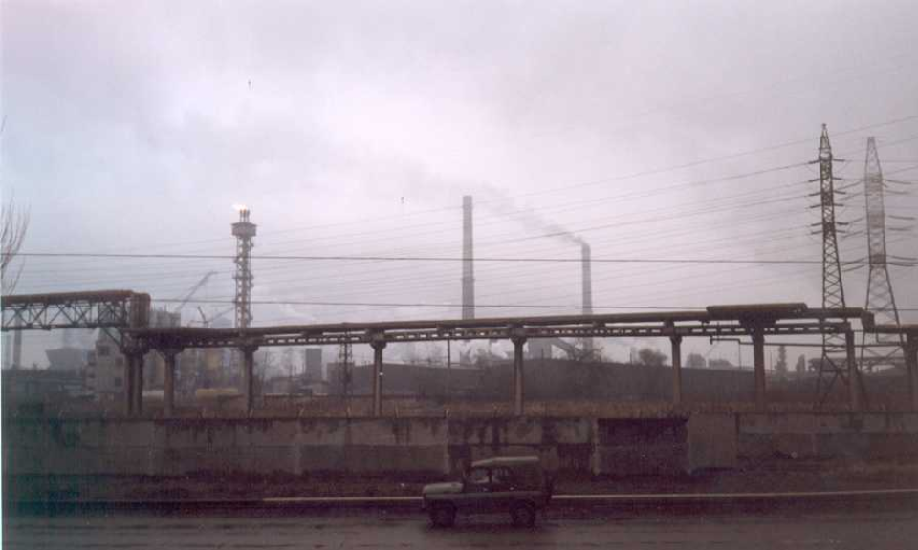
Запороже, Украйна

Slide 17
Zaporozhia, Ukraine
Typical Environmental Situation in a Former Soviet Country
Hundreds of Priority Chemicals
Compliance with only 5 – 10
How to Make Progress to Reduce Pollution?

Slide 18
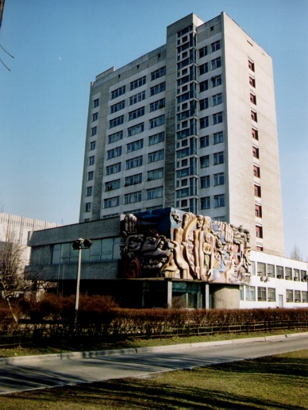
Institute of Hygiene and Medical Ecology
Academy of medical Sciences of Ukraine
Kyiv
Human Health Risk Assessment and Management in Ukraine
Center of Environmental Health Risk Assessment (CEHRA)

Slide 19
Implementing Human Health Risk Assessment In Ukraine
2 Stage Process
  3 facilities
  32 facilities
Key Players
  State Administration of Environment and Natural Resources
  Sanitary and Epidemiological Station
  Local authorities
  Center of Environmental Health Risk Assessment (CEHRA)
  World Bank, Kyiv Office

Slide 20
Characterizing Facility Emissions
Emissions Inventory
Identifying Substances
Identifying Emission Sources
Estimating Concentrations

Slide 21
Emission Inventory
Sources and Pollutants
Exposure Is Site-specific And Usually The Most Difficult Part Of The Analysis
  State Statistical Forms
  Permitted Atmospheric Emissions
Use of Air Dispersion Models
  Approved Ukrainian (former Soviet)
  Experimentation with models from other countries

Slide 22
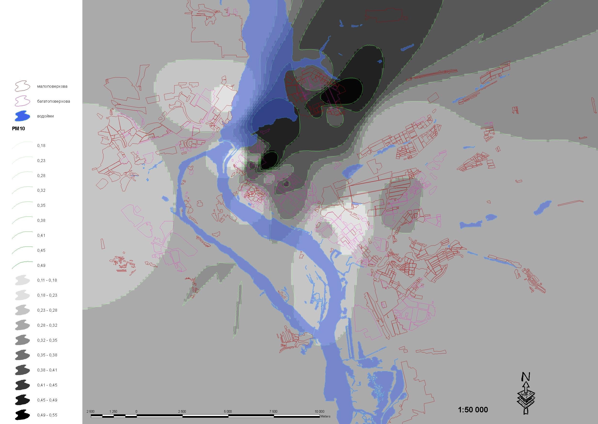
Estimating substances concentrations: example media concentration TSP

Slide 23
Cases of Additional Mortality from PM10
Population in Zapo – 834,800
Annual mortality 11,700
Mortality/1000 = 14,0
Excess of the mortality - 0,6% / 10 μg/m3
Individual risk Q = 8,4 E-5 /10 μg/m3 or 8,4 E-6 /1 μg/m3 PM 10
Receptor point | C (TSP) | C (PM10) | IRM* | Population | AM (PM10) **
1 | 0,33 | 0,18 | 0,001512 | 52958 | 80,07
2 | 0,42 | 0,23 | 0,001932 | 62146 | 120,07
3 | 0,51 | 0,28 | 0,002352 | 323963 | 762
4 | 0,58 | 0,32 | 0,002688 | 144292 | 387,86
5 | 0,64 | 0,35 | 0,00294 | 61695 | 181,38
6 | 0,69 | 0,38 | 0,003192 | 78978 | 252,1
7 | 0,74 | 0,41 | 0,003444 | 57280 | 197,27
8 | 0,81 | 0,45 | 0,00378 | 21849 | 82,59
9 | 0,89 | 0,49 | 0,004116 | 31639 | 130,2
Σ |  |  |  | 828000 | 2193,54

Slide 24
The Challenge for Risk Management
Reach Achievable, Environmental Goals At Lowest Possible Cost;
  A few conventional pollutants (e.g. PM, SO₂ and NO_{x}) are often the major source of risk;
  A small number of facilities may be the source of a large percentage of that risk;
  Introduce market based instruments such as emission trading;
Build Compromise Among Stakeholders;
Communicate The Benefits Of Environmental Policy By Using Indicators Such As Avoided Risk.

Slide 25
The Challenge for Risk Management
Convince Decision-makers That Environmental Damages May Be A Barrier To Steady Economic Growth;
  Based on annual health costs of air pollution
  Annual mortality risk attributed to air pollution in Ukraine estimated at 27,000
Need Development Of Monitoring, Reporting And Analysis Of Particulate Matter – PM2.5
Need Improved Economic Methods and Analyses

Slide 26
Cost-Benefit or
Cost-Effectiveness Analysis?
Cost-benefit Analysis To Define The Scope Of The Overall Discussion;
Emission Targets Are Always The Result Of Compromise;
Cost-effectiveness Analysis Used To Select The Regulatory Strategy.

Slide 27
Economic Considerations In Ukraine
The cost of air pollution-related premature mortality in Ukraine was estimated to be in the neighborhood of 4% of GDP
  EU only about 2% GDP;
30-40% of air pollution related mortality risk might be prevented by low-cost options;
Need a robust policy response to the health and economic significance of the mortality levels;
First identify no-regret and low cost policies;

Slide 28
Modern Environmental Policy
Science-based Decision-making
  Risk assessment and benefit-cost analysis
Transparency
  Goals, objectives, rationale and strategies available to the public
Increased Stakeholder Involvement
  Public, NGOs, industry, regional and local governments
Flexibility in Methods to Reduce Emissions

Slide 29
Environmental Protection Is A System
Research and Analysis is a Foundation but the System Includes:
  Regulations
  Permits
  Monitoring
  Oversight
  Enforcement
  Finance

Slide 30
Спасибо за Винимание!
Contact Information
  michaelsbrody@gmail.com

