Slide 1
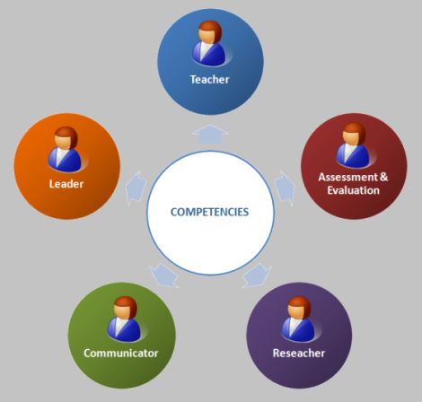
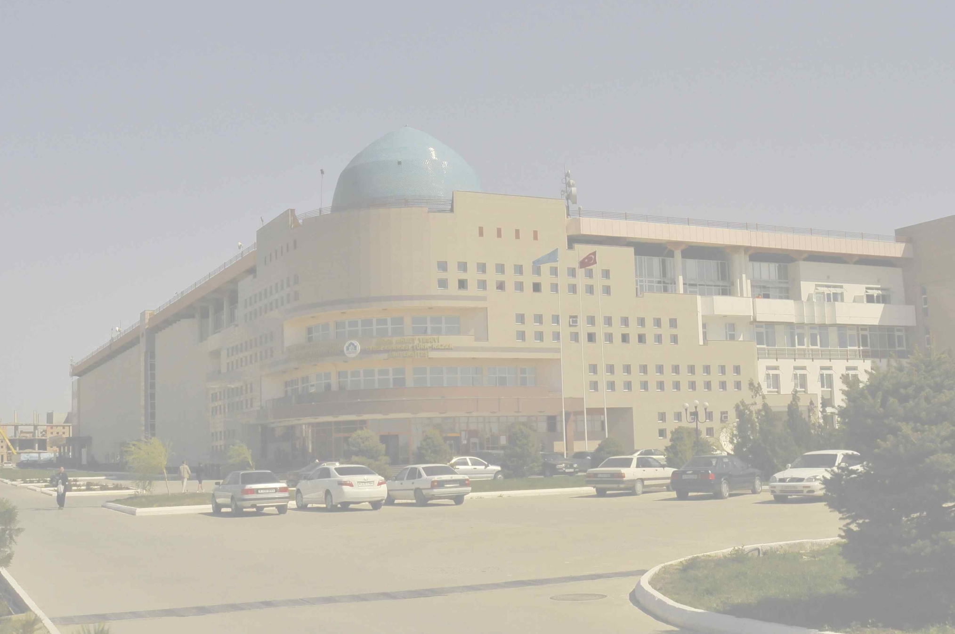
Мозаичная децентрализованная модель развития компетенций ППС через программу подготовки магистров медицинских наук
Ж.С.Шалхарова
Международный Казахско-Турецкий университет имени Х.А.Ясави

Slide 2
October 24-28, 2011
Seminar in Astana
The unified vision of teachers’ competencies
in Medical Education
in Kazakhstan

Slide 3
COMPETENCIES
Teacher
Researcher
Communicator
Leader
Assessment & Evaluation

Slide 4
COMPETENCIES
Teacher
Reseacher
Communicator
Leader
Assessment & Evaluation

Slide 5
COMPETENCIES
Teacher
Reseacher
Communicator
Leader
Assessment & Evaluation
1st term

Slide 6
COMPETENCIES
Teacher
Reseacher
Communicator
Leader
Assessment & Evaluation
2nd term
1st term

Slide 7
COMPETENCIES
Teacher
Reseacher
Communicator
Leader
Assessment & Evaluation
3rd term
2nd term
1st term

Slide 8
Mandatory courses

Slide 9
3
COMPETENCIES
Teacher
Reseacher
Communicator
Leader
Assessment & Evaluation
3- Pedagogy

Slide 10
3
COMPETENCIES
Teacher
Reseacher
Communicator
Leader
Assessment & Evaluation
2
3- Pedagogy
2- Science history & philosophy

Slide 11
3
COMPETENCIES
Teacher
Reseacher
Communicator
Leader
Assessment & Evaluation
4
3- Pedagogy
2- Epidemiology and research
2- Science history & philosophy

Slide 12
3
COMPETENCIES
Teacher
Reseacher
Communicator
Leader
Assessment & Evaluation
5
3- Pedagogy
1- Bioethics
2- Epidemiology and research
2- Science history & philosophy

Slide 13
3
COMPETENCIES
Teacher
Reseacher
Communicator
Leader
Assessment & Evaluation
7
3- Pedagogy
2- Biostatistics
1- Bioethics
2- Epidemiology and research
2- Science history & philosophy

Slide 14
3
COMPETENCIES
Teacher
Reseacher
Communicator
Leader
Assessment & Evaluation
2
7
3- Pedagogy
2- Biostatistics
1- Bioethics
2- Epidemiology and research
Professional foreign language - 2
2- Science history & philosophy

Slide 15
3
COMPETENCIES
Teacher
Reseacher
Communicator
Leader
Assessment & Evaluation
1
2
7
3- Pedagogy
Organizational
behavior - 1
2- Biostatistics
1- Bioethics
2- Epidemiology and research
Professional foreign language - 2
2- Science history & philosophy

Slide 16
4
COMPETENCIES
Teacher
Reseacher
Communicator
Leader
Assessment & Evaluation
1
3
7
1- Psychology
3- Pedagogy
Organizational
behavior - 1
2- Biostatistics
1- Bioethics
Psychology -1
2- Epidemiology and research
Professional foreign language - 2
2- Science history & philosophy

Slide 17
4
COMPETENCIES
Teacher
Reseacher
Communicator
Leader
Assessment & Evaluation
1
3
9
1- Psychology
3- Pedagogy
Organizational
behavior - 1
2- Evidence-based medicine
2- Biostatistics
1- Bioethics
Psychology -1
2- Epidemiology and research
Professional foreign language - 2
2- Science history & philosophy

Slide 18
4
COMPETENCIES
Teacher
Reseacher
Communicator
Leader
Assessment & Evaluation
3
3
9
Health care management - 2
1- Psychology
3- Pedagogy
Organizational
behavior - 1
2- Evidence-based medicine
2- Biostatistics
1- Bioethics
Psychology -1
2- Epidemiology and research
Professional foreign language - 2
2- Science history & philosophy

Slide 19
4
COMPETENCIES
Teacher
Reseacher
Communicator
Leader
Assessment & Evaluation
5
3
9
Law in Health Care - 2
Health care management - 2
1- Psychology
3- Pedagogy
Organizational
behavior - 1
2- Evidence-based medicine
2- Biostatistics
1- Bioethics
Psychology -1
2- Epidemiology and research
Professional foreign language - 2
2- Science history & philosophy

Slide 20
5
COMPETENCIES
Teacher
Reseacher
Communicator
Leader
Assessment & Evaluation
5
0.5
1 - Fundamentals of teaching
and research
in medicine
3
9.5
Law in Health Care - 2
0.5 - Fundamentals of teaching and research in medicine
Health care management - 2
1- Psychology
3- Pedagogy
Organizational
behavior - 1
0.5 - Fundamentals of teaching and research in medicine
2- Evidence-based medicine
2- Biostatistics
1- Bioethics
Psychology -1
2- Epidemiology and research
Professional foreign language - 2
2- Science history & philosophy

Slide 21
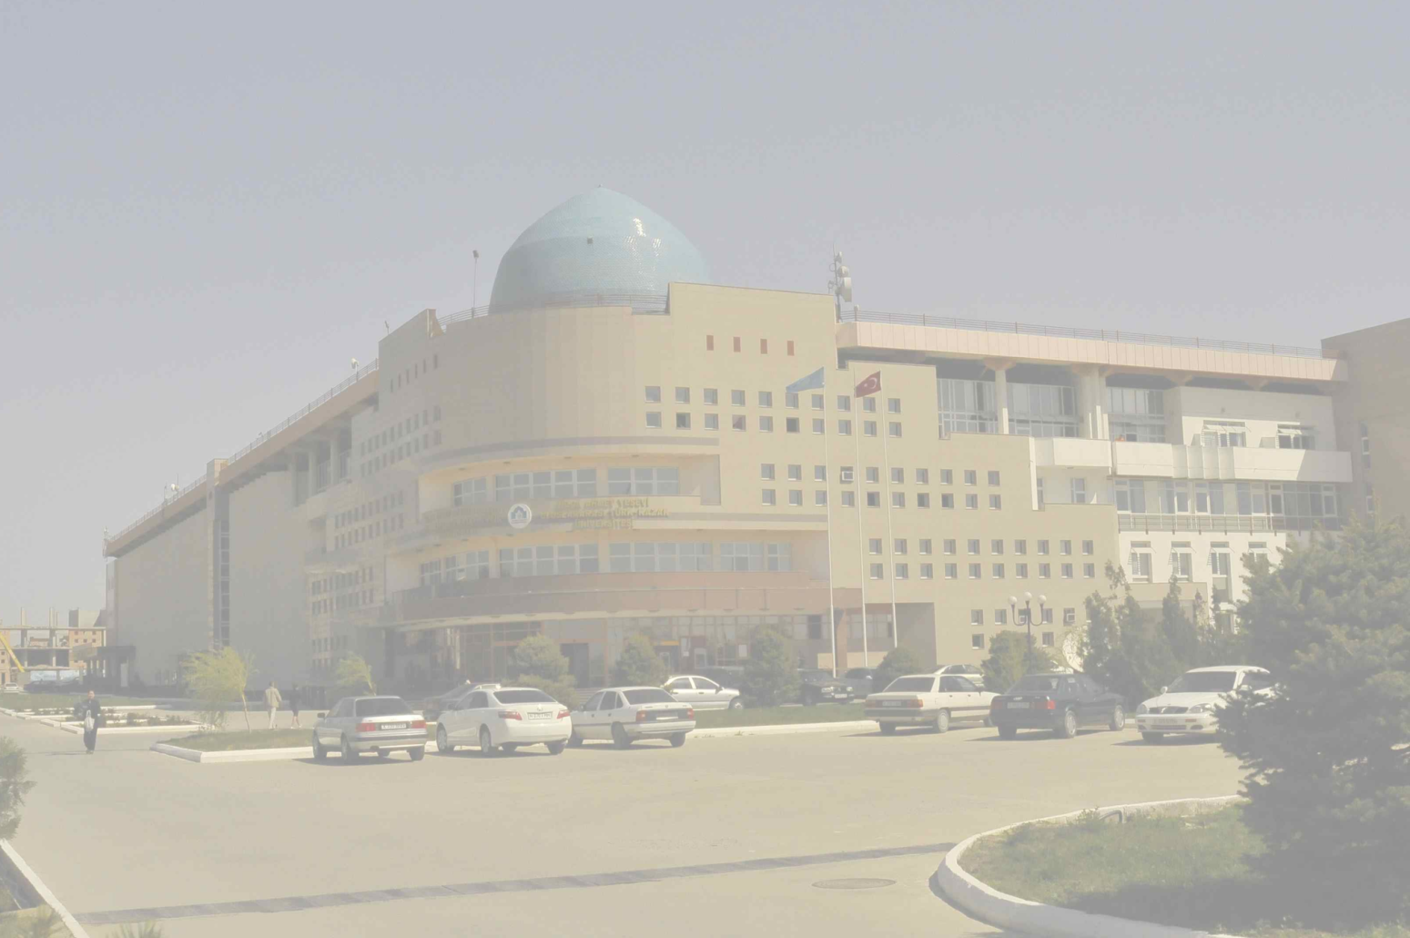
Electives

Slide 22
9
COMPETENCIES
Teacher
Reseacher
Communicator
Leader
Assessment & Evaluation
8
4.5
4 electives
1 elective
1 - Fundamentals of teaching
and research
in medicine
4 electives
8
14.5
Law in Health Care - 2
0.5 - Fundamentals of teaching and research in medicine
Health care management - 2
1- Psychology
3- Pedagogy
2 electives
5 electives:
Organizational
behavior - 1
0.5 - Fundamentals of teaching and research in medicine
2- Evidence-based medicine
5 electives
2- Biostatistics
1- Bioethics
Psychology -1
2- Epidemiology and research
Professional foreign language - 2
2- Science history & philosophy

Slide 23
9
COMPETENCIES
Teacher
Reseacher
Communicator
Leader
Assessment & Evaluation
4 from 8 electives:
1 – Facilitating in small groups
1 – Teaching large groups
1 – Problem-based learning
1 – Clinical teaching
1 – Interactive teaching
1 – IT technologies for teaching
1 – Curriculum development
1 – Students’ needs and learning styles
5
0.5
1 - Fundamentals of teaching
and research
in medicine
3
9.5
Law in Health Care - 2
0.5 - Fundamentals of teaching and research in medicine
Health care management - 2
1- Psychology
3- Pedagogy
Organizational
behavior - 1
0.5 - Fundamentals of teaching and research in medicine
2- Evidence-based medicine
2- Biostatistics
1- Bioethics
Psychology -1
2- Epidemiology and research
Professional foreign language - 2
2- Science history & philosophy

Slide 24
9
COMPETENCIES
Teacher
Reseacher
Communicator
Leader
Assessment & Evaluation
5
4.5
4 electives
4 from 8 electives:
1 - Feedback
1 – Assessment methods
1 – Tests development
1 – Teaching cases development
1 – OSCE development
1 - Assessment of communicative skills
1 - Standardized patient
1 - Teacher & Curriculum evaluation
1 - Fundamentals of teaching
and research
in medicine
3
9.5
Law in Health Care - 2
0.5 - Fundamentals of teaching and research in medicine
Health care management - 2
1- Psychology
3- Pedagogy
Organizational
behavior - 1
0.5 - Fundamentals of teaching and research in medicine
2- Evidence-based medicine
2- Biostatistics
1- Bioethics
Psychology -1
2- Epidemiology and research
Professional foreign language - 2
2- Science history & philosophy

Slide 25
9
COMPETENCIES
Teacher
Reseacher
Communicator
Leader
Assessment & Evaluation
5
4.5
4 electives
1 - Fundamentals of teaching
and research
in medicine
4 electives
3
14.5
Law in Health Care - 2
0.5 - Fundamentals of teaching and research in medicine
Health care management - 2
1- Psychology
5 from 9 electives:
2 - Research protocol development
1 - Critical thinking
1 – Medical writing
1 – Oral presentations for congresses and conferences
1 – Intellectual property registration
1 - International research standards
1 - Financing in research
1 - Research in Medical Education
3- Pedagogy
Organizational
behavior - 1
0.5 - Fundamentals of teaching and research in medicine
2- Evidence-based medicine
2- Biostatistics
1- Bioethics
Psychology -1
2- Epidemiology and research
Professional foreign language - 2
2- Science history & philosophy

Slide 26
9
COMPETENCIES
Teacher
Reseacher
Communicator
Leader
Assessment & Evaluation
5
4.5
4 electives
1 - Fundamentals of teaching
and research
in medicine
4 electives
8
14.5
5 from 8 electives:
2 – Turkish
1 – Medical Turkish
1 – Active listening
1 – Verbal and Non-verbal information patterns
1 – IT communications for Internet and Intranet
1 - Professional collaboration
1 – Communicative skills teaching
Law in Health Care - 2
0.5 - Fundamentals of teaching and research in medicine
Health care management - 2
1- Psychology
3- Pedagogy
5 electives:
Organizational
behavior - 1
0.5 - Fundamentals of teaching and research in medicine
2- Evidence-based medicine
2- Biostatistics
1- Bioethics
Psychology -1
2- Epidemiology and research
Professional foreign language - 2
2- Science history & philosophy

Slide 27
9
COMPETENCIES
Teacher
Reseacher
Communicator
Leader
Assessment & Evaluation
7
4.5
4 electives
1 - Fundamentals of teaching
and research
in medicine
4 electives
8
14.5
Law in Health Care - 2
0.5 - Fundamentals of teaching and research in medicine
Health care management - 2
1- Psychology
3- Pedagogy
2 from 6 electives:
1 – Strategic planning
1 – Time-management
1 – Project-management
1 – Team-building
1 – Change-management
1 – Conflict-management
5 electives:
Organizational
behavior - 1
0.5 - Fundamentals of teaching and research in medicine
2- Evidence-based medicine
5 electives
2- Biostatistics
1- Bioethics
Psychology -1
2- Epidemiology and research
Professional foreign language - 2
2- Science history & philosophy

Slide 28
9
COMPETENCIES
Teacher
Reseacher
Communicator
Leader
Assessment & Evaluation
8
4.5
1 from 6 electives:
Problems and perspectives in:
1 – Fundamental medicine
1 – Internal diseases
1 – Surgery
1 – Obstetrics and gynecology
1 – Pediatrics
1 – General Practice
4 electives
1 - Fundamentals of teaching
and research
in medicine
4 electives
8
14.5
Law in Health Care - 2
0.5 - Fundamentals of teaching and research in medicine
Health care management - 2
1- Psychology
3- Pedagogy
2 electives:
5 electives:
Organizational
behavior - 1
0.5 - Fundamentals of teaching and research in medicine
2- Evidence-based medicine
5 electives
2- Biostatistics
1- Bioethics
Psychology -1
2- Epidemiology and research
Professional foreign language - 2
2- Science history & philosophy

Slide 29
COMPETENCIES
Teacher
Researcher
Communicator
Leader
Assessment & Evaluation
9
8
4.5
8
14.5

Slide 30
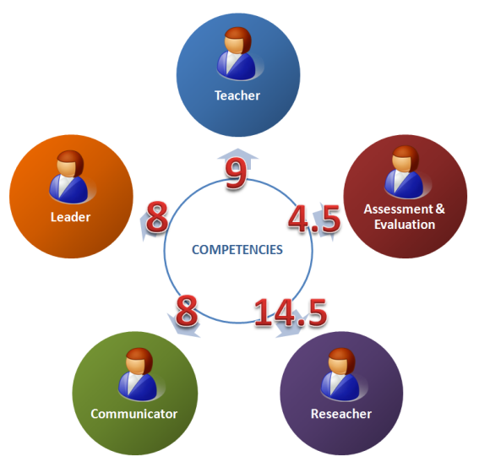
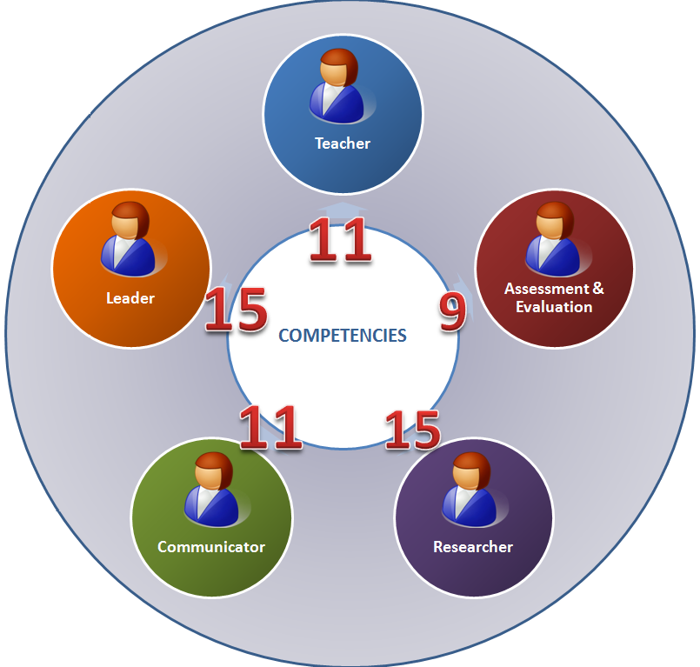

Slide 31
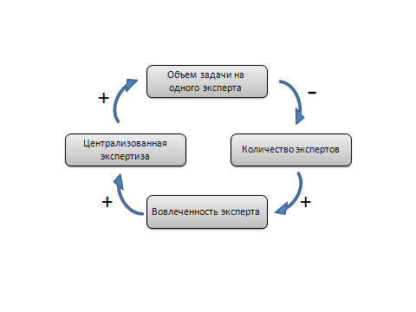

Slide 32
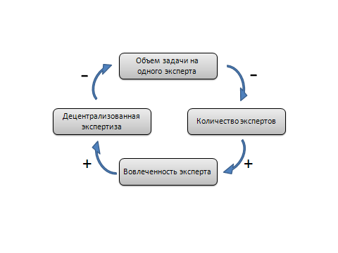

Slide 34
3

Slide 35
11

Slide 36
11
1

Slide 37
11
9

Slide 38
11
9
6

Slide 39
11
9
15

Slide 40
11
9
15
2

Slide 41
11
9
15
11

Slide 42
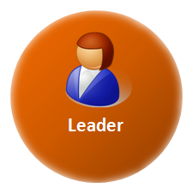
11
9
15
11
3

Slide 43
11
9
15
11
15

Slide 44
Спасибо за внимание!
zhanar.shalkharova@gmail.com

