Slide 1
Asfendiyarov Kazakh National medical university

Slide 2
Content
History of Asfendiyarov KazNMU
Schools and Clinics
Faculty and students
Research and infrastructure
Formation of an Integrated Academic Health System
Research activities
KazNMU’s tasks for the academic year 2018-2019
Plans for research activities for the academic year 2018-2019

Slide 3
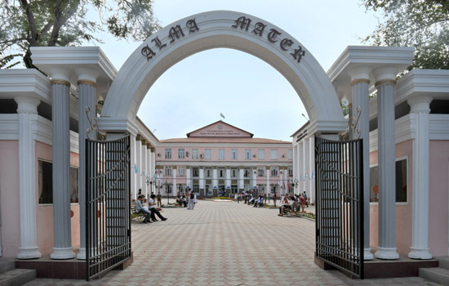
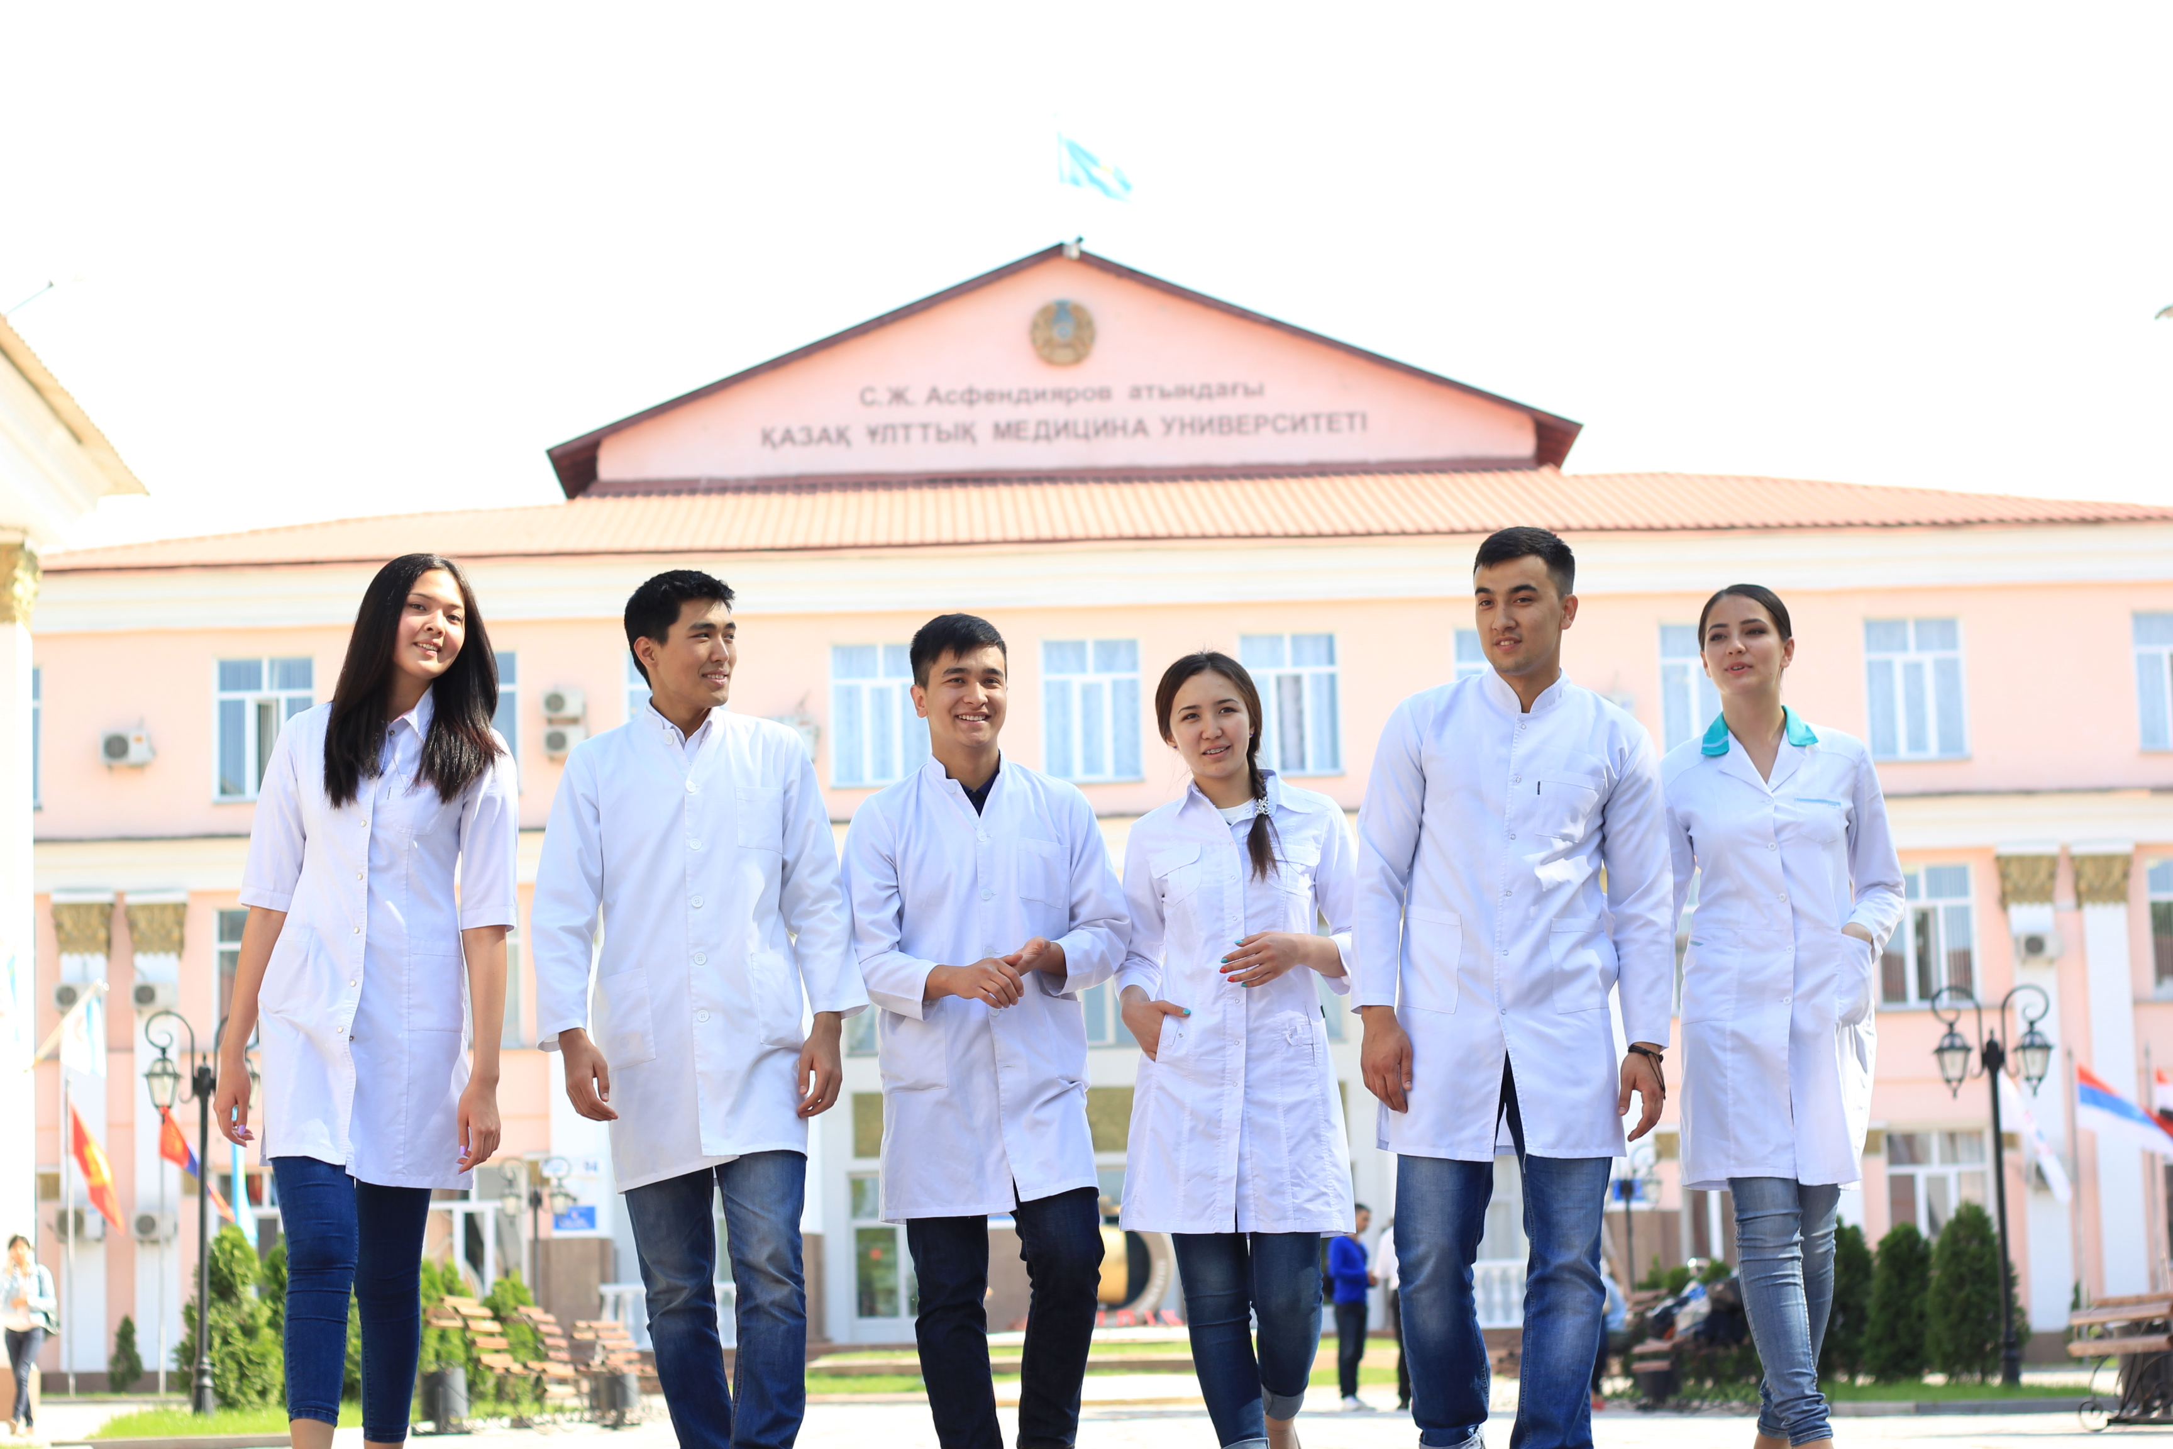
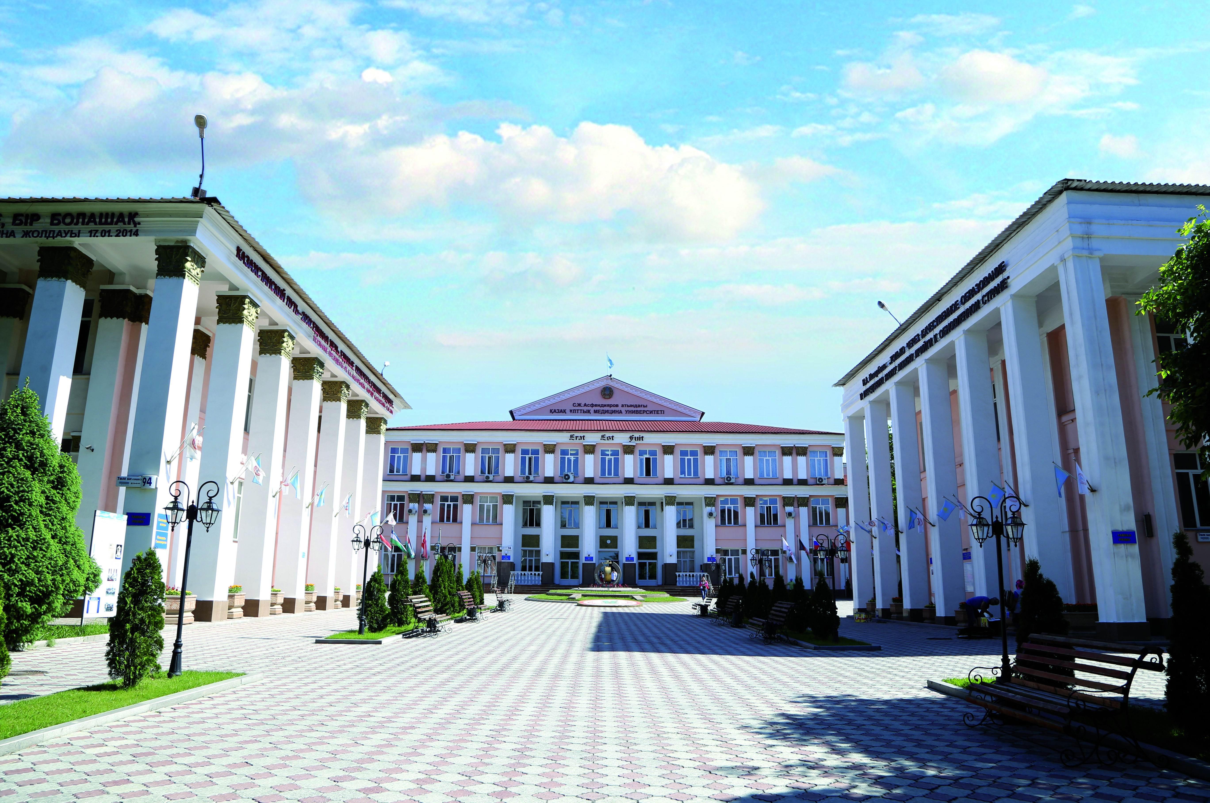
History
Established as a medical institute in 1930
The first graduates in 1936
Awarded with the status “National” in 2001

Slide 4
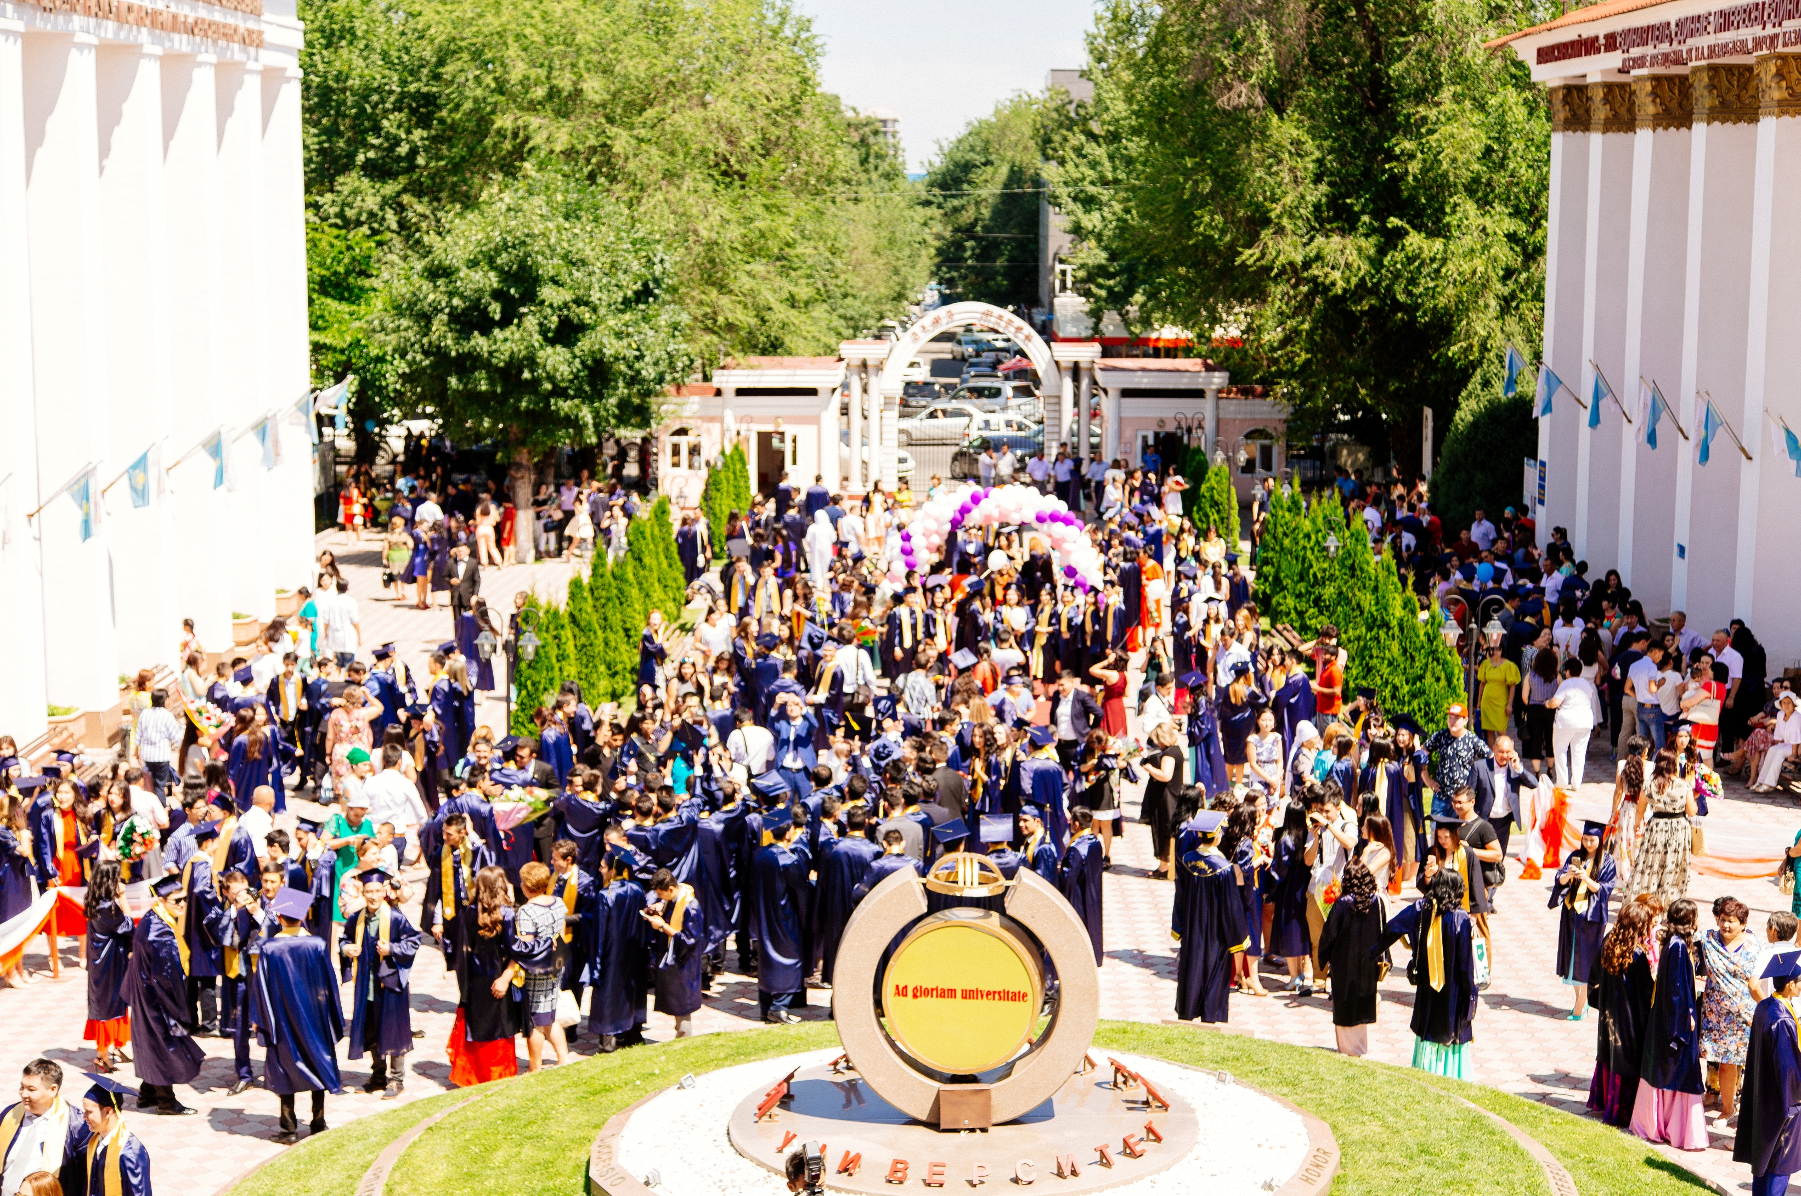
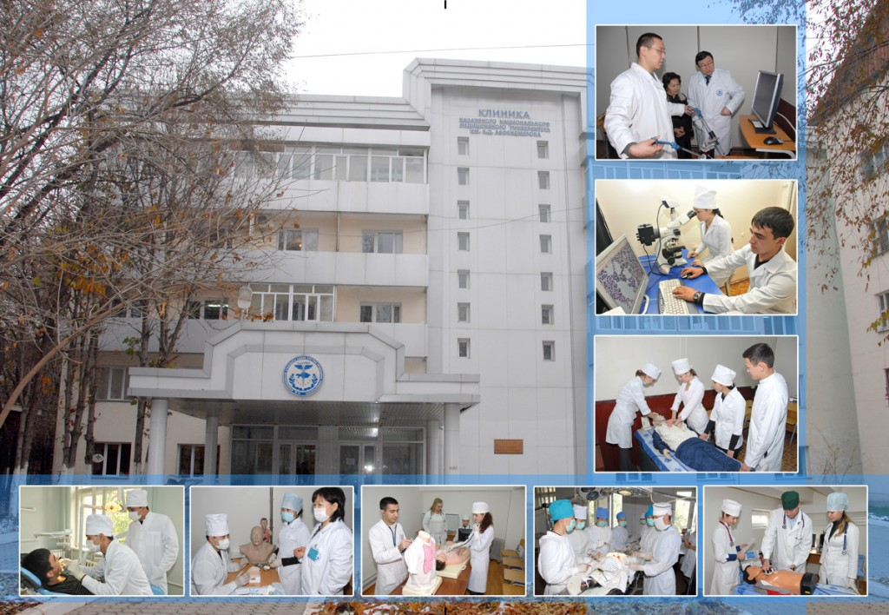
Education
Clinics
7 Schools:
General medicine
International medical faculty
Dentistry
Pharmacy and Pharmaceutical Technology
Public health, preventive medicine, nursing and management
Postgraduate education
4 Clinics:
Professorial clinic
Dentistry clinic
Clinic of internal diseases
Children’s clinic “Aksay”
Pediatrics

Slide 5
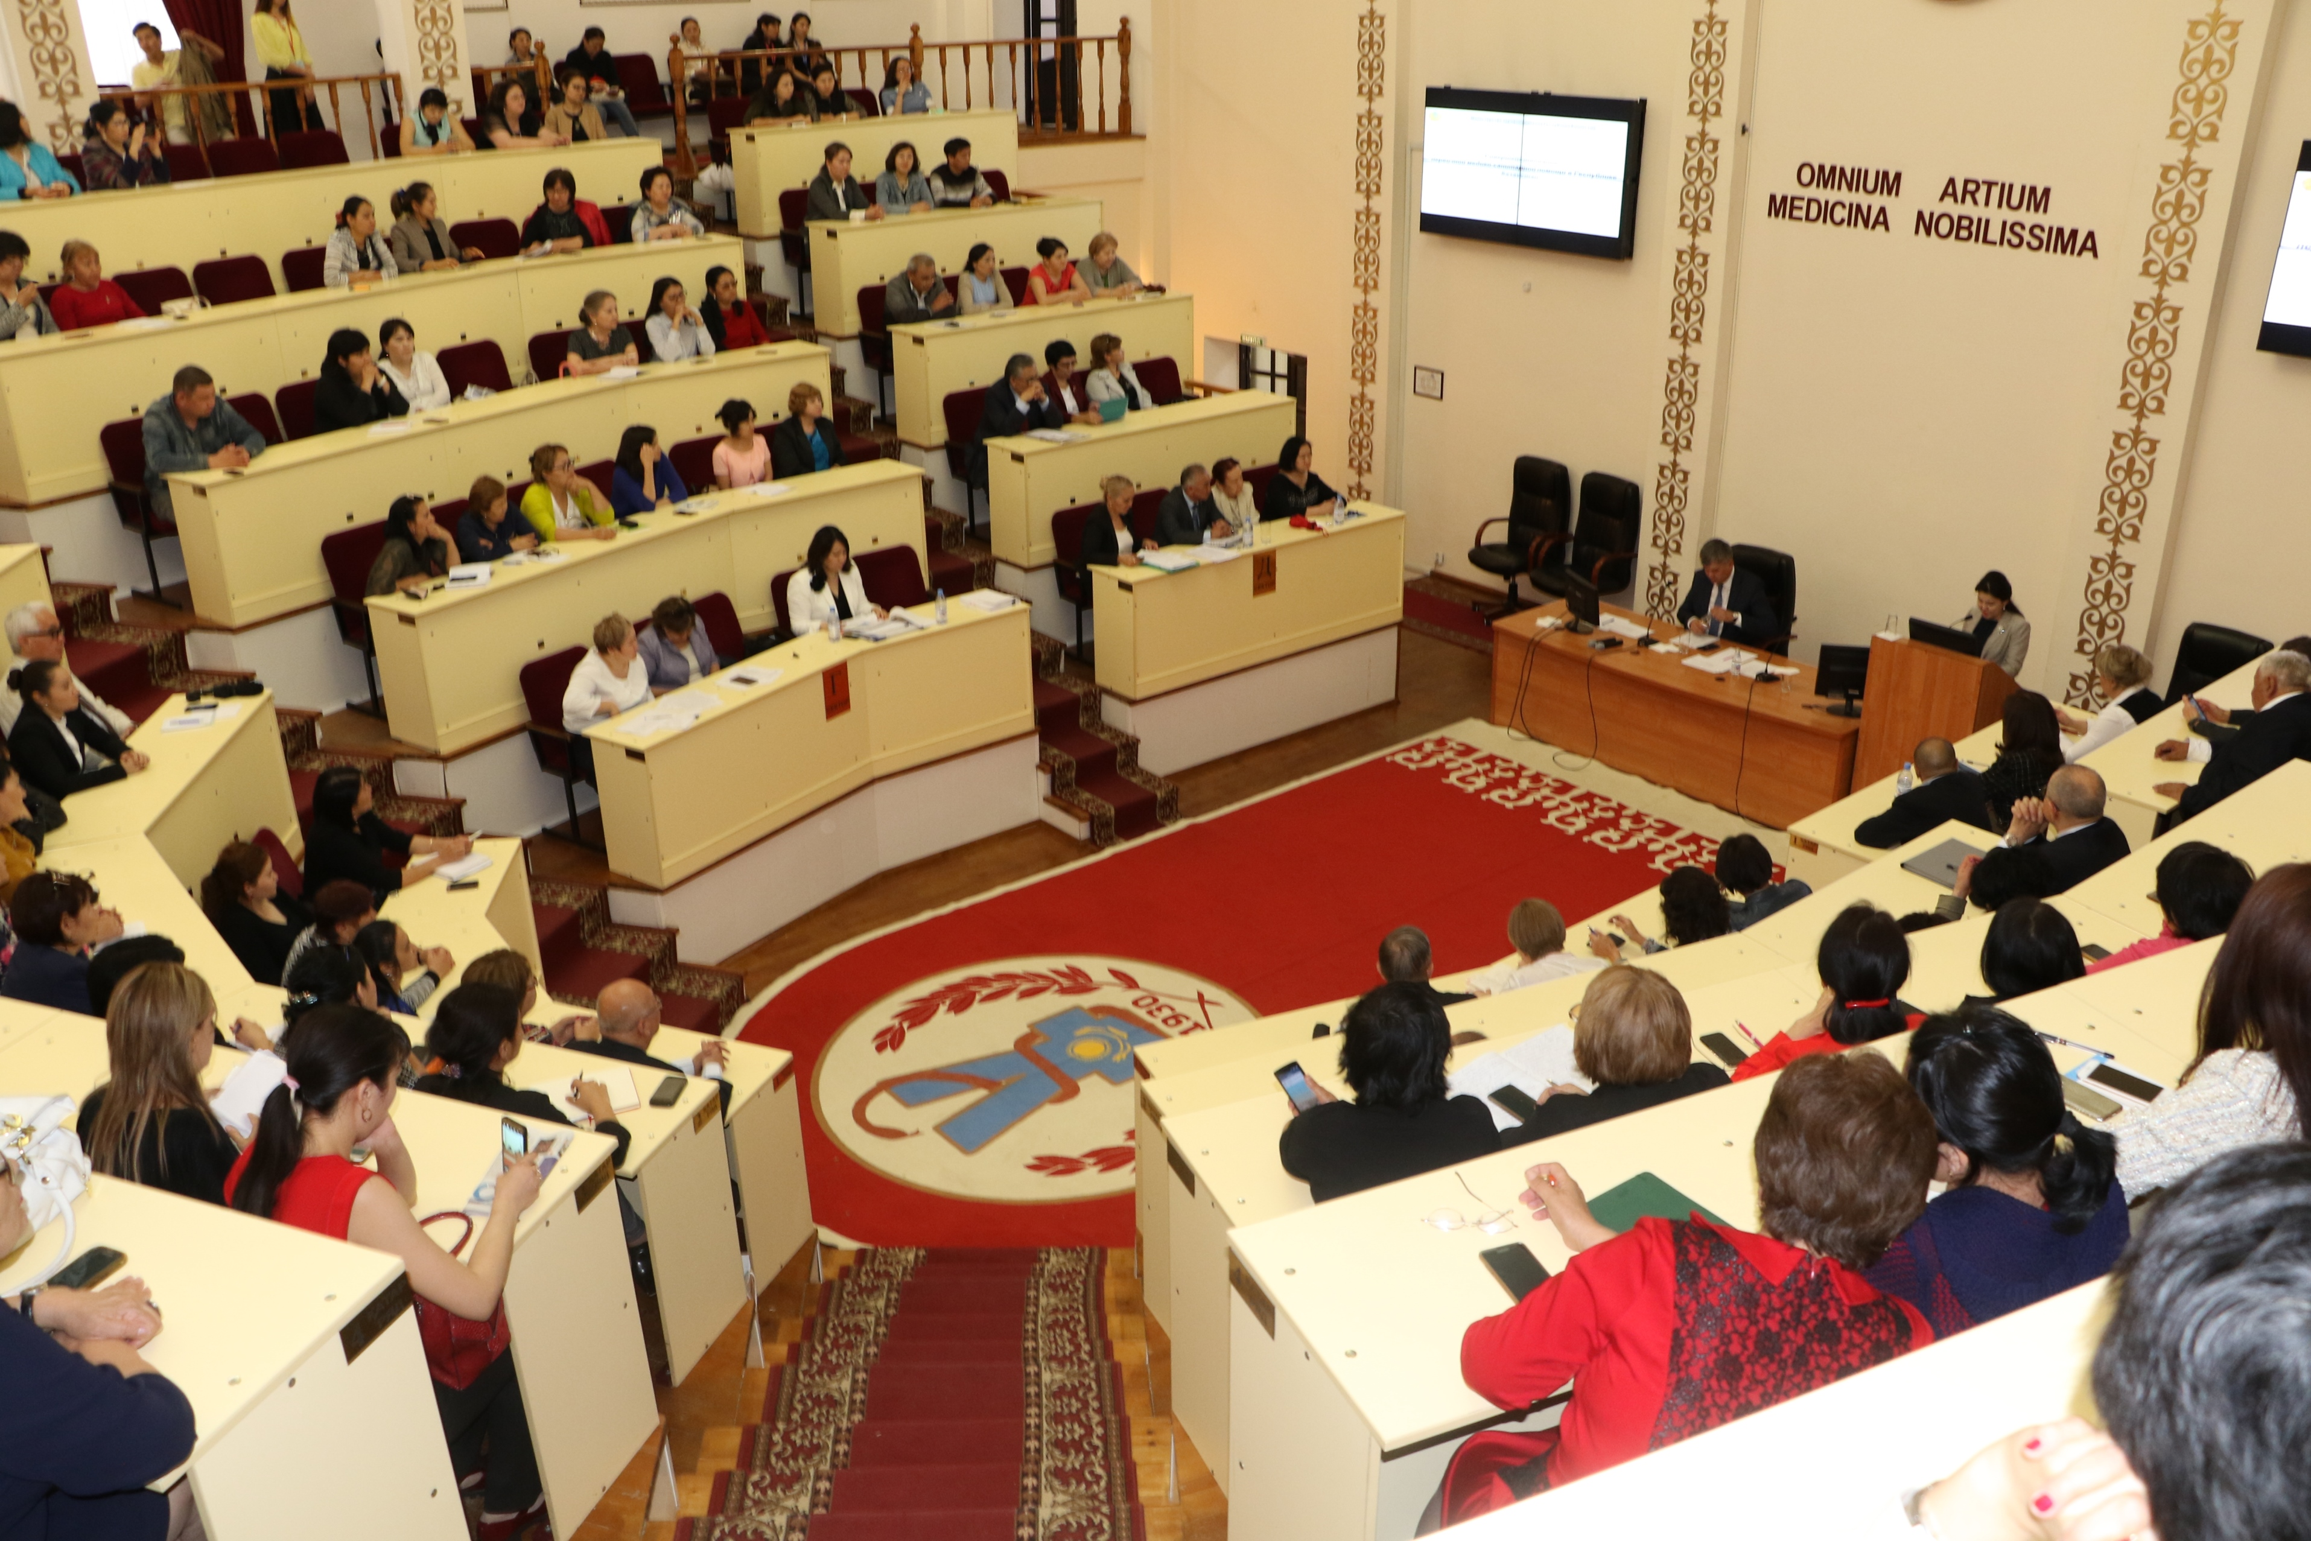
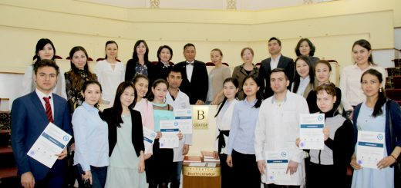
Students
Academic staff
Academic staff – 1283
More than 9000 students including undergraduates, interns, residents, postgraduates and PhD students
Academicians - 9
Professors - 83
More than 1000 international students representing 15 countries
Doctors of sciences – 151
Clinical staff - 736
Over 1000 graduates annually
PhD doctors - 22
Docents – 157
Scientists - 36

Slide 6
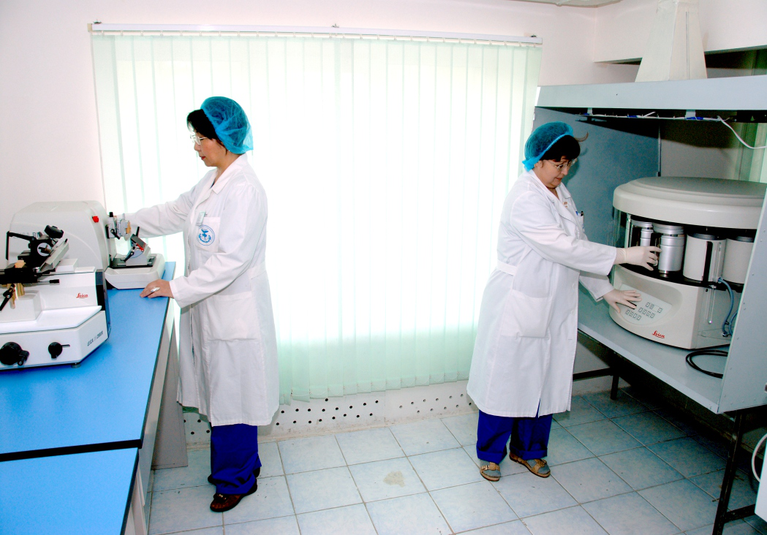
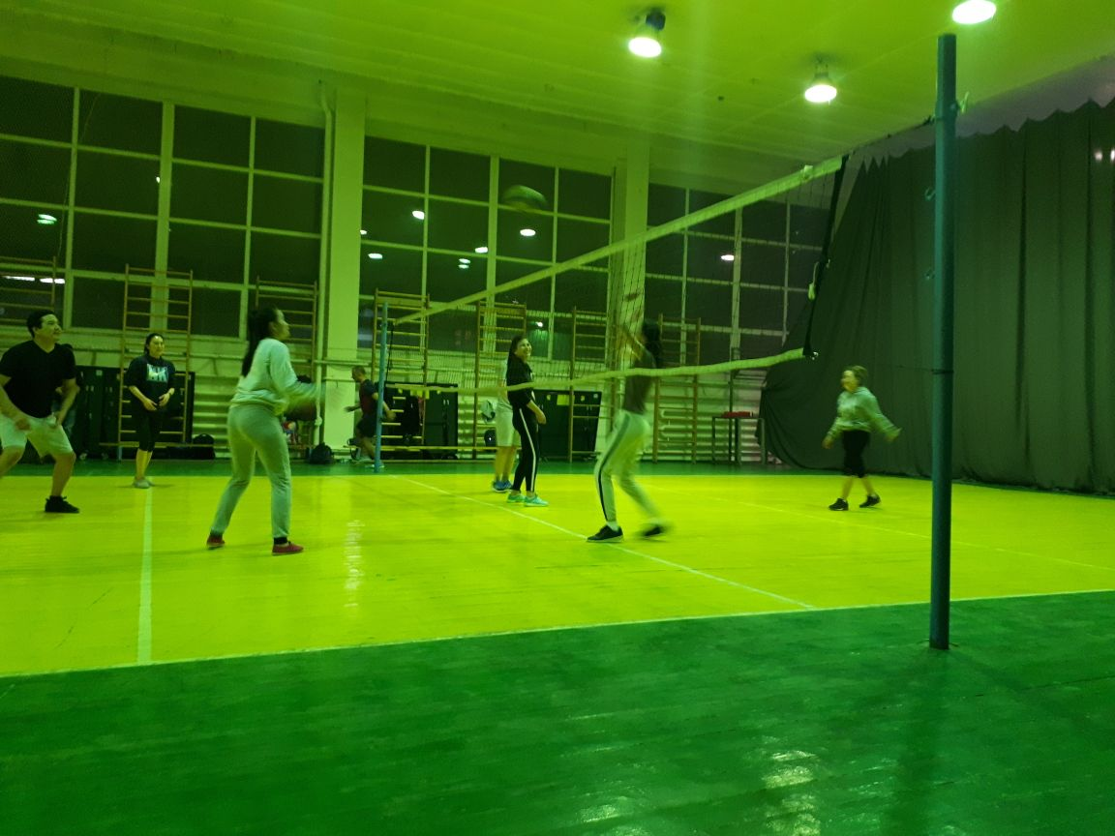
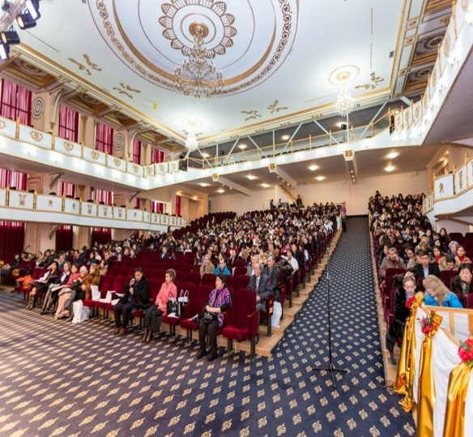
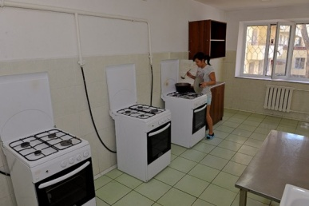
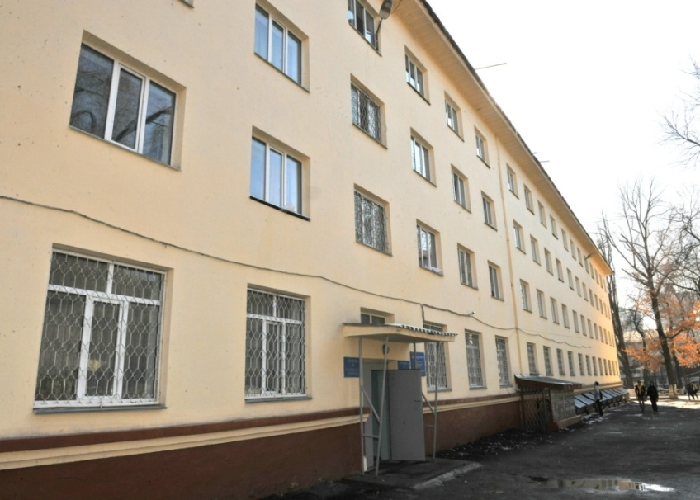
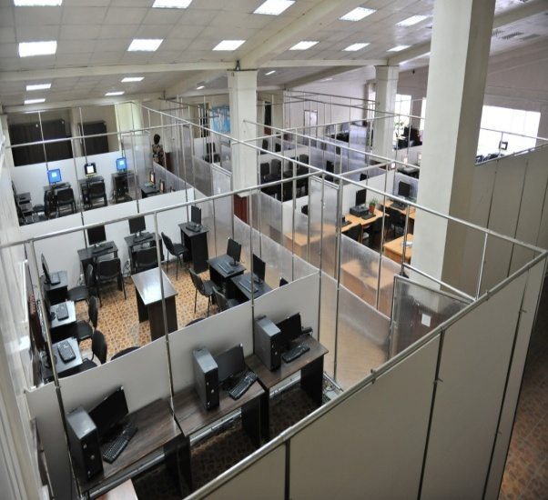
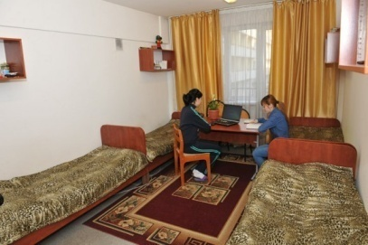
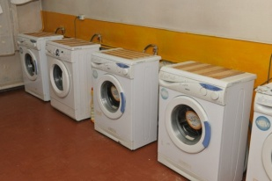
Research
Infrastructure
Facilities
Museum
7 dormitories
7 academic buildings
100 clinical sites
Museum of anatomy
Sports Hall with a total area of 1 361 sq.m.
Test centre
Theatre “Concordia”
Atshabarov Scientific Research Institute of Fundamental and Applied Medicine
Vivariy
Clinical and experimental laboratory
Scientific Clinical and Diagnostic Laboratory
Molecular Genetic Laboratory “Centre for Collective Use”

Slide 7
Formation of an Integrated Academic Health System
MINISTRY OF Translational medical education Health management technologies
HEALTH
Research Institute of Cardiology and Internal Medicine
KazNMU
Strategic partner - Lithuanian University of Health Sciences
Scientific Centre of Pediatrics and Pediatric Surgery
Modernization of medical education
Scientific Centre of Obstetrics, Gynecology and Perinatology
Non-commercial JSC “KazNMU”
Research grants of the Ministry of Education and Science, International grants
Research Institute of Oncology and Radiology
Syzganov National Scientific Centre
University Clinic

Slide 8
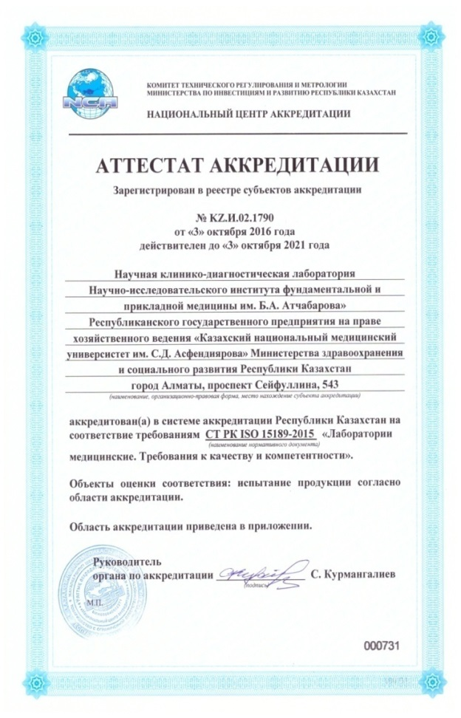
Research activities
Accreditation on research activities
Certificate of accreditation as a subject of scientific and/or scientific and technical activities of August 03, 2017
ISO 15189-2015 “Medical laboratories. Requirements for quality and competence of October 3, 2016
ISO 17025

Slide 9
KazNMU’s tasks for the academic year 2018-2019
Improving the quality of training of health professionals
Development of an Integrated Academic Health System
Capacity building of faculty and university staff
Improving the management of medical education and science

Slide 10
Plans for research activities for the academic year 2018-2019
Obtaining the status of “Research University”
Creation of Technopark at the Atshabarov Research Institute of Fundamental and Applied Medicine
Projects to finance Islamic Development Bank «The IsDB Science, Technology & Innovation Fund (IsDB-STIF):
“Development of novel type of wound dressing for treatment of diabetic and chronic ulcers”
“Development of a new drug-sorbent based on natural minerals”
«Capacity building of state institutions on air monitoring to address development challenges in SDG 3 “Good health and well-being”».
Projects within the program of «Emerging Security Challenges Division. Science for Peace and Security Programme» (НАТО):
“Determination of novel effective radio-protectors against ionizing radiation”
“Mapping areas of plant contamination by radionuclides in Kazakhstan”

Slide 11
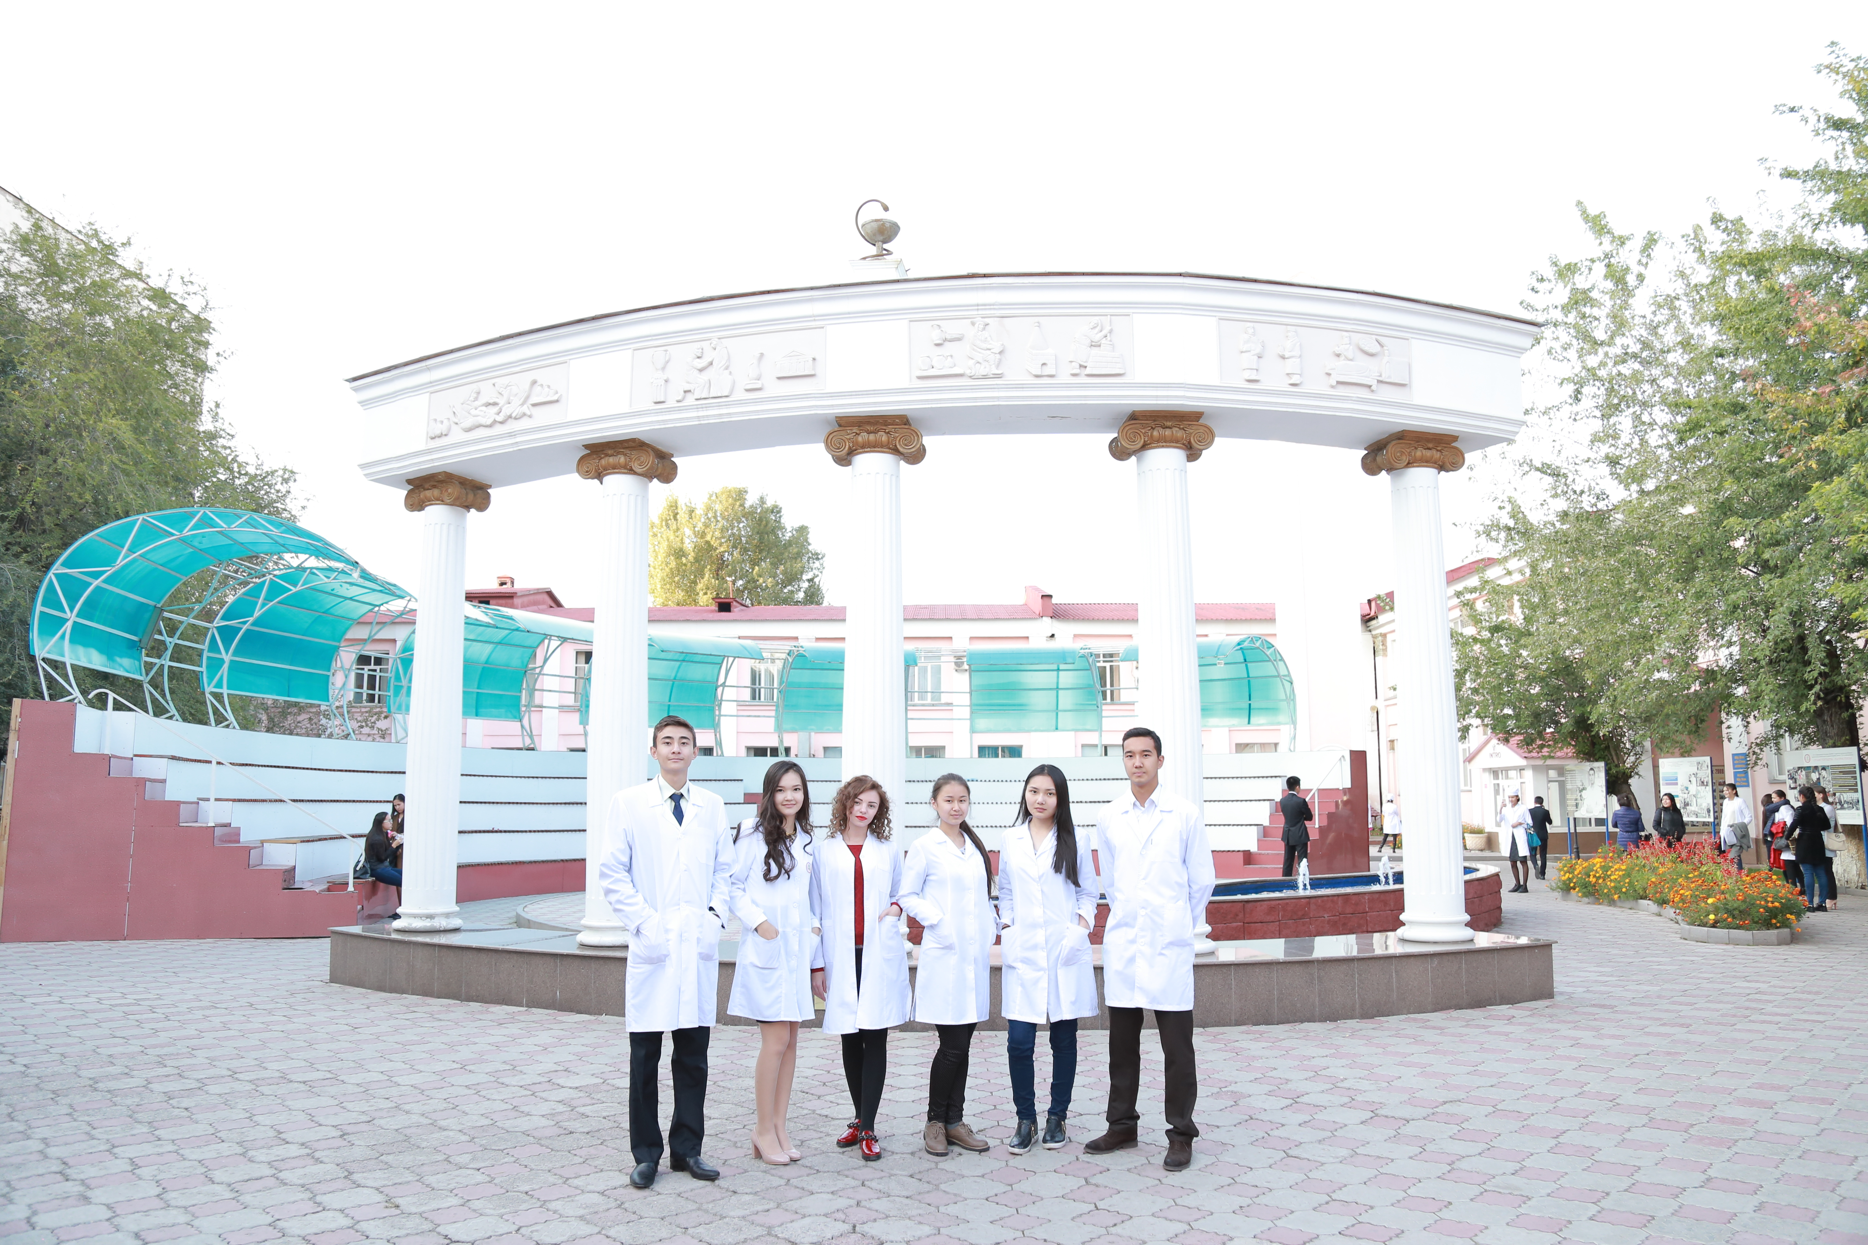
Thank you!

